Slide 1
Conceptual Understanding Series for West Virginia Teachers
Sedimentary Rocks
ED-16 Part 2: Figures 45-91

Slide 2
Figure 45

Slide 3
Figure 46

Slide 4
Figure 47

Slide 5
Figure 48

Slide 6
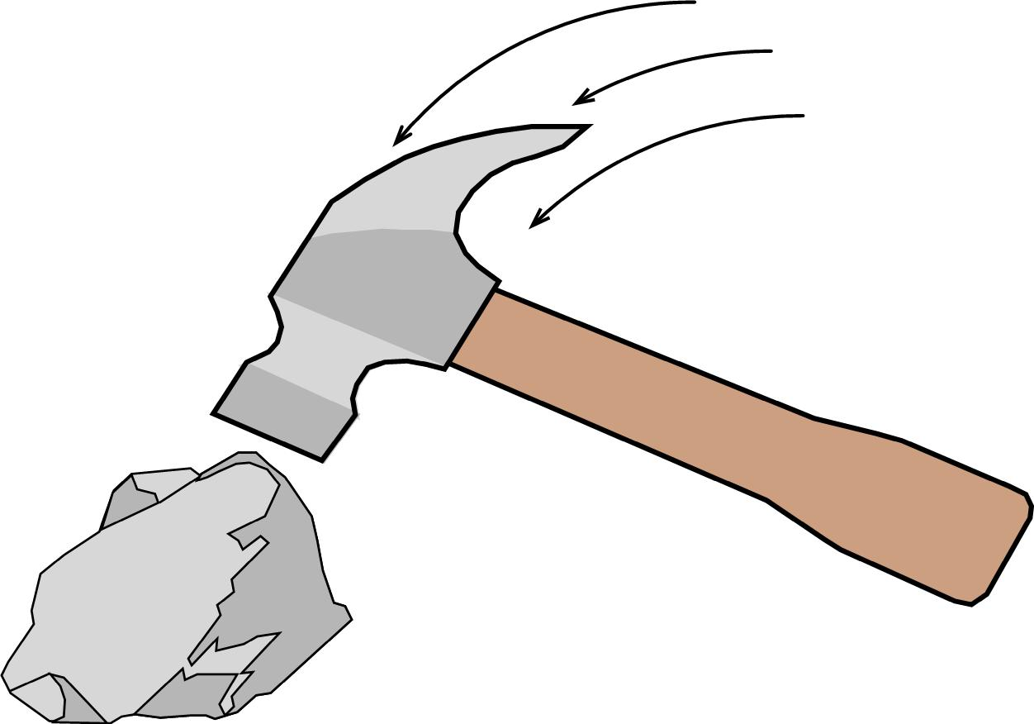
Figure 49a, b

Slide 7
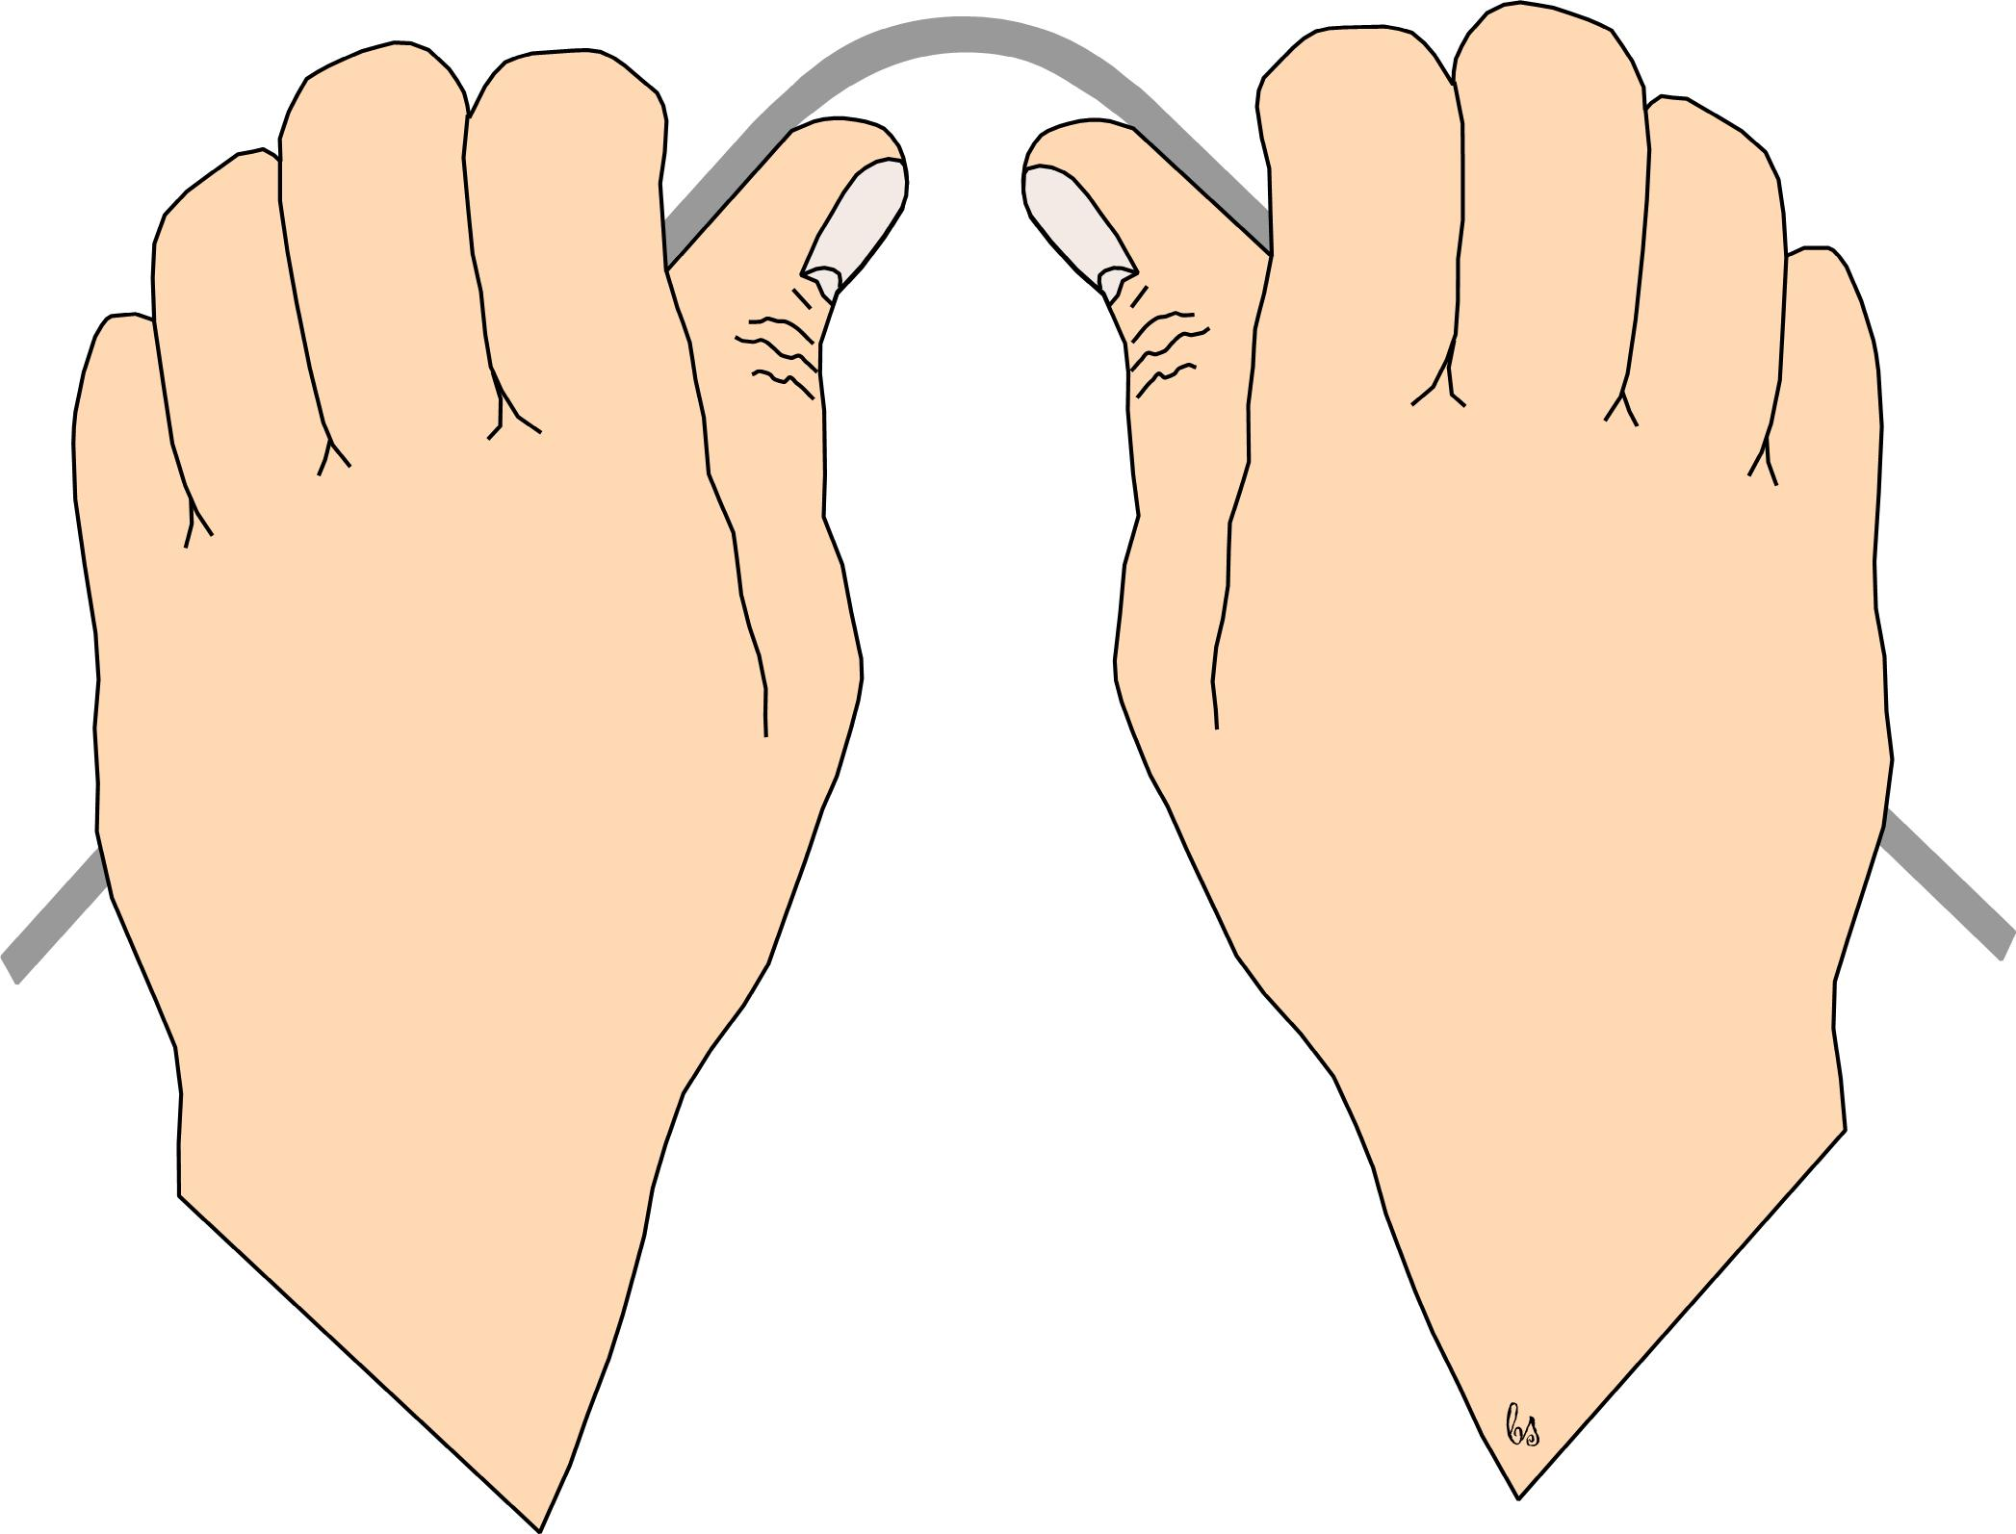
Need text…
Figure 50a, b

Slide 8
Figure 51

Slide 9
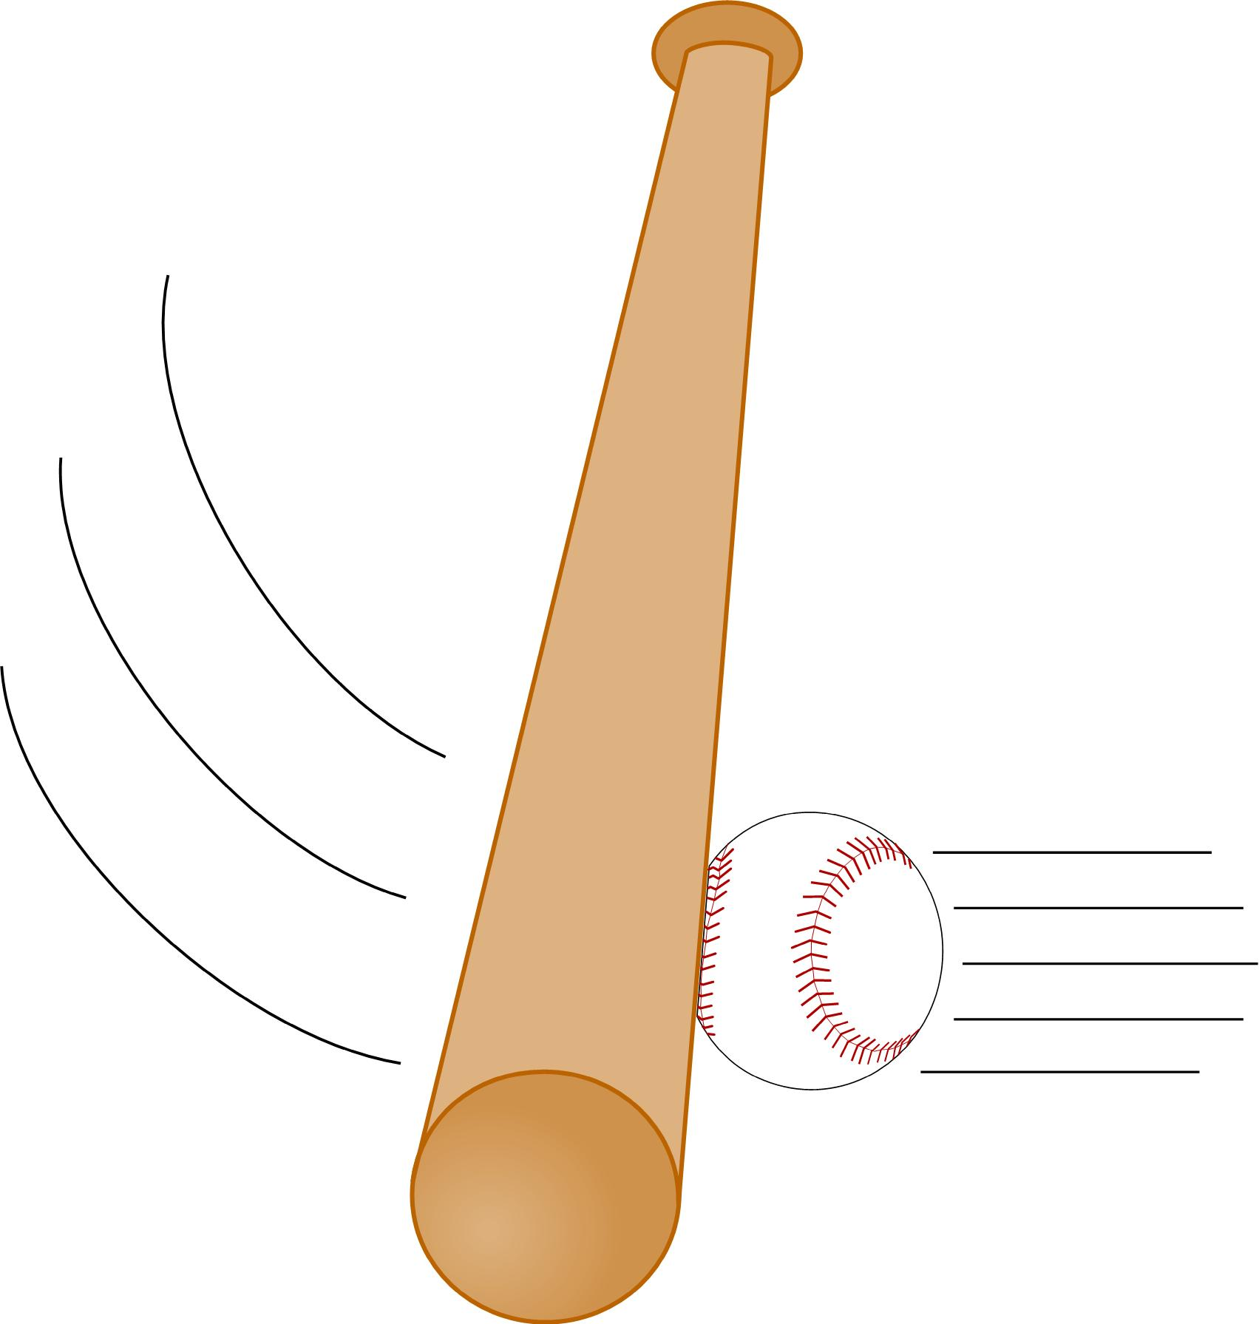
Figure 52a, b

Slide 10
Figure 53

Slide 11
G
F
E
D
C
B
A
Figure 54

Slide 12
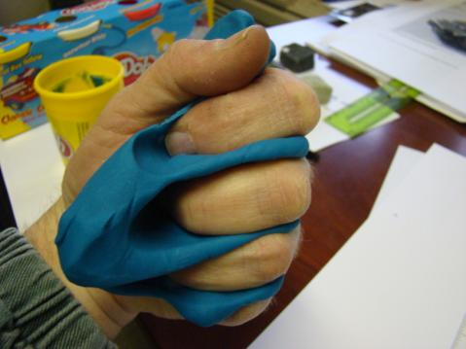
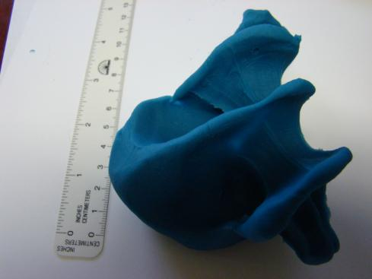
Figure 55a, b, c

Slide 13
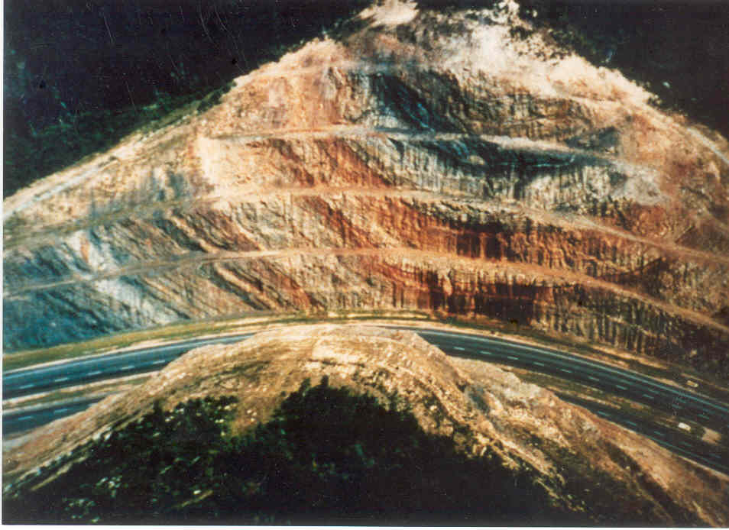
Figure 56 and 57

Slide 14
Figure 58 and 60

Slide 15
Figure 59

Slide 16
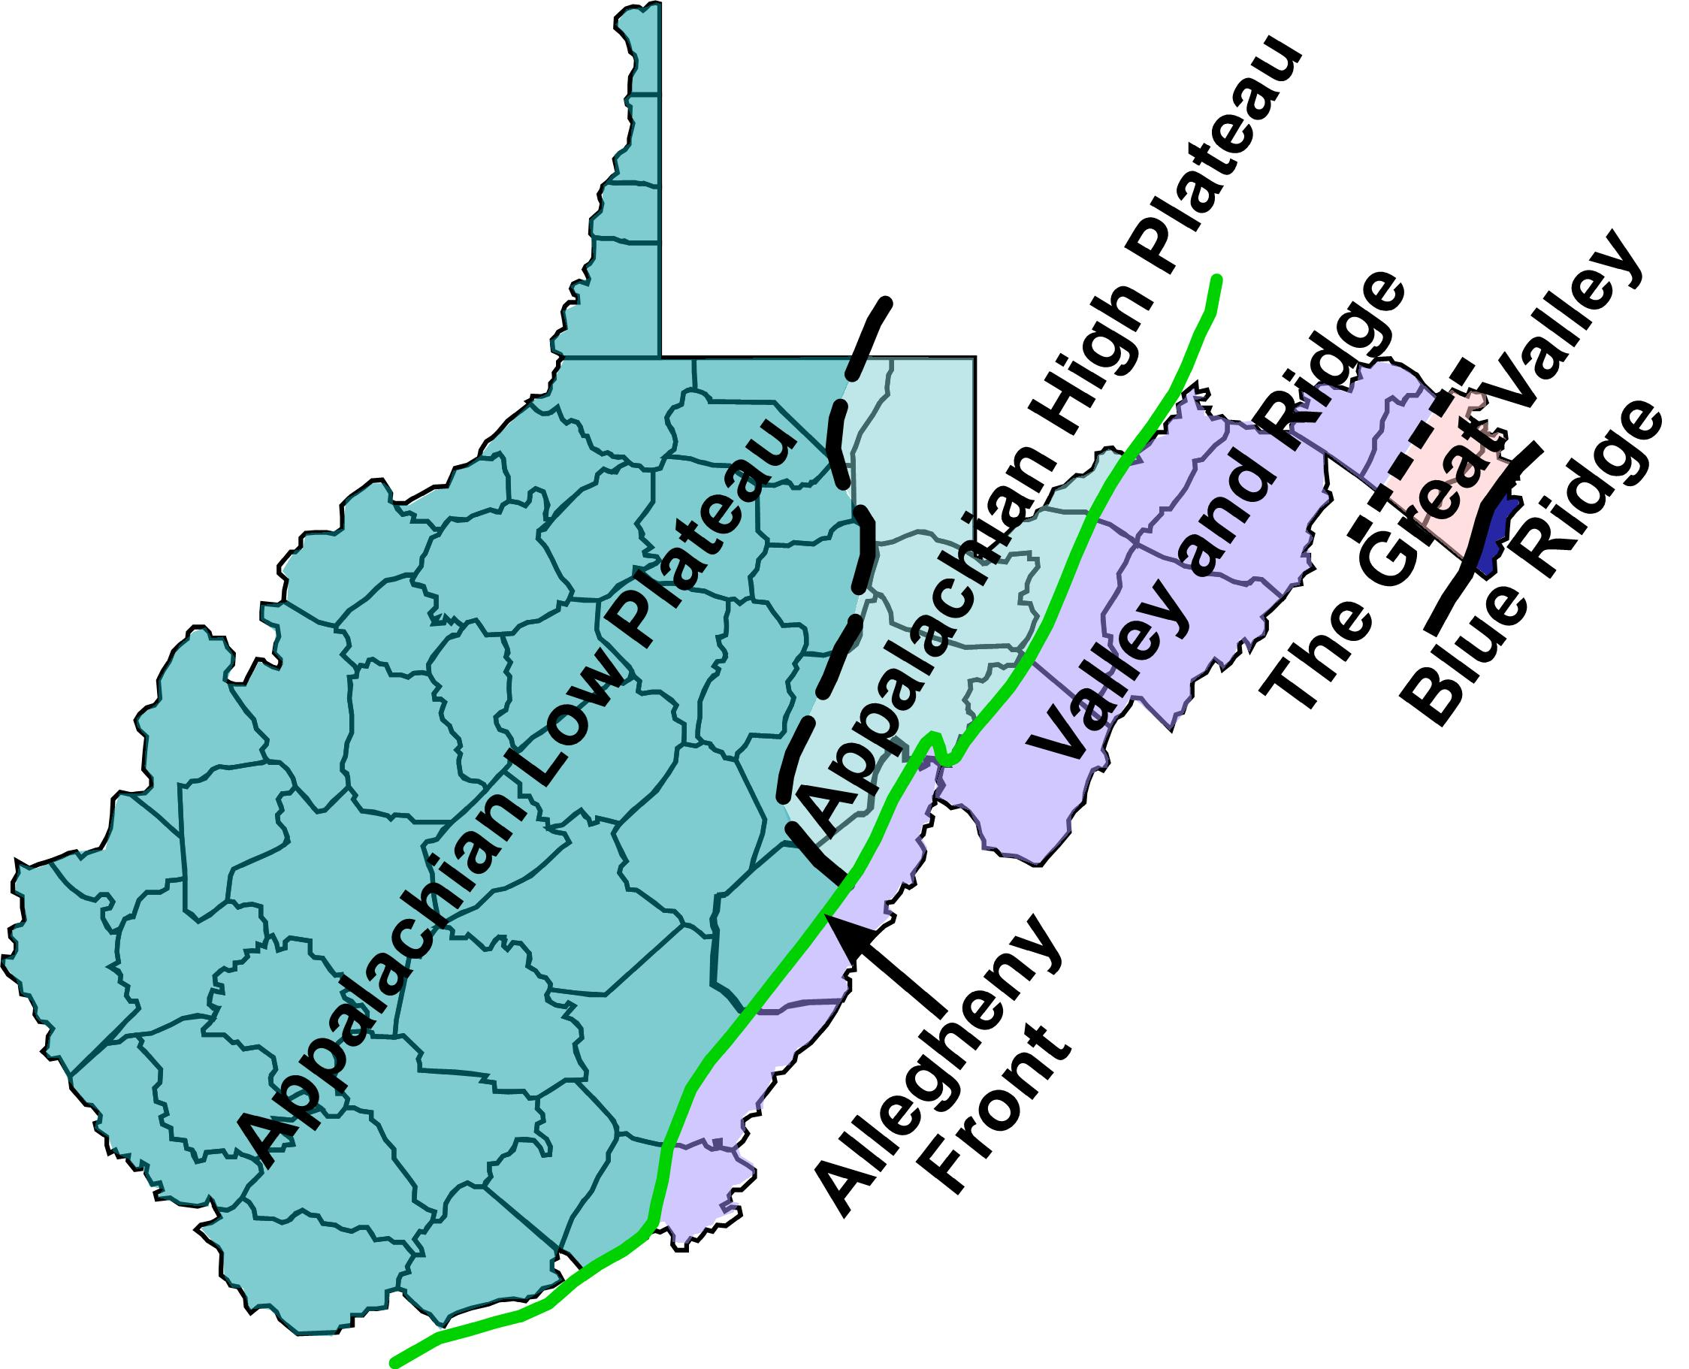
Figure 61 and 62

Slide 17
Figure 63

Slide 18
Figure 64

Slide 19
Figure 65

Slide 20
Figure 66

Slide 21
Figure 67

Slide 22
Figure 68

Slide 23
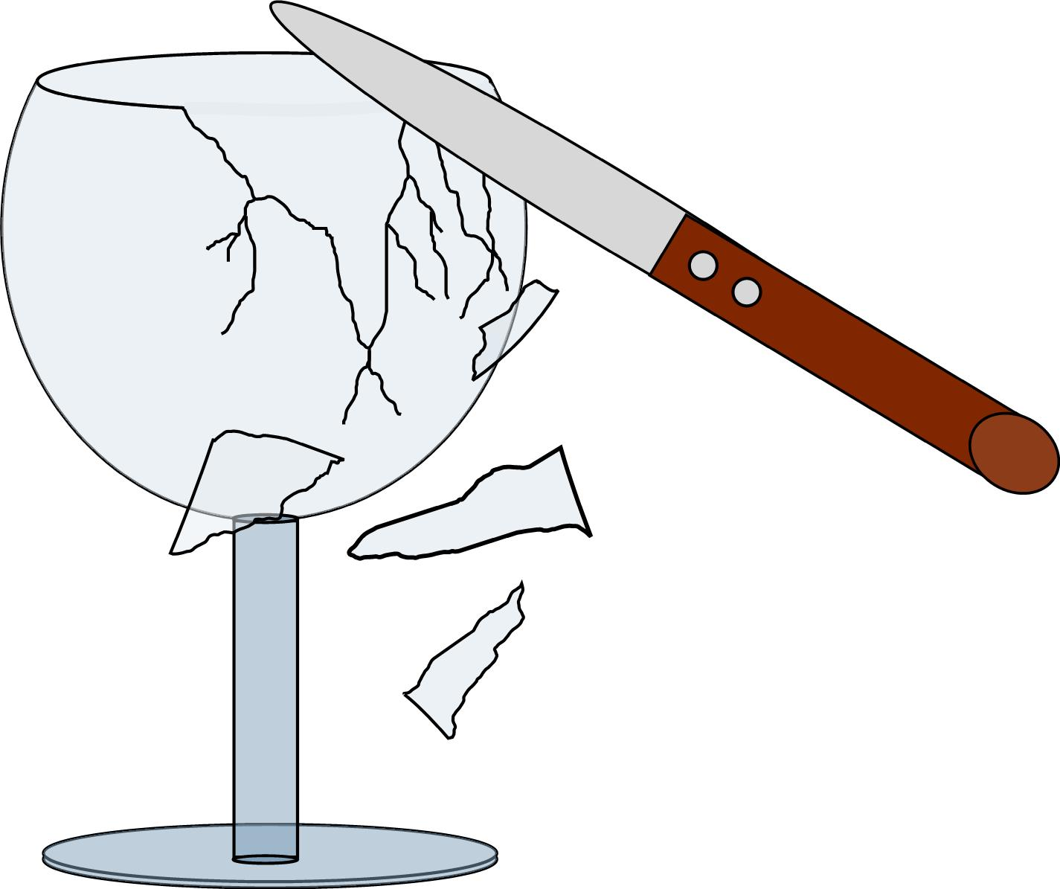
Figure 69 and 70

Slide 24
Figure 71

Slide 25
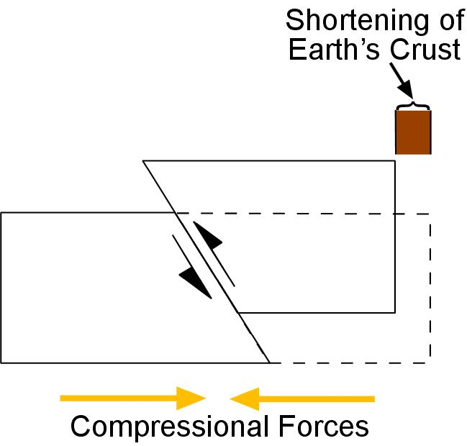
Figure 72 and 73

Slide 26
Figure 74

Slide 27
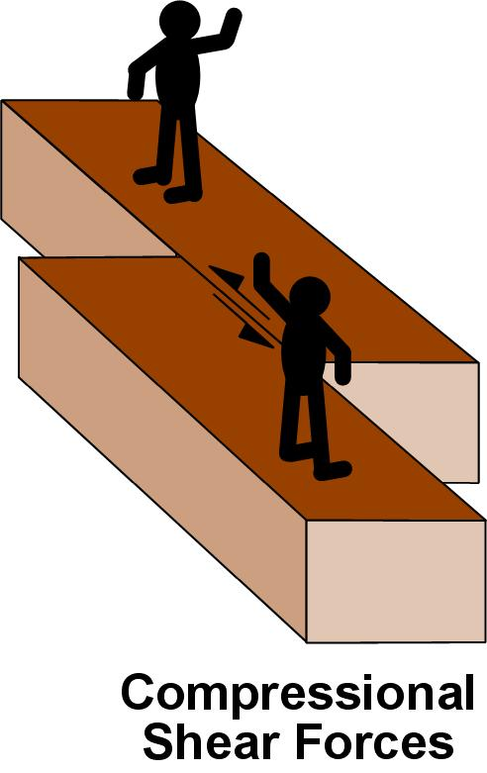
Figure 75a, b

Slide 28
Figure 76

Slide 29
Figure 77

Slide 30
Figure 78

Slide 31
Figure 79

Slide 32
Figure 80

Slide 33
Figure 81

Slide 34
Figure 82

Slide 35
Figure 83

Slide 36
Figure 84

Slide 37
Figure 85

Slide 38
Figure 86

Slide 39
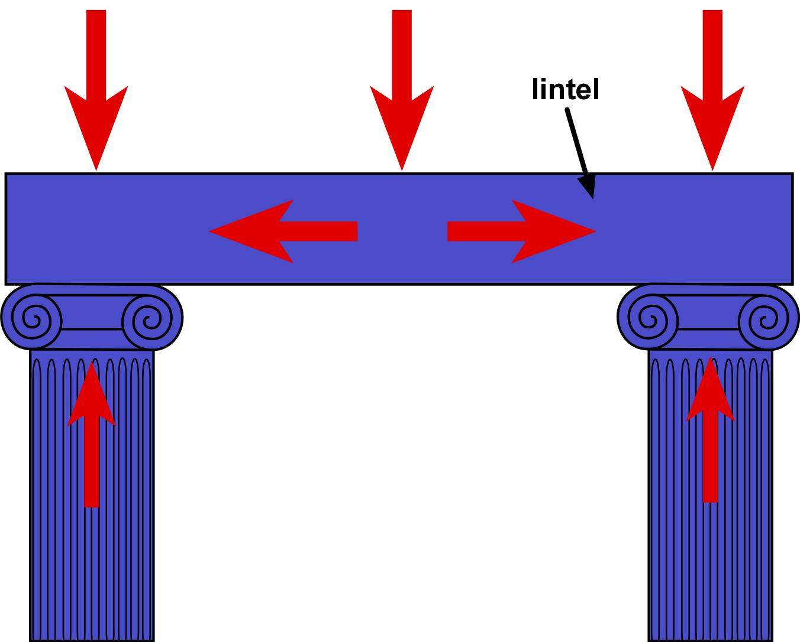
Figure 87 and 88

Slide 40
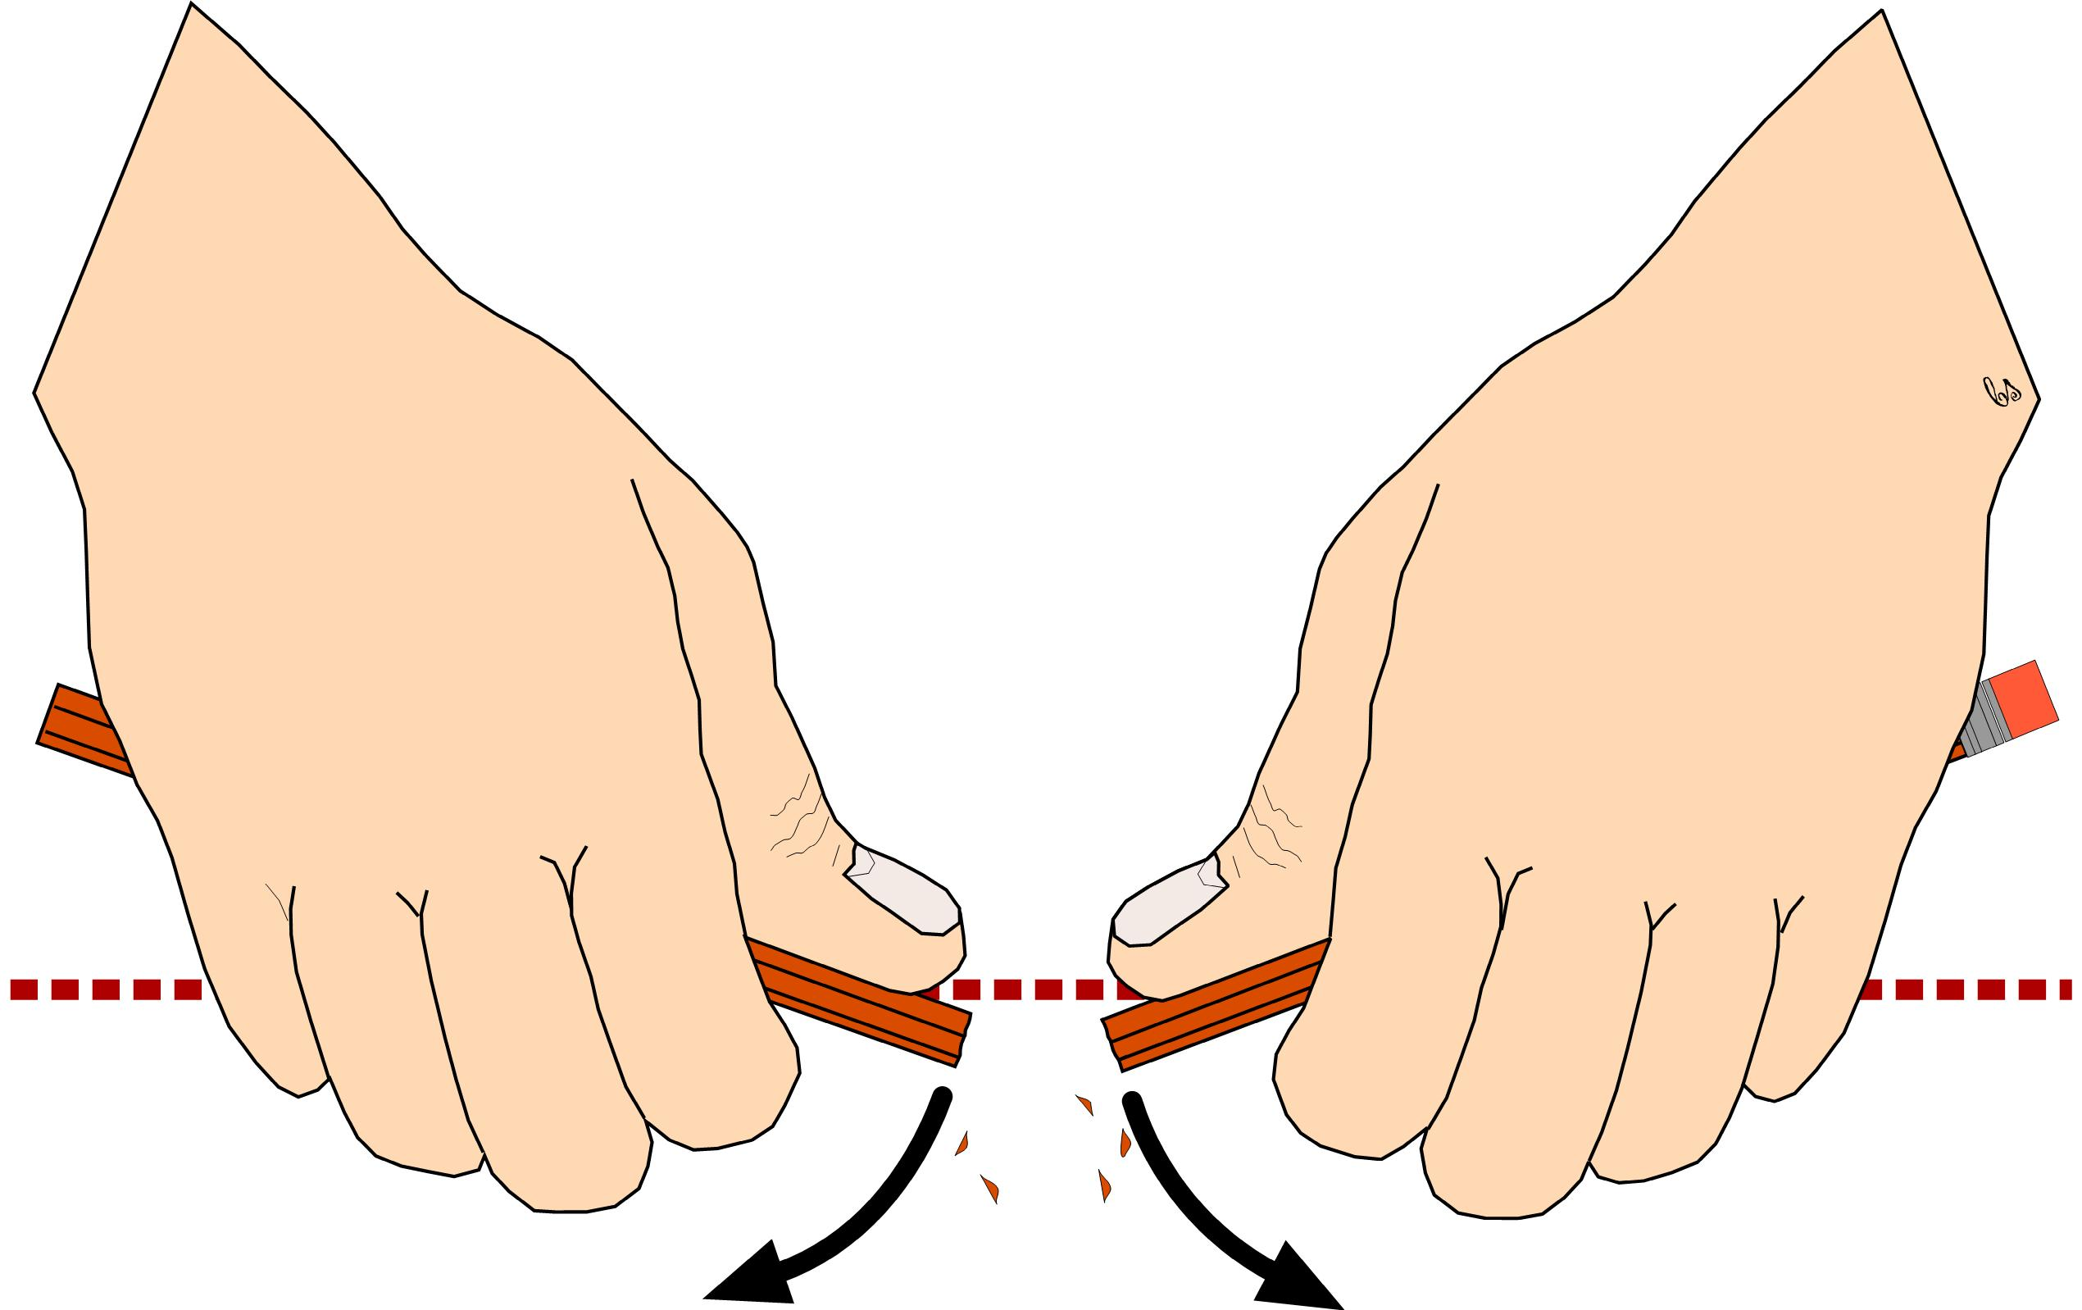
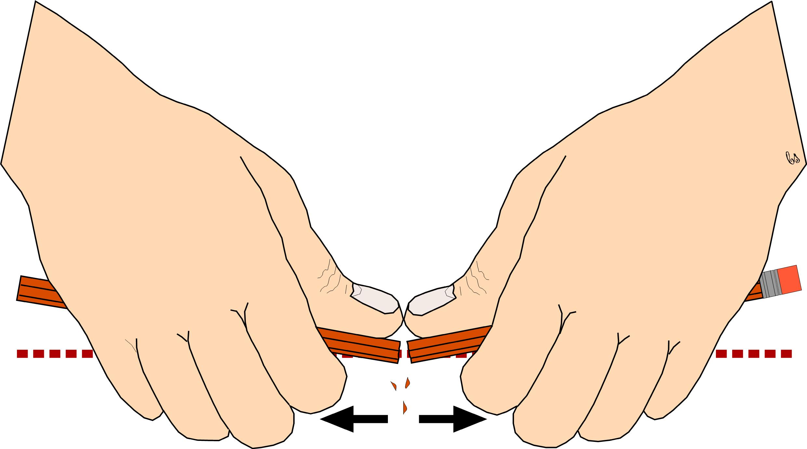
Figure 89a, b, c

Slide 41
Figure 90

Slide 42
Figure 91

