Slide 1
Conceptual Understanding Series for West Virginia Teachers
Sedimentary Rocks
ED-16 Part 1: Figures 1-44

Slide 2
Figure 1

Slide 3
Figure 2

Slide 4
Figure 3

Slide 5
Figure 4

Slide 6
Figure 5

Slide 7
Figure 6

Slide 8
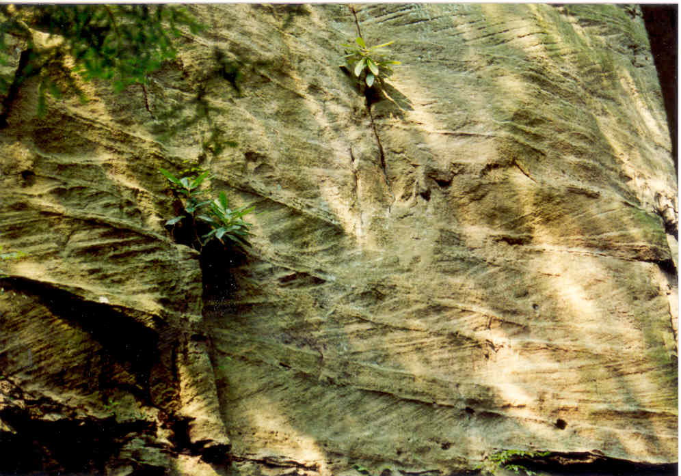
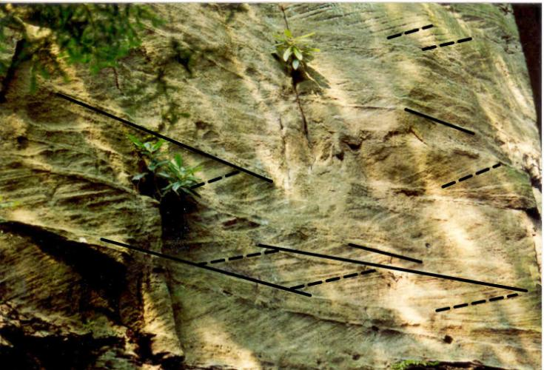
Figure 7, 8, 9

Slide 9
Figure 10

Slide 10
Figure 11

Slide 11
Figure 12

Slide 12
Figure 13

Slide 13
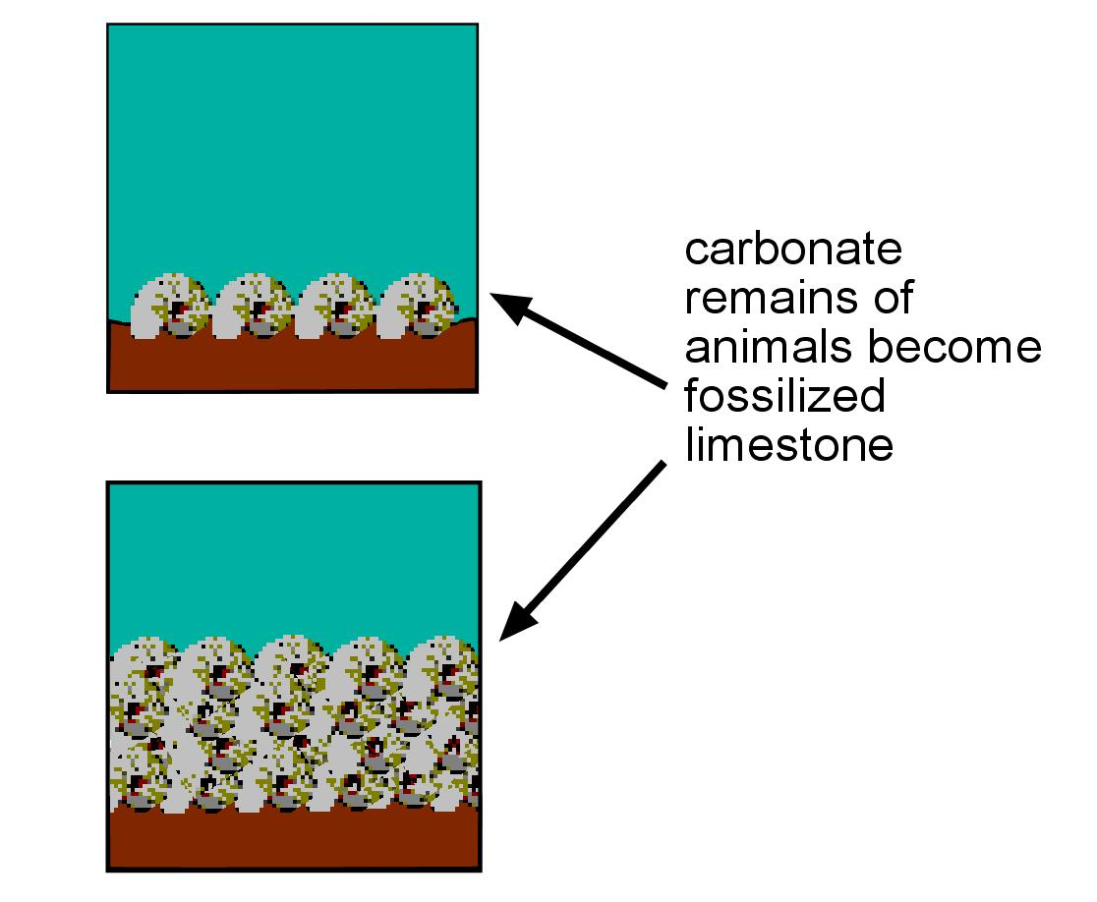
Figure 14

Slide 14
Figure 15

Slide 15
Figure 16

Slide 16
Figure 17

Slide 17
Figure 18

Slide 18
Figure 19

Slide 19
Figure 20

Slide 20
Figure 21

Slide 21
Figure 22

Slide 22
Figure 23

Slide 23
Figure 24

Slide 24
Figure 25

Slide 25
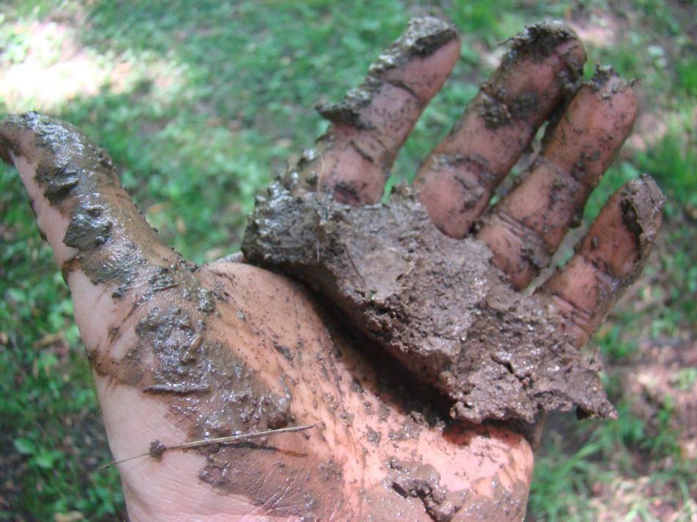
Figure 26, 27

Slide 26
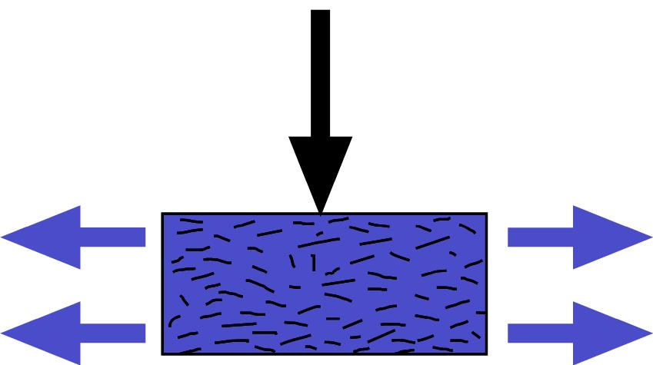
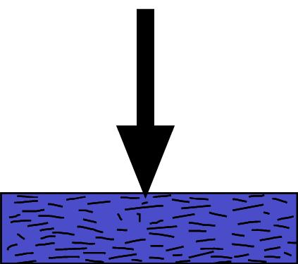
Figure 28a, b, and c

Slide 27
Figure 29

Slide 28
Figure 30

Slide 29
Figure 31

Slide 30
Figure 32

Slide 31
Figure 33

Slide 32
Figure 34

Slide 33
Figure 35

Slide 34
Figure 36

Slide 35
Need text…
Figure 37

Slide 36
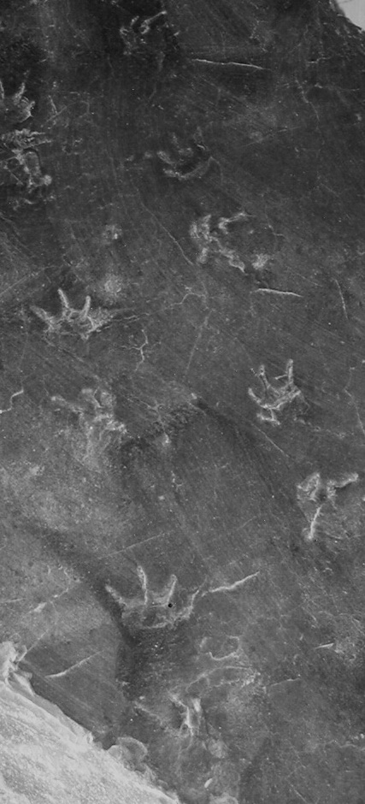
Need text…
Figure 38a, b

Slide 37
Figure 39

Slide 38
Figure 40

Slide 39
Figure 41

Slide 40
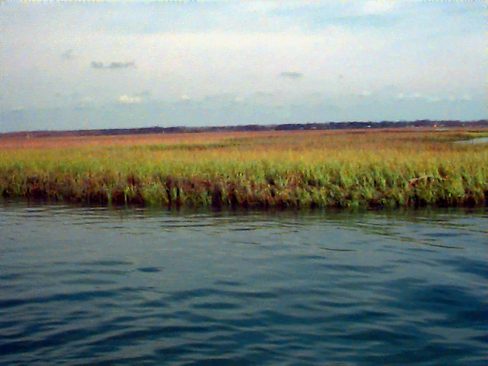
Figure 42a, b

Slide 41
Figure 43a, b

Slide 42
Figure 44

