Slide 1
Photographs of West Virginia Outcrops by Topic
Mining/Quarrying/Drilling
Sedimentary Rock Features
Anticline/Syncline
Erosion/Mass Wasting
Faults
Stream Features
Fossils
Photos by:
Peter Lessing, Ph.D.
Senior Research Geologist (retired)
West Virginia Geological
and Economic Survey
1997
Click On Photos To See Additional Information
Photo Credits

Slide 2
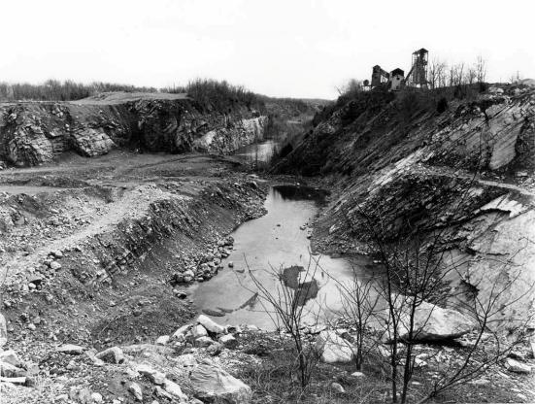
Limestone Quarry
County: Berkeley
Quadrangle: Inwood
Location Info: Just east of Route 11, one mile SE of Inwood.
Rock Formation(s): Ordovician New Market Limestone overlain by Ordovician Chambersburg Limestone.
Strike/Dip (in degrees): N 25 E, dip about 45 SE.
Comments: Overview from upper bench showing lower benches and standing water; dip is to the left. Contact of Chambersburg/New Market on wall of far quarry, about half way up. Chambersburg is dark limestone at top and New Market is light gray below. Mining is for the New Market.
Topics List
Next

Slide 3
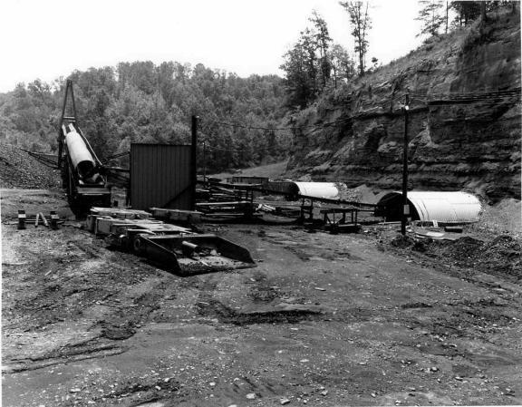
Coal Mine Entry
County: Monongalia
Quadrangle: Morgantown South
Location Info: On Mays Run, 1 mile SE of I-79, exit 146 (Goshen Road exit)
Rock Formation(s): Pennsylvanian Allegheny Formation
Strike/Dip (in degrees): Horizontal
Comments: Four active portals (two shown here) into coal with conveyor belt that transports coal out and dumps coal into trucks. Coal seam also surface mined and reclaimed along this creek. Coal seam is the Upper Freeport.
Topics List
Previous
Next

Slide 4
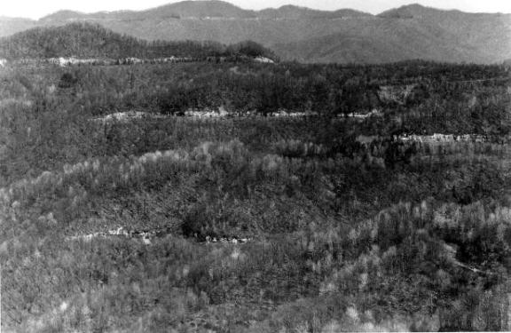
Coal Strip Mine Benches
County: Raleigh
Quadrangle: Arnett
Location Info: 4.2 miles west of Bolt, WV on Route 99.
Rock Formation(s): Pennsylvanian Kanawha Formation
Strike/Dip (in degrees): Horizontal
Comments: Five benches in photo.
Topics List
Previous
Next

Slide 5
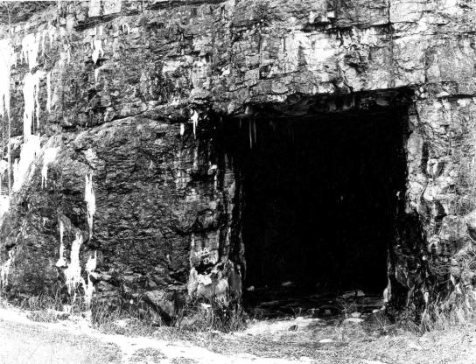
Abandoned Limestone Mine
County: Randolph
Quadrangle: Bowden
Location Info: South side of new Route 33 at Bowden.
Rock Formation(s): Mississippian Greenbrier Limestone
Strike/Dip (in degrees): Nearly horizontal.
Comments: Opening to mine is about 30-40 feet high. Another opening to the same mine is also at this location. Route 33 built here disrupted springs that fed the Bowden fish hatchery and so, this portion of “Corridor H” was abandoned and ends at Shavers Fork.
Topics List
Previous
Next

Slide 6
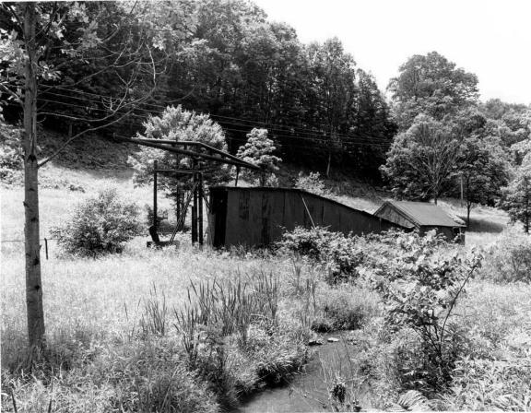
Old Oil Well
County: Roane
Quadrangle: Gay
Location Info: On Route 33, 0.5 miles E of Roane/Jackson line and 2.6 miles W of Peniel
Rock Formation(s): Well is spudded in Permian Dunkard Group
Strike/Dip (in degrees): None in photo, but horizontal
Comments: This oil well is in the Buffalo-Peniel field (number 162) and oil was obtained from the Salt Sand (Lower Pennsylvanian).
Topics List
Previous

Slide 7
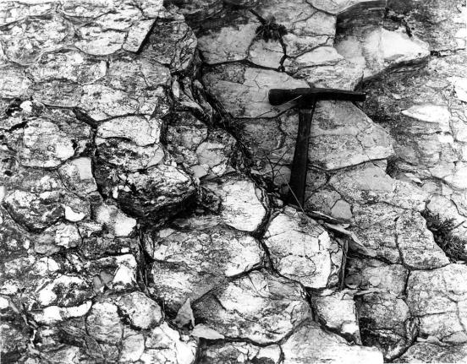
Mud Cracks
County: Hardy
Quadrangle: Baker
Location Info: At limestone quarry, 0.3 miles east of intersection of Routes 55 and 29.
Rock Formation(s): Silurian Tonoloway Formation
Strike/Dip (in degrees): N 40 E, 55 NW
Comments: Hammer (about 1 foot long) is parallel to dip and rock is dipping towards viewer.
Topics List
Next

Slide 8
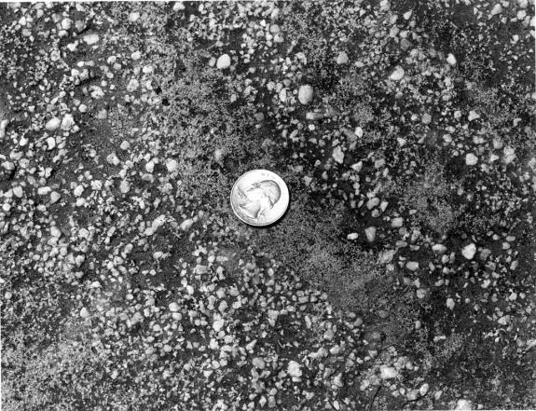
Conglomerate
County: Marion
Quadrangle: Fairmont East
Location Info: Valley Falls State Park
Rock Formation(s): Pennsylvanian Conoquesnessing Sandstone (Pottsville)
Strike/Dip (in degrees): Horizontal
Comments: The pebbles in this rock are 1/8” to 1/4” in diameter.
Topics List
Previous
Next

Slide 9
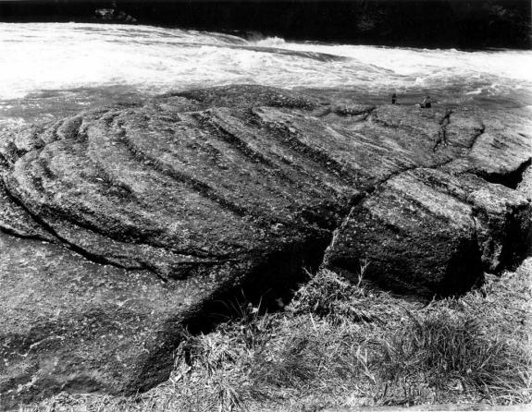
Crossbedding
County: Marion
Quadrangle: Fairmont East
Location Info: Valley Falls State Park
Rock Formation(s): Pennsylvanian Conoquesnessing Sandstone (Pottsville)
Strike/Dip (in degrees): Horizontal, but dip of crossbedding is about 20.
Comments: View shows side and top of crossbedding in sandstone that is partly conglomeratic. Entire bowl shape is about ten feet in diameter.
Topics List
Previous
Next

Slide 10
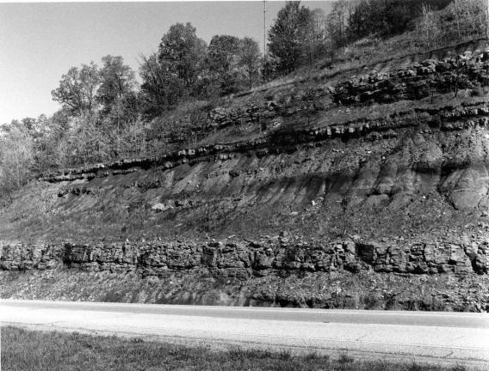
Sandstone and Shale Roadcut
County: Ritchie
Quadrangle: Schultz
Location Info: On Route 50, just E of Bear Run Road and 4.5 miles W of Ellenboro
Rock Formation(s): Permian Dunkard (may be Pennsylvanian)
Strike/Dip (in degrees): Horizontal
Comments: Entire road cut is about 100 feet high. Thick sandstone near base is about 10 feet thick and green on fresh surface. There are thinner sandstones in middle and upper sections. Interlayered shales are red and green. Note different weathering characteristics.
Topics List
Previous

Slide 11
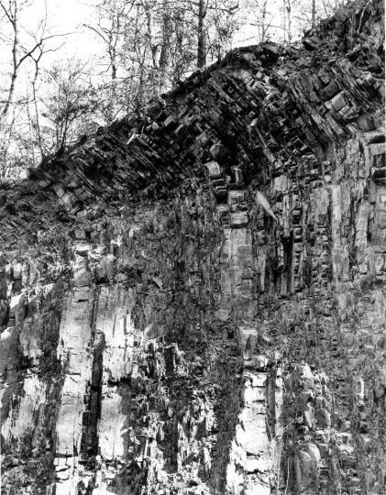
Folded Rocks
County: Hardy
Quadrangle: Baker
Location Info: On Route 29, 0.7 miles north of intersection with Route 55.
Rock Formation(s): Devonian Brallier Formation
Strike/Dip (in degrees): Nearly vertical dip; strike N 30 E
Comments: Folded layers near top. Hammer in lower center is about one foot long.
Topics List
Next

Slide 12
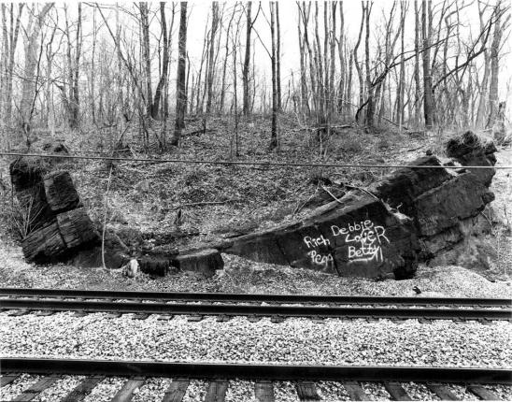
Syncline
County: Morgan
Quadrangle: Hancock
Location Info: Along Potomac River and railroad, approximately 3.5 miles SW of Hancock, MD and 1.5 miles north of Sir Johns Run, WV.
Rock Formation(s): Silurian Bloomsburg Formation
Strike/Dip (in degrees): Left side; N 35 E, 60 SE: Right side; N 25 E, 25 NW.
Comments: Bloomsburg is about 30 feet thick here, although only about 10 feet is visible in photo. Axis of syncline strike 35 NE and plunges 10 SW (towards viewer). Excellent cleavage perpendicular to bedding.
Topics List
Previous
Next

Slide 13
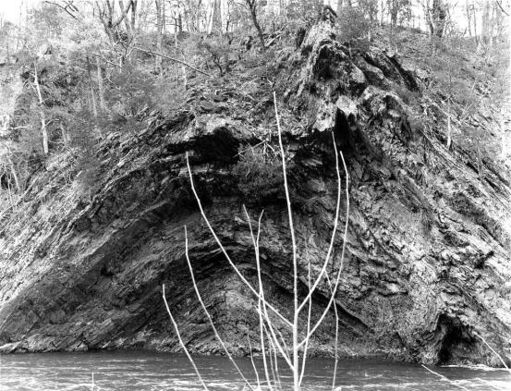
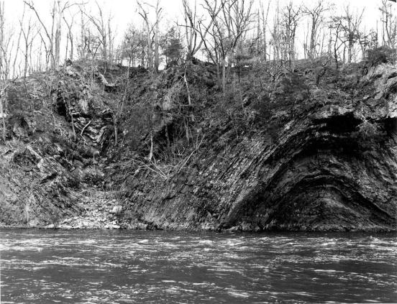
Anticline
County: Morgan
Quadrangle: Great Cacapon
Location Info: Just downstream from old power dam and one mile SE of Great Cacapon.
Rock Formation(s): Silurian Rose Hill Formation
Strike/Dip (in degrees): None taken, but strike is about N 25 E and dips can be measured from water.
Comments: Anticline with a fault on the right side just below right anticline; fault has steep dip 60 SE with drag folds. Same anticline with adjacent syncline on left side.
Click on photo above to zoomed view of the fold.
Topics List
Previous
Next
close

Slide 14
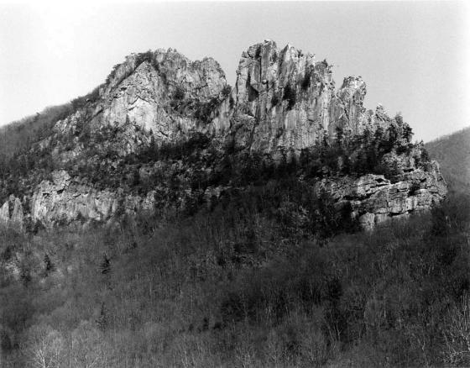
Vertical Tuscarora
County: Pendleton
Quadrangle: Upper Tract
Location Info: See comments
Rock Formation(s): Silurian Tuscarora Sandstone
Strike/Dip (in degrees): N 30 E, dip is vertical
Comments: Seneca Rocks from visitors center area (many climbers on the face and at top). The Tuscarora at this location is approximately 200 feet thick with several faults parallel to bedding.
Topics List
Previous
Next

Slide 15
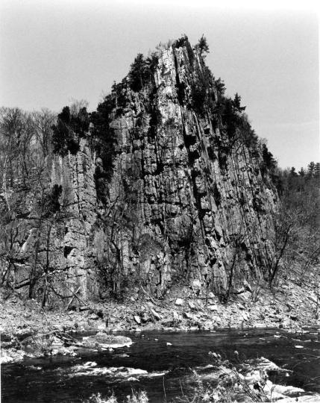
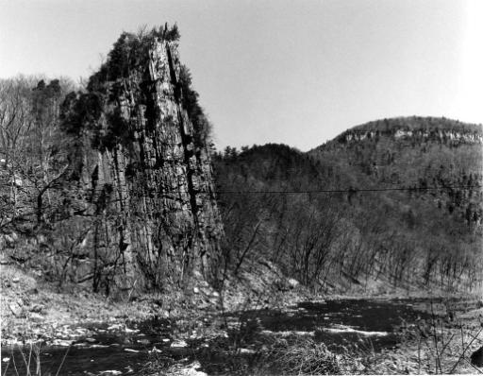
Overturned Devonian
Oriskany Sandstone
County: Pendleton
Quadrangle: Upper Tract
Location Info: Approximately 2 miles northwest of Route 220 on Smoke Hole Road
Rock Formation(s): Devonian Oriskany Sandstone
Strike/Dip (in degrees): Overturned and now dips 80 SE with Devonian Helderberg on southeast side. Strike is N 20 E.
Comments: Also called “Eagle Rocks” and located on Cave Mountain.
From Sign at this Location: “Eagle Rocks. Named for William Eagle, a Revolutionary War soldier who lived nearby. Enlisted at age fifteen, 12-24-1776, he served in the 3rd, 4th, 8th, and 12th, Virginia Regiments, Continental Line, at Valley Forge and Yorktown. Died 1848, and is buried here.” Grave is right behind this sign at Eagle Rocks.
Click on photo above to zoomed view of the fold.
Topics List
close
Previous

Slide 16
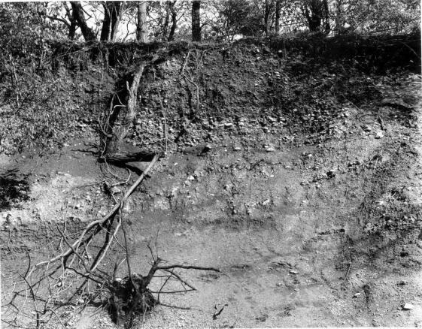
Quaternary Alluvial Gravel
County: Hancock
Quadrangle: East Liverpool South
Location Info: One mile W of Newell on Route 2
Rock Formation(s): Quaternary Alluvium
Strike/Dip (in degrees): None
Comments: Sand and gravel deposit composed of quartzites, gneisses, sandstone, conglomerates, etc. Some gravel reaches 6 inches in diameter and all are very rounded. Source of clast is most likely Canada.
Topics List
Previous
Next

Slide 17
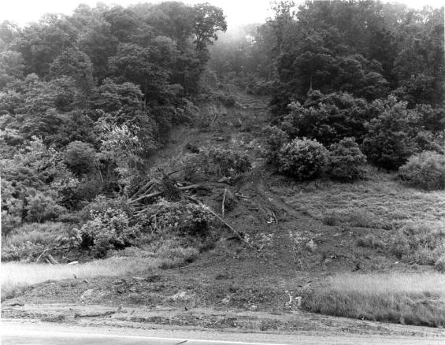
Landslide
County: Cabell
Quadrangle: Athalia
Location Info: On Route 22, 2.5 miles S of Mason/Cabell line
Rock Formation(s): Pennsylvania Monongahela Group
Strike/Dip (in degrees): Horizontal
Comments: Height of slide is about 100 feet. Composed mostly of soil and trees with a few blocks of rock. This is a very recent slide, perhaps less than a month old.
Topics List
Next

Slide 18
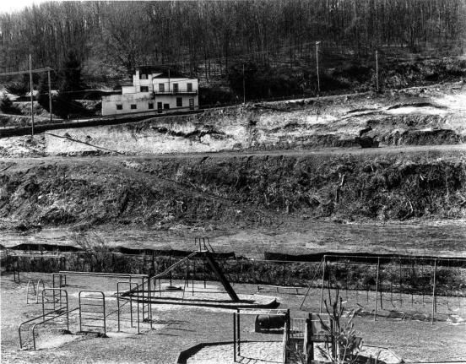
Landslides
County: Monongalia
Quadrangle: Morgantown North
Location Info: On hillside just above Easton School
Rock Formation(s): Pennsylvanian Conemaugh Group, specifically, just below the Pittsburgh coal.
Strike/Dip (in degrees): Horizontal, but strata are not visible in this photo.
Comments: Several landslides have formed above the school due to instability of soil and the removal of an old house. Also, water is a contributing factor coming off the Easton Hill road (Route 857). This water drains from abandoned Pittsburgh coal mines approximately 60 feet below the Mileground and airport.
Topics List
Previous
Next

Slide 19
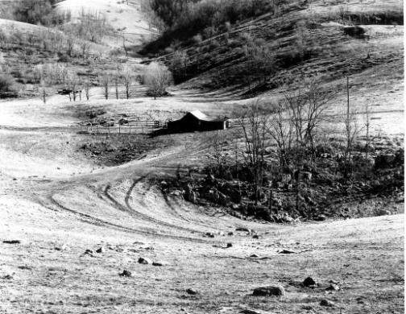
Sink Holes
County: Monroe
Quadrangle: Gap Mills
Location Info: Waiteville Road at intersection with Gap Mills/Zenith Road
Rock Formation(s): Ordovician Black River Limestone
Strike/Dip (in degrees): N 60 E; 23 SE
Comments: Several sink holes are shown in this photo. The rocks at this location are dipping away from the viewer.
Topics List
Previous
Next

Slide 20
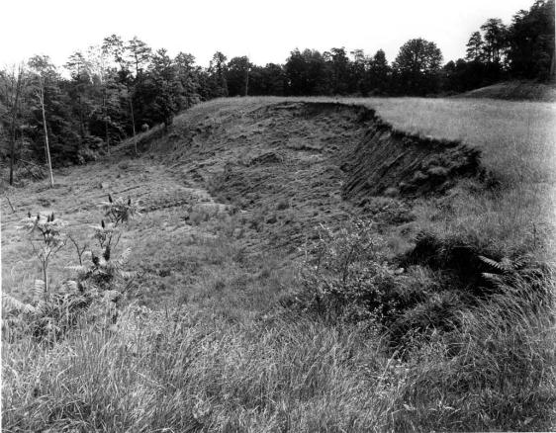
Top of Landslide
County: Putnam
Quadrangle: Bancroft
Location Info: On Route 34, next to Lone Oak Church
Rock Formation(s): Base of Permian Dunkard Group
Strike/Dip (in degrees): None
Comments: This is the top of a landslide showing the crown, scarp, and head. The upper scarp is about 15 feet high and the distance across is about 175-200 feet. Slide is mostly red soil of the Dunkard, which is notoriously unstable.
Topics List
Previous
Next

Slide 21
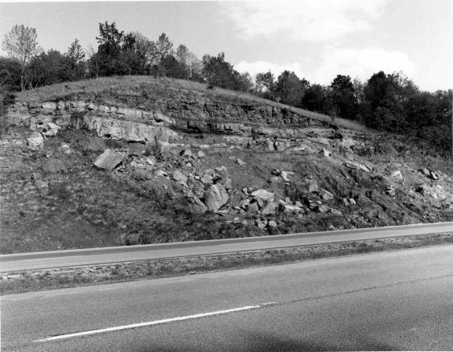
Landslide
County: Wood
Quadrangle: Rockport
Location Info: On I-77, 0.7 miles N of Jackson/Wood County line and 0.7 miles N of mile post 157
Rock Formation(s): Permian Dunkard (may be Pennsylvanian)
Strike/Dip (in degrees): Horizontal
Comments: Large blocks of rock (the size of cars) with associated red shale have fallen to road level. Red shale here has no strength, and when combined with water, it will slide. Sandstone ledges now have no support, so they too tumble down.
Topics List
Previous

Slide 22
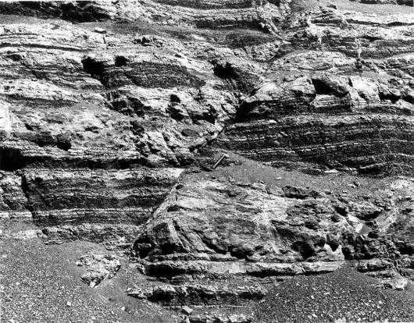
Normal Fault
County: Mercer
Quadrangle: Princeton
Location Info: On Route 460,2 miles east of interchange with I-77 (Princeton) and ¼ mile west of mile post 18.
Rock Formation(s): Mississippian Hinton Formation
Strike/Dip (in degrees): Horizontal
Comments: This is a normal (or gravity) fault with a displacement of 4 feet. The left side has moved down relative to the right side. Strike fault is N 40 E and it dips 55 NW. Hammer handle (about one foot long) is parallel to fault. The Hinton at this location is interbedded red and light gray shale and gray siltstone and sandstone.
Topics List
Next

Slide 23
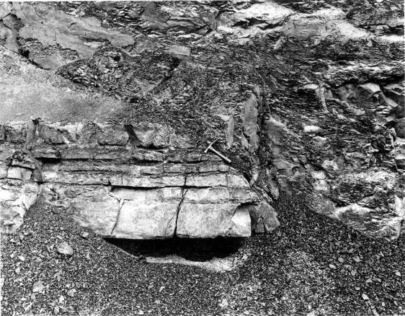
Thrust Fault
County: Summers
Quadrangle: Dawson
Location Info: On I-64 at mile post 147; 0.8 miles west of Summers/Greenbrier County line and 3.5 miles east of Green Sulphur Springs exit.
Rock Formation(s): Mississippian Hinton Formation
Strike/Dip (in degrees): Horizontal
Comments: Hammer handle (about one foot long) is parallel to fault that dips 25 E. Displacement unknown. Right side has moved upwards towards upper left of photo.
Topics List
Previous

Slide 24
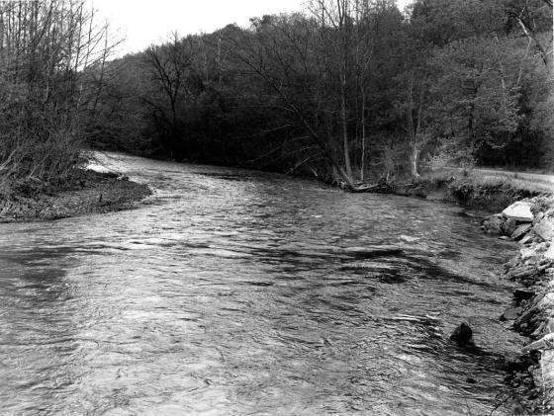
Meander Bend
County: Brooke
Quadrangle: Bethany
Location Info: On Route 67, 2.5 miles W of Bethany and 3.5 miles E of Wellsburg
Rock Formation(s): None
Strike/Dip (in degrees): None
Comments: Gravel deposit on left and steep, cut-bank on right, next to Route 67. Stream is flowing W (away from viewer), and named Buffalo Creek.
Topics List
Next

Slide 25
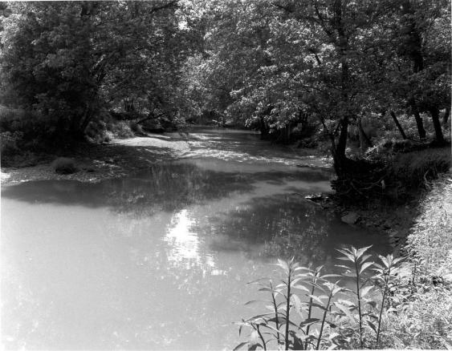
Meander Bend
County: Gilmer
Quadrangle: Glenville
Location Info: On Cedar Creek in Cedar Creek State Park, 3.5 miles S of Glenville
Rock Formation(s): Pennsylvanian Conemaugh Group
Strike/Dip (in degrees): Horizontal
Comments: Cut bank is on the right and deposition is occurring at the left bank. No bedrock is visible here, but can be seen across the road.
Topics List
Previous
Next

Slide 26
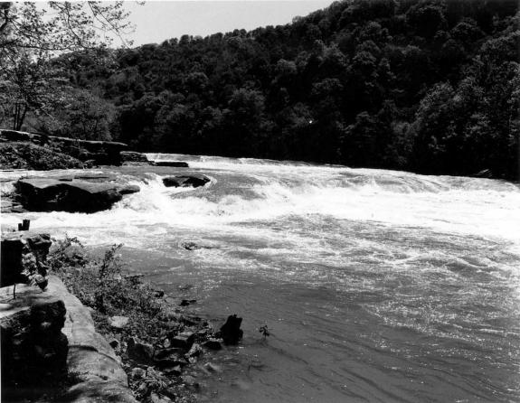
Waterfall
County: Marion
Quadrangle: Fairmont East
Location Info: Valley Falls State Park
Rock Formation(s): Pennsylvanian Conoquesnessing Sandstone (Pottsville)
Strike/Dip (in degrees): Horizontal
Comments: Conoquenessing is conglomeratic and cross bedded (photos of both). Sight of old grist mill with race used in early 1800s.
Topics List
Previous
Next

Slide 27
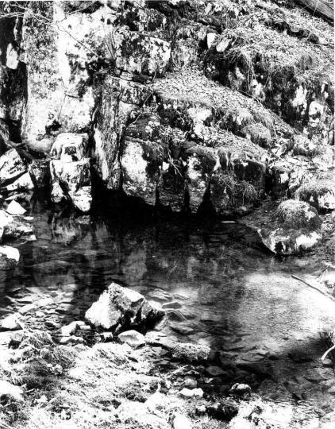
Spring and Cave
County: Monroe
Quadrangle: Gap Mills
Location Info: 1.3 miles southeast of Gap Mills
Rock Formation(s): Ordovician Black River Limestone
Strike/Dip (in degrees): Strike is N 35 and dip is 16 NW
Comments: Cave part in this photo has been partially blocked by limestone boulders that have fallen at cave entrance. Water still issues forth at several hundred gallons per minute.
There is a big sink hole 50 yards behind this spring that is probably Patton Cave.
Topics List
Previous
Next

Slide 28
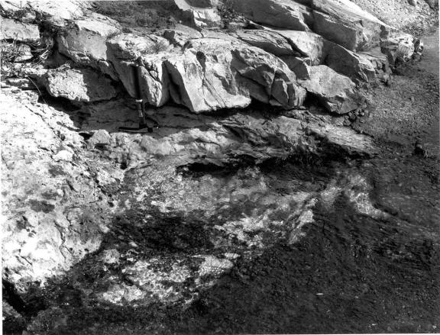
Berkeley Springs
County: Morgan
Quadrangle: Hancock
Location Info: In town of Berkeley Springs (Bath) on Route 522
Rock Formation(s): Devonian Oriskany Sandstone
Strike/Dip (in degrees): N 25 E; 45 SE
Comments: The Oriskany exposed in this spring is a quartzite; extensively faulted and fractured. Spring bubbles upward with white, Oriskany sand grains. Hammer is one foot long. Water rises from about 1800 feet below the surface through a complex fracture pattern. There is NO hot, subterranean magma needed to heat the water as the Park Museum would have one believe.
Topics List
Previous
Next

Slide 29
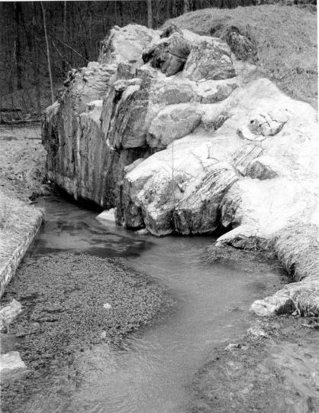
Spring
County: Morgan
Quadrangle: Great Cacapon
Location Info: 3.5 miles NE of Largent along Cacapon River
Rock Formation(s): Devonian Helderberg Limestone
Strike/Dip (in degrees): N 25 E; 85 SE overturned
Comments: Spring issues from two cavities in the Helderberg, which also has some cement added to hold this outcrop together. Watercress can be seen in the lower left of the photo. The limestone dips steeply away from the viewer. The spring probably produces several hundred gallons per minute.
Topics List
Previous
Next

Slide 30
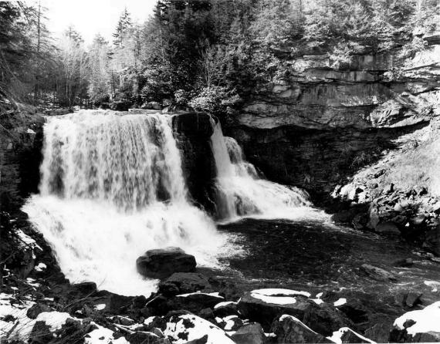
Blackwater Falls
County: Tucker
Quadrangle: Blackwater Falls
Location Info: At Blackwater State Park
Rock Formation(s): Pennsylvanian Conoquesnessing and Homewood Sandstones
Strike/Dip (in degrees): Horizontal
Comments: Several frames from first overlook and from lower walkway. Good photo ops from “Gentle Trail” on other side also. Falls caused by resistant sandstones visible on right.
Topics List
Previous

Slide 31
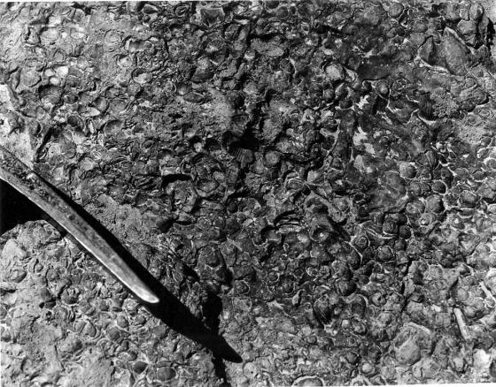
Fossils
County: Berkeley
Quadrangle: Glengary
Location Info: Along Back Creek, 0.6 miles SE of Glengary.
Rock Formation(s): Devonian Mahantango Formation
Strike/Dip (in degrees): N 30 E, 25 SE
Comments: Fossils are brachiopods, all about ¼ to ½ inch in diameter.
Topics List
Next

Slide 32
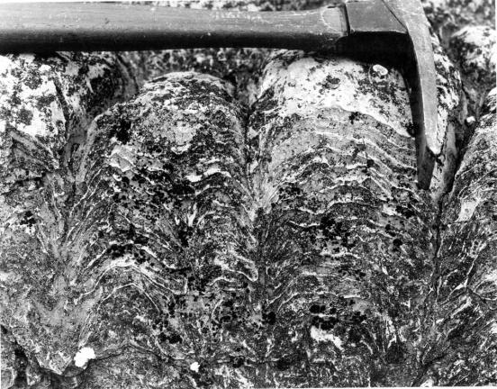
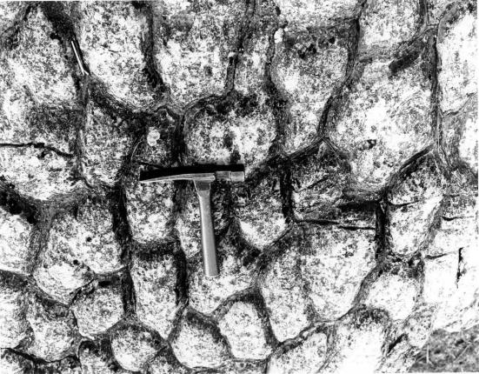
Stomatolites
County: Jefferson
Quadrangle: Charles Town
Location Info: Vicinity of Charles Town.
Rock Formation(s): Cambrian Conococheage Formation
Strike/Dip (in degrees): Nearly horizontal, on axis of anticline.
Comments: These Cambrian stomatolites are elongated parallel to elongation.
Additional Photo (click on photo to left): Perpendicular to bedding showing Stomatolites in cross section and layers of algal mats. Exact location must remain unnamed because site must not be destroyed.
Topics List
close
Previous
Next

Slide 33
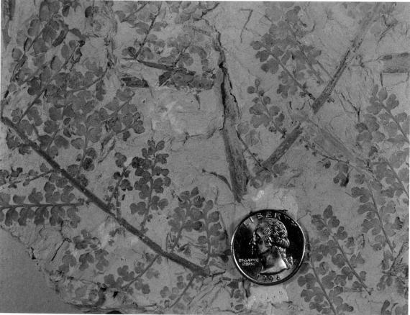
Fossil Leaves
County: Logan
Quadrangle: Amherstdale
Location Info: One mile north of Amherstdale
Rock Formation(s): Pennsylvanian Kanawha Formation (upper part of formation)
Strike/Dip (in degrees): Horizontal
Comments: Fossil leaves are Eusphenopteris obtusalopa.
Topics List
Previous

