Slide 1
Photographs of West Virginia Outcrops by County
Marion
Mercer
Monongalia
Monroe
Morgan
Photos by:
Peter Lessing, Ph.D.
Senior Research Geologist (retired)
West Virginia Geological
and Economic Survey
1997
Click on a photo above to see photo(s) available for a County
Photo Credits

Slide 2
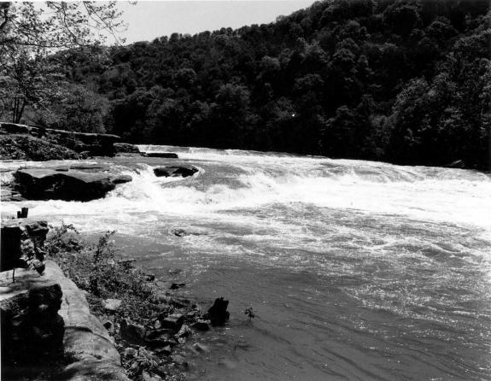
Waterfall
County: Marion
Quadrangle: Fairmont East
Location Info: Valley Falls State Park
Rock Formation(s): Pennsylvanian Conoquesnessing Sandstone (Pottsville)
Strike/Dip (in degrees): Horizontal
Comments: Conoquenessing is conglomeratic and cross bedded (photos of both). Sight of old grist mill with race used in early 1800s.
County List
Next

Slide 3
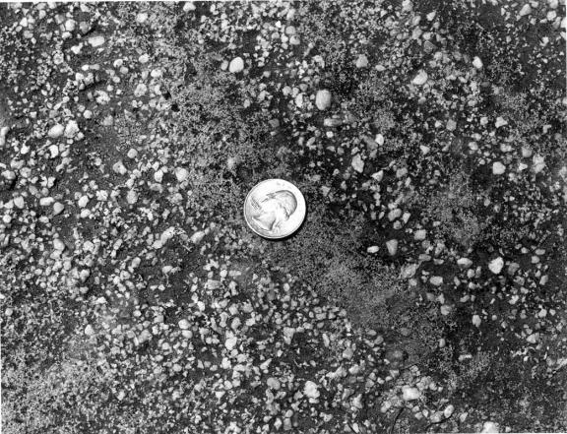
Conglomerate
County: Marion
Quadrangle: Fairmont East
Location Info: Valley Falls State Park
Rock Formation(s): Pennsylvanian Conoquesnessing Sandstone (Pottsville)
Strike/Dip (in degrees): Horizontal
Comments: The pebbles in this rock are 1/8” to 1/4” in diameter.
County List
Previous
Next

Slide 4
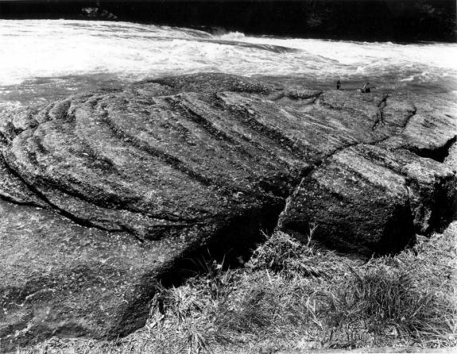
Crossbedding
County: Marion
Quadrangle: Fairmont East
Location Info: Valley Falls State Park
Rock Formation(s): Pennsylvanian Conoquesnessing Sandstone (Pottsville)
Strike/Dip (in degrees): Horizontal, but dip of crossbedding is about 20.
Comments: View shows side and top of crossbedding in sandstone that is partly conglomeratic. Entire bowl shape is about ten feet in diameter.
County List
Previous

Slide 5
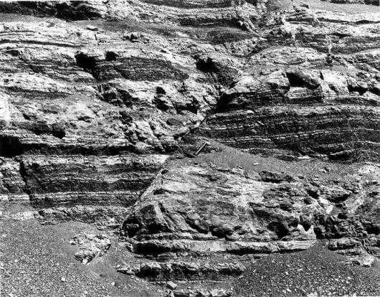
Normal Fault
County: Mercer
Quadrangle: Princeton
Location Info: On Route 460,2 miles east of interchange with I-77 (Princeton) and ¼ mile west of mile post 18.
Rock Formation(s): Mississippian Hinton Formation
Strike/Dip (in degrees): Horizontal
Comments: This is a normal (or gravity) fault with a displacement of 4 feet. The left side has moved down relative to the right side. Strike fault is N 40 E and it dips 55 NW. Hammer handle (about one foot long) is parallel to fault. The Hinton at this location is interbedded red and light gray shale and gray siltstone and sandstone.
County List

Slide 6
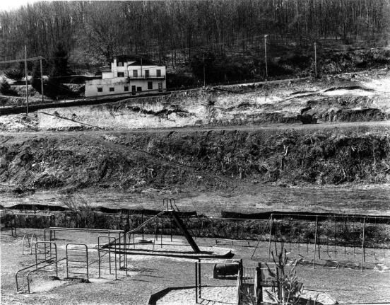
Landslides
County: Monongalia
Quadrangle: Morgantown North
Location Info: On hillside just above Easton School
Rock Formation(s): Pennsylvanian Conemaugh Group, specifically, just below the Pittsburgh coal.
Strike/Dip (in degrees): Horizontal, but strata are not visible in this photo.
Comments: Several landslides have formed above the school due to instability of soil and the removal of an old house. Also, water is a contributing factor coming off the Easton Hill road (Route 857). This water drains from abandoned Pittsburgh coal mines approximately 60 feet below the Mileground and airport.
County List
Next

Slide 7
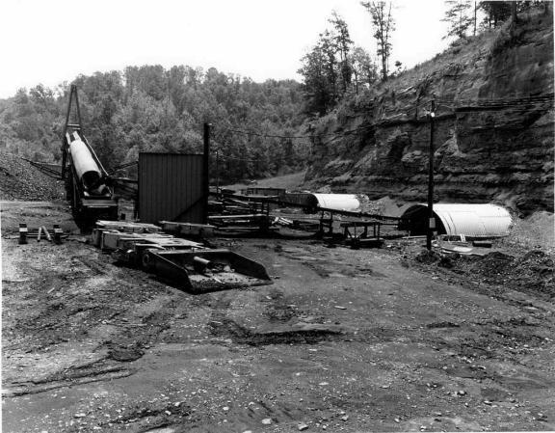
Coal Mine Entry
County: Monongalia
Quadrangle: Morgantown South
Location Info: On Mays Run, 1 mile SE of I-79, exit 146 (Goshen Road exit)
Rock Formation(s): Pennsylvanian Allegheny Formation
Strike/Dip (in degrees): Horizontal
Comments: Four active portals (two shown here) into coal with conveyor belt that transports coal out and dumps coal into trucks. Coal seam also surface mined and reclaimed along this creek. Coal seam is the Upper Freeport.
County List
Previous

Slide 8
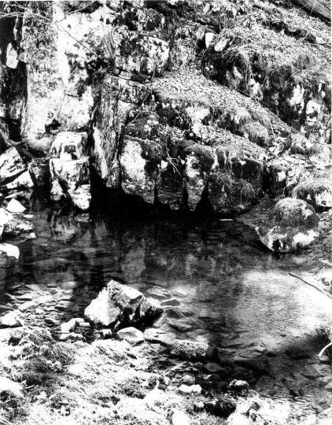
Spring and Cave
County: Monroe
Quadrangle: Gap Mills
Location Info: 1.3 miles southeast of Gap Mills
Rock Formation(s): Ordovician Black River Limestone
Strike/Dip (in degrees): Strike is N 35 and dip is 16 NW
Comments: Cave part in this photo has been partially blocked by limestone boulders that have fallen at cave entrance. Water still issues forth at several hundred gallons per minute.
There is a big sink hole 50 yards behind this spring that is probably Patton Cave.
County List
Next

Slide 9
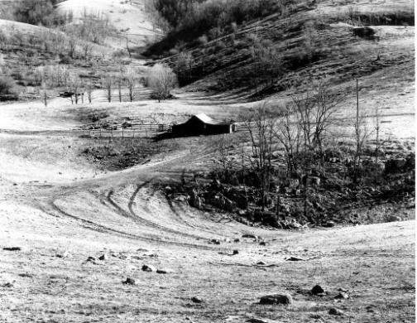
Sink Holes
County: Monroe
Quadrangle: Gap Mills
Location Info: Waiteville Road at intersection with Gap Mills/Zenith Road
Rock Formation(s): Ordovician Black River Limestone
Strike/Dip (in degrees): N 60 E; 23 SE
Comments: Several sink holes are shown in this photo. The rocks at this location are dipping away from the viewer.
County List
Previous

Slide 10
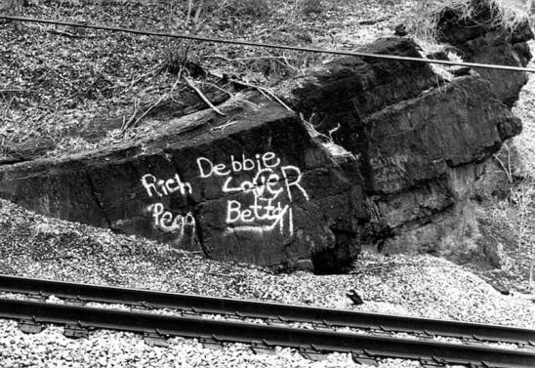
Syncline
County: Morgan
Quadrangle: Hancock
Location Info: Along Potomac River and railroad, approximately 3.5 miles SW of Hancock, MD and 1.5 miles north of Sir Johns Run, WV.
Rock Formation(s): Silurian Bloomsburg Formation
Strike/Dip (in degrees): Left side; N 35 E, 60 SE: Right side; N 25 E, 25 NW.
Comments: Bloomsburg is about 30 feet thick here, although only about 10 feet is visible in photo. Axis of syncline strike 35 NE and plunges 10 SW (towards viewer). Excellent cleavage perpendicular to bedding.
County List
Next

Slide 11
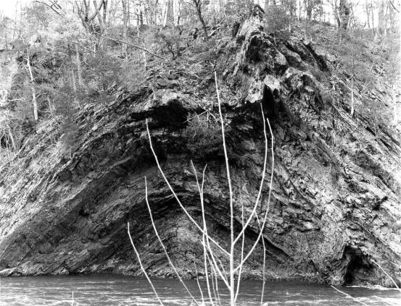
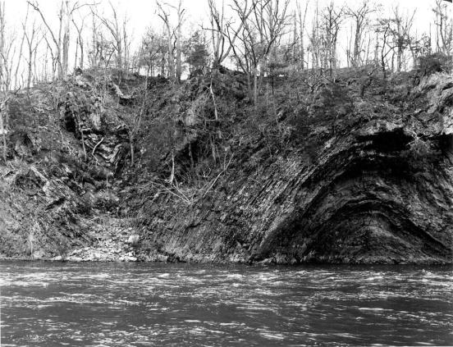
Anticline
County: Morgan
Quadrangle: Great Cacapon
Location Info: Just downstream from old power dam and one mile SE of Great Cacapon.
Rock Formation(s): Silurian Rose Hill Formation
Strike/Dip (in degrees): None taken, but strike is about N 25 E and dips can be measured from water.
Comments: Anticline with a fault on the right side just below right anticline; fault has steep dip 60 SE with drag folds. Same anticline with adjacent syncline on left side.
Click on photo above to zoomed view of the fold.
County List
CLOSE
Previous
Next

Slide 12
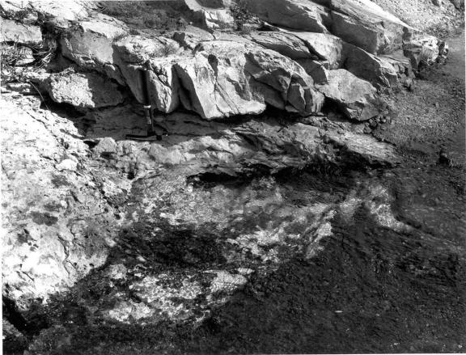
Berkeley Springs
County: Morgan
Quadrangle: Hancock
Location Info: In town of Berkeley Springs (Bath) on Route 522
Rock Formation(s): Devonian Oriskany Sandstone
Strike/Dip (in degrees): N 25 E; 45 SE
Comments: The Oriskany exposed in this spring is a quartzite; extensively faulted and fractured. Spring bubbles upward with white, Oriskany sand grains. Hammer is one foot long. Water rises from about 1800 feet below the surface through a complex fracture pattern. There is NO hot, subterranean magma needed to heat the water as the Park Museum would have one believe.
County List
Previous
Next

Slide 13
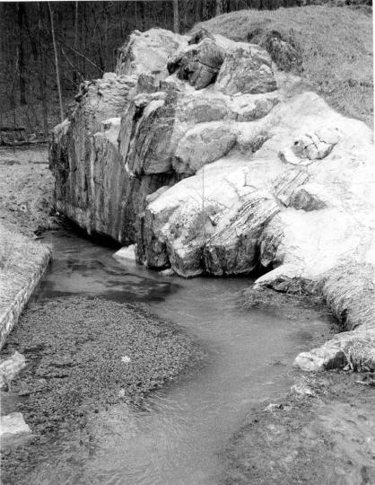
Spring
County: Morgan
Quadrangle: Great Cacapon
Location Info: 3.5 miles NE of Largent along Cacapon River
Rock Formation(s): Devonian Helderberg Limestone
Strike/Dip (in degrees): N 25 E; 85 SE overturned
Comments: Spring issues from two cavities in the Helderberg, which also has some cement added to hold this outcrop together. Watercress can be seen in the lower left of the photo. The limestone dips steeply away from the viewer. The spring probably produces several hundred gallons per minute.
County List
Previous

