Slide 1
Photographs of West Virginia Outcrops by County
Berkeley
Brooke
Hancock
Hardy
Cabell
Jefferson
Logan
Gilmer
Photos by:
Peter Lessing, Ph.D.
Senior Research Geologist (retired)
West Virginia Geological
and Economic Survey
1997
Click on a photo above to see photo(s) available for a County.
Use “esc” button to end show.
Photo Credits

Slide 2
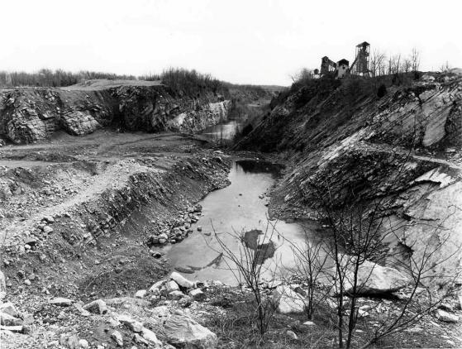
Limestone Quarry
County: Berkeley
Quadrangle: Inwood
Location Info: Just east of Route 11, one mile SE of Inwood.
Rock Formation(s): Ordovician New Market Limestone overlain by Ordovician Chambersburg Limestone.
Strike/Dip (in degrees): N 25 E, dip about 45 SE.
Comments: Overview from upper bench showing lower benches and standing water; dip is to the left. Contact of Chambersburg/New Market on wall of far quarry, about half way up. Chambersburg is dark limestone at top and New Market is light gray below. Mining is for the New Market.
County List
Next

Slide 3
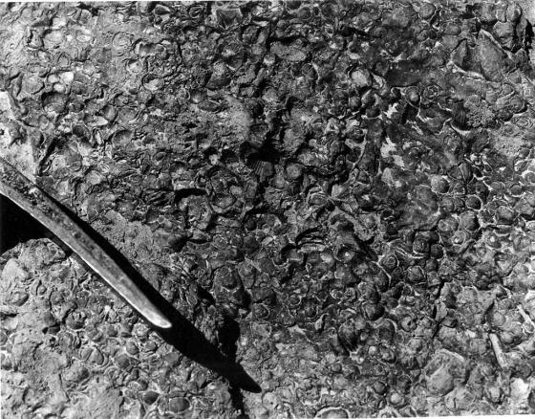
Fossils
County: Berkeley
Quadrangle: Glengary
Location Info: Along Back Creek, 0.6 miles SE of Glengary.
Rock Formation(s): Devonian Mahantango Formation
Strike/Dip (in degrees): N 30 E, 25 SE
Comments: Fossils are brachiopods, all about ¼ to ½ inch in diameter.
County List
Previous

Slide 4
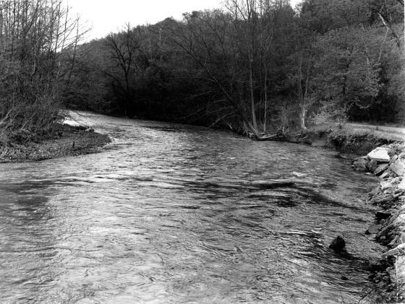
Meander Bend
County: Brooke
Quadrangle: Bethany
Location Info: On Route 67, 2.5 miles W of Bethany and 3.5 miles E of Wellsburg
Rock Formation(s): None
Strike/Dip (in degrees): None
Comments: Gravel deposit on left and steep, cut-bank on right, next to Route 67. Stream is flowing W (away from viewer), and named Buffalo Creek.
County List

Slide 5
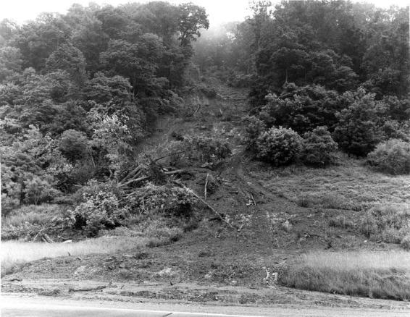
Landslide
County: Cabell
Quadrangle: Athalia
Location Info: On Route 22, 2.5 miles S of Mason/Cabell line
Rock Formation(s): Pennsylvania Monongahela Group
Strike/Dip (in degrees): Horizontal
Comments: Height of slide is about 100 feet. Composed mostly of soil and trees with a few blocks of rock. This is a very recent slide, perhaps less than a month old.
County List

Slide 6
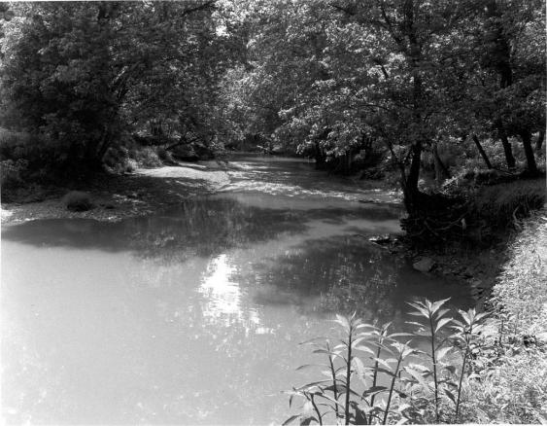
Meander Bend
County: Gilmer
Quadrangle: Glenville
Location Info: On Cedar Creek in Cedar Creek State Park, 3.5 miles S of Glenville
Rock Formation(s): Pennsylvanian Conemaugh Group
Strike/Dip (in degrees): Horizontal
Comments: Cut bank is on the right and deposition is occurring at the left bank. No bedrock is visible here, but can be seen across the road.
County List

Slide 7
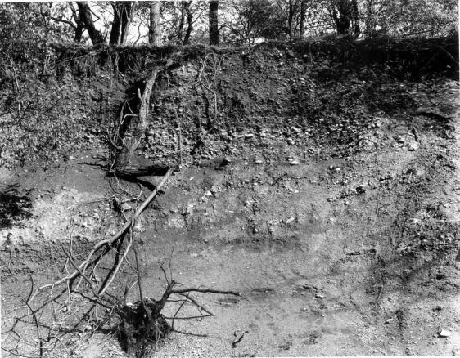
Quaternary Alluvial Gravel
County: Hancock
Quadrangle: East Liverpool South
Location Info: One mile W of Newell on Route 2
Rock Formation(s): Quaternary Alluvium
Strike/Dip (in degrees): None
Comments: Sand and gravel deposit composed of quartzites, gneisses, sandstone, conglomerates, etc. Some gravel reaches 6 inches in diameter and all are very rounded. Source of clast is most likely Canada.
County List

Slide 8
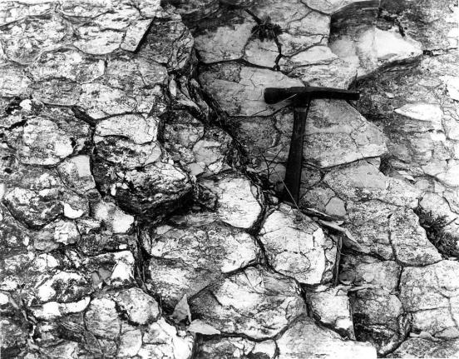
Mud Cracks
County: Hardy
Quadrangle: Baker
Location Info: At limestone quarry, 0.3 miles east of intersection of Routes 55 and 29.
Rock Formation(s): Silurian Tonoloway Formation
Strike/Dip (in degrees): N 40 E, 55 NW
Comments: Hammer (about 1 foot long) is parallel to dip and rock is dipping towards viewer.
County List
Next

Slide 9
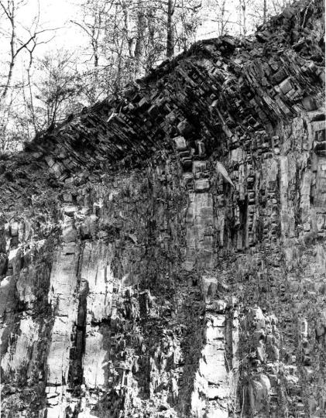
Folded Rocks
County: Hardy
Quadrangle: Baker
Location Info: On Route 29, 0.7 miles north of intersection with Route 55.
Rock Formation(s): Devonian Brallier Formation
Strike/Dip (in degrees): Nearly vertical dip; strike N 30 E
Comments: Folded layers near top. Hammer in lower center is about one foot long.
County List
Previous

Slide 10
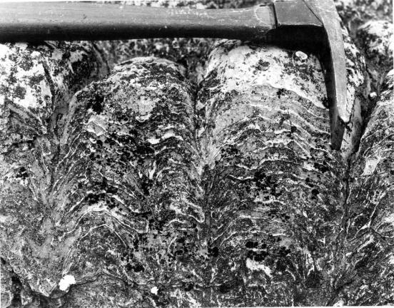
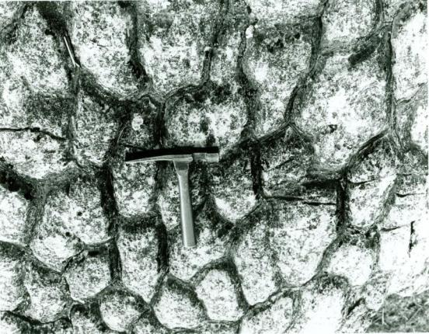
Stomatolites
County: Jefferson
Quadrangle: Charles Town
Location Info: Vicinity of Charles Town.
Rock Formation(s): Cambrian Conococheage Formation
Strike/Dip (in degrees): Nearly horizontal, on axis of anticline.
Comments: These Cambrian stromatolites are elongated parallel to elongation.
Additional Photo (click on photo to left): Perpendicular to bedding showing Stomatolites in cross section and layers of algal mats. Exact location must remain unnamed because site must not be destroyed.
County List

Slide 11
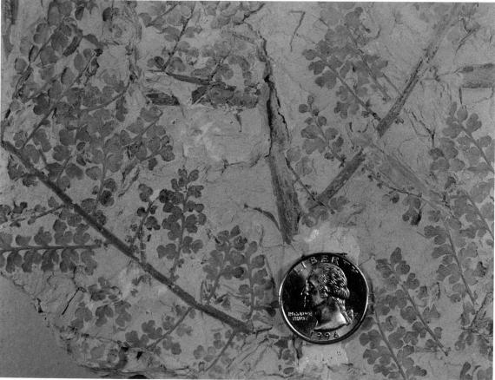
Fossil Leaves
County: Logan
Quadrangle: Amherstdale
Location Info: One mile north of Amherstdale
Rock Formation(s): Pennsylvanian Kanawha Formation (upper part of formation)
Strike/Dip (in degrees): Horizontal
Comments: Fossil leaves are Eusphenopteris obtusalopa.
County List

