Slide 1
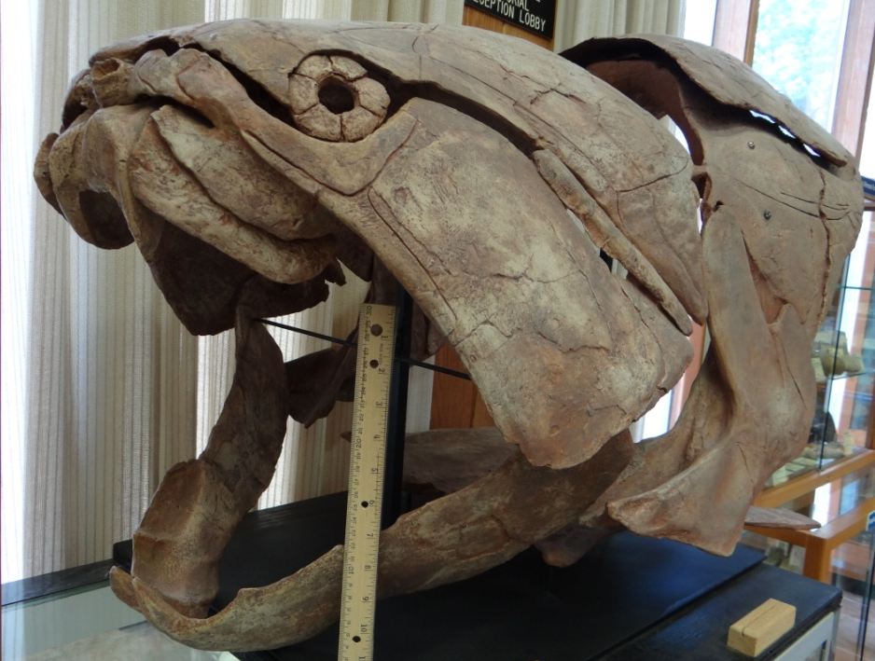
West Virginia Fossils
Most often young people hear the word “fossil” and imagine dinosaurs. However, no dinosaur fossils have been found in West Virginia’s sedimentary rocks.
West Virgina’s sedimentary rocks have yielded an impressive diversity of animal and plant fossils. One of the more rare finds are bones that prove the marine creature pictured to the left lived in a sea that covered the Elkins area about 400 million years ago.
These kind of fossil discoveries are rare. Fortunately, West Virginia’s sedimentary rocks do contain an abundant amount of smaller animal and plant fossils. In this presentation we are going to try ot help you focus on the observation process of a few commonly found fossils rather than just the name of the fossil.
Keep your eyes on the rocks and you will probably
find some yourself!
Like to see this guy coming after you?
That’s a 35 cm (12 inch) ruler in its mouth!
Do you know why?
For more information, click here.
Enter
This is a fiberglass replica of an armored fish named Dunkleosteus (Dunk-le-os-teus). A complete fossil has never been found in West Virginia but bones recovered from rocks excavated by new highway construction in Randolph County prove this animal lived in the area. More importantly, the fossil confirms the fact that, 400 million years ago, an ocean occupied what we now think of as West Virginia.
Because the rocks we see are too old! Most of the rock we see around West Virginia’s rocks formed during the Paleozoic Era that lasted from 540 to 250 million years ago. Rocks containing dinosaur fossils were formed 250 to 65 million years ago during the Mesozoic Era. These younger rocks MAY once have covered West Virginia. If they did exist, weathering and erosion has removed them to reveal the much older rocks we see today.

Slide 2
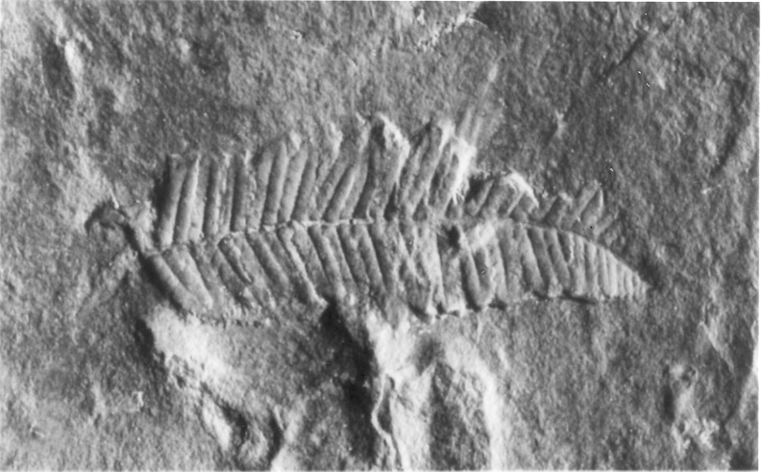
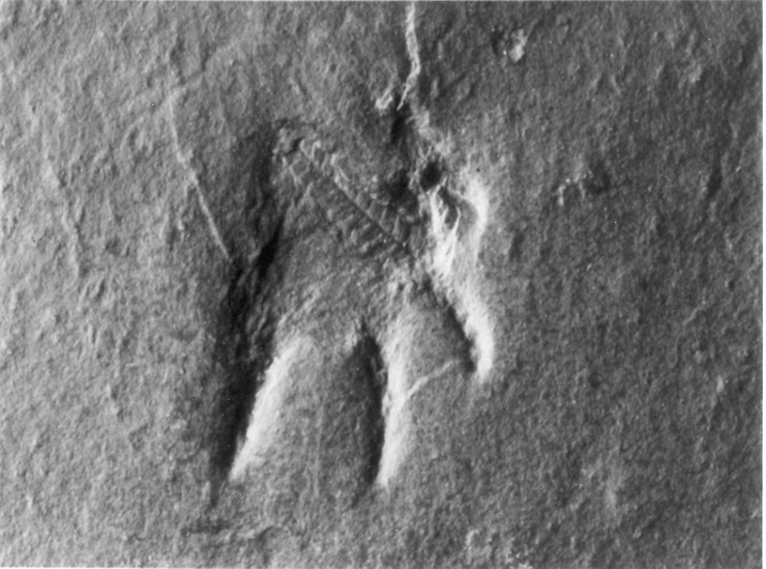
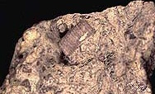
Look at the images below. Which appears to show an animal tramping on a fern leaf? Hopefully, you picked the one on the left. The action of trapping on the leaf happened more than 300 million years ago. Yet, it is preserved in a piece of rock found in Tucker County. Imagine what the ground must have been like and how big and heavy the animal needed to be make such an impression. The ground was muddy enough for the animal to make a footprint but not so muddy that the mud oozed back into the depression. We know it was mud, not sand, because the rock in which the fossil was found is shale. The leaf suggests some trees were nearby. Accumulated small clues, once combined, help us reconstruct what West Virginia looked like hundreds of millions of years ago.
Observational skills and interpretation of any observed unique and distinguishing characteristics are critical to identifying West Virginia’s abundant small fossils. In this presentation, various kinds of questions will test your observational skills. In some cases you will encounter new words. When that happens, ask your teacher to explain it or look it up.
Click to
begin exploring.
Next

Slide 3
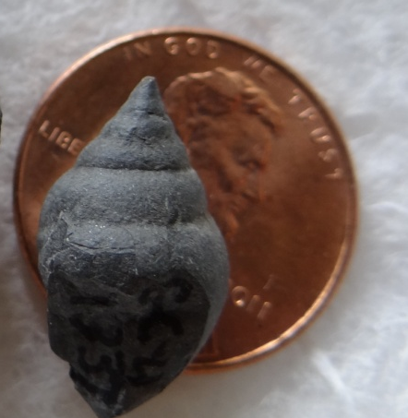
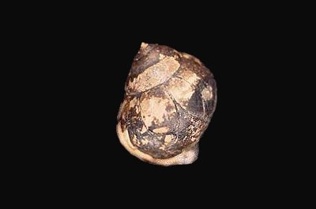
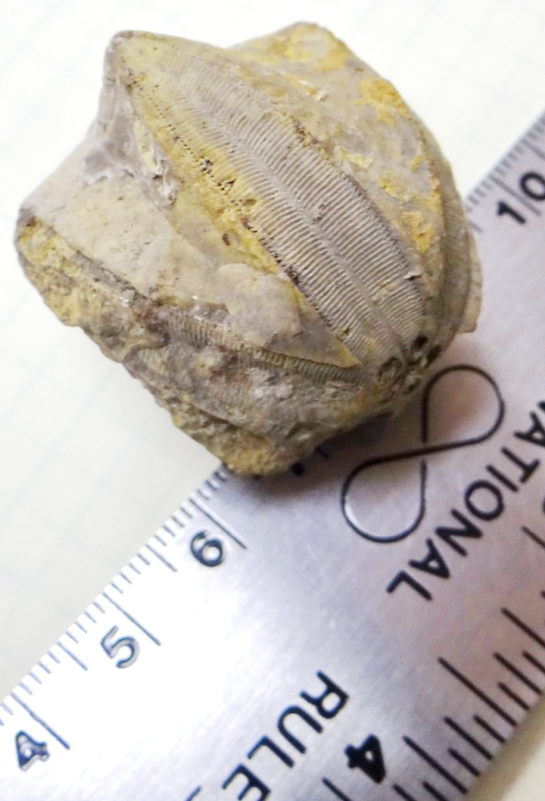
I am a GASTROPOD. I have a single shell that is closed at the apex. Usually, I have the spiraled shape of a snail. My fossils are found in rocks that formed on the land, in fresh water lakes and ponds, and in the salt water of the ocean. While I am a neat fossil and fun to collect, the fact that I may have lived in so many different places makes it difficult for geologists to use me to determine ancient environments.
Which of these fossils am I? (There may be more than one correct answer.)
Correct!
Correct!
Sorry,
Try again!
Previous
Next

Slide 4
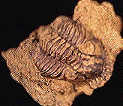
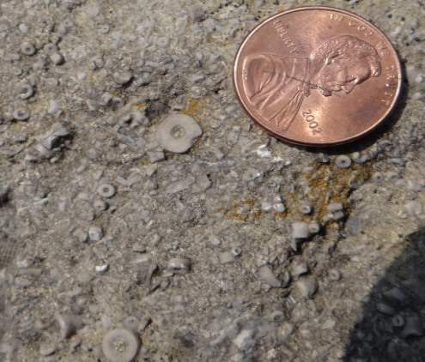
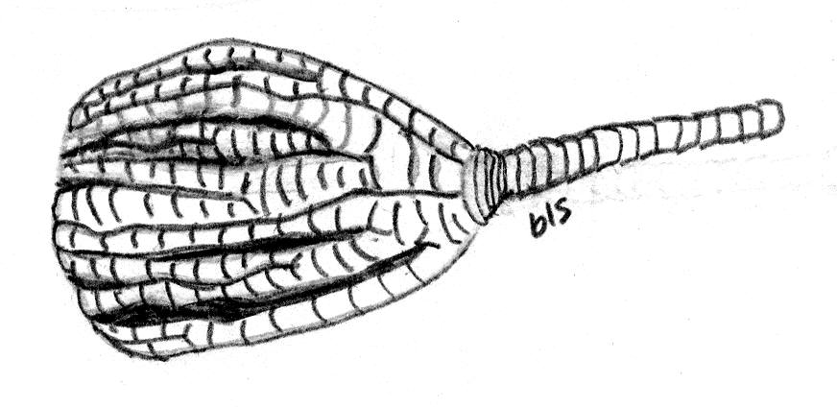
I am a CRINOID. I’m sometimes called a sea lily because the calyx, the top part where the animal lived, sometimes looks like curled up flower petals. Fossilized calyx are rare discoveries. However, West Virginia’s rocks contain lots of pieces of the column, or stem, that held the calyx to the ocean floor. Column pieces look like tiny donuts or life savers. If you look really close you may see a five-pointed star pattern in the middle of some stem pieces. Since I primarily lived in shallow salt water my presence in the rock indicates an ocean environment was present when I was alive.
Which of these fossils am I? (There may be more than one correct answer.)
Sorry,
Try again!
Correct!
The illustration will give you a better idea what I looked like when I was alive
Correct!
column or stem
calax
Previous
Next

Slide 5
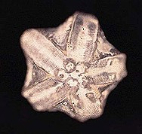
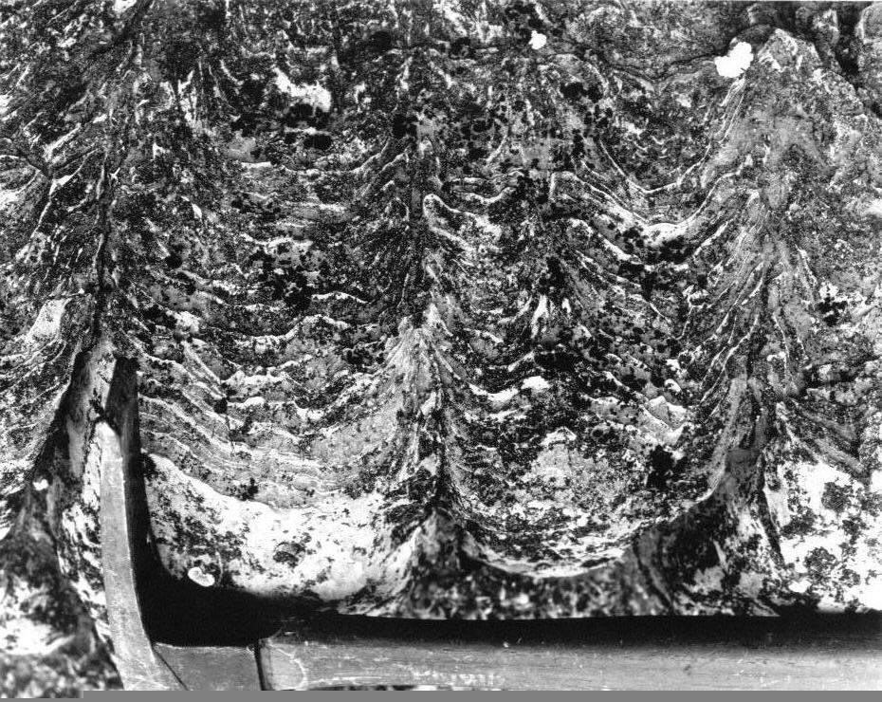
I am a BLASTOID. Sometimes I am mistaken for a crinoid calyx because I am also attached to the sea floor by a stem. However, I am a very different animal. The clue to identifying me it to look for the pentagonal (five-part) symmetry.
I am another indicator that the rock I am found in originated in a salt water environment.
Which of these fossils am I? (There may be more than one correct answer.)
Correct!
Here’s another blastoid fossil
Sorry,
Try again!
Sorry,
Try again!
Previous
Next

Slide 6
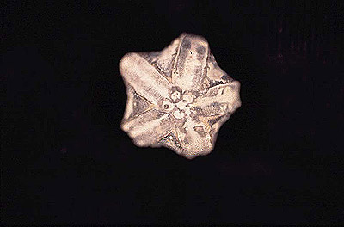
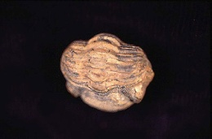
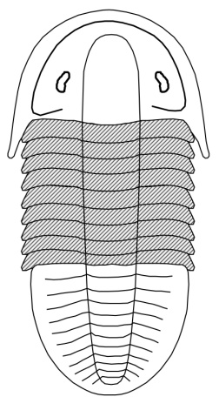
I am a TRILOBITE. My most distinguishing characteristic is my three-part (tri) body structure: a head, a thorax, and a tail. I can be found more frequently in the sedimentary rocks located in the Eastern Panhandle and along the Virginia-West Virginia border. I can be hard to identify if I am rolled up. If you look real close, you will find two small eyes on my head. I lived in salt water so my presence indicates that the rock formed in an ocean environment.
Which of these fossils am I? (There may be more than one correct answer.)
Correct!
If you unrolled me I might look like this!
Sorry,
Try again!
Correct!
Head (cehpalon)
Eye
Thorax
Tail (pygidium)
Previous
Next

Slide 7
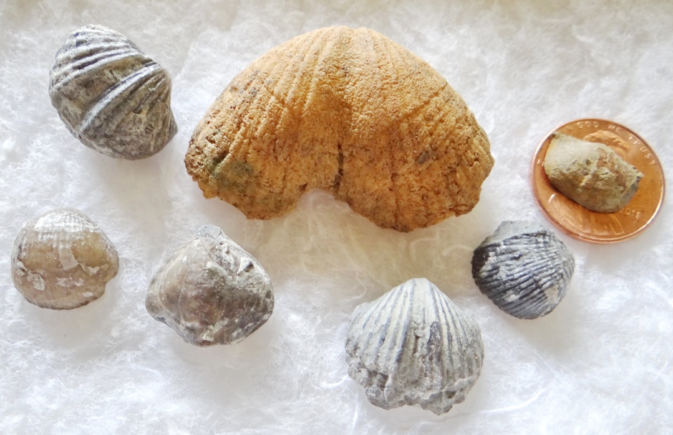
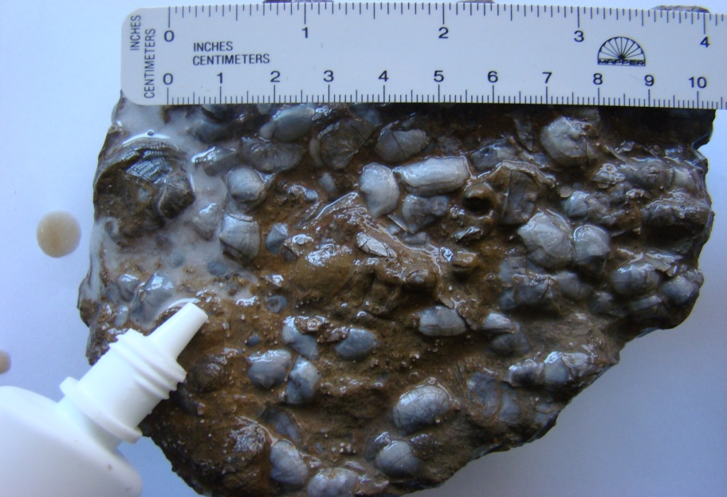
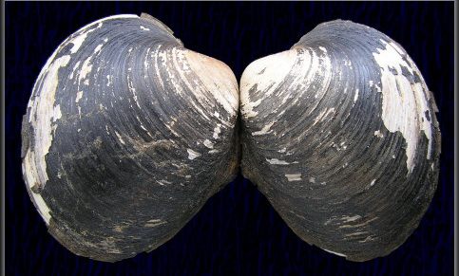
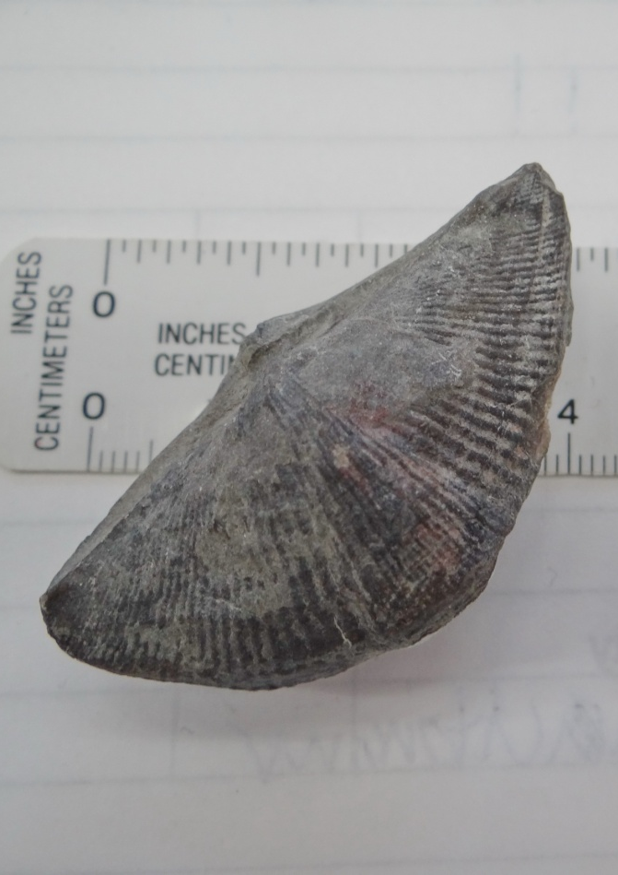
I am a BRACHIOPOD, one of the most common of West Virginia’s fossils. Although I look like a clam, I’m not. The difference between me and clams (or bivalves) is the symmetry of our two shells. If you split my shells I half, the right side of my shell is a mirror image of the left side. This is called bilateral symmetry and is distinctive to brachiopods. Bivalves do not share this characteristic.
Which of these fossils am I? (There may be more than one correct answer.)
Incorrect!
This is a bivalve. Note the lack of bilateral symmetry.
Correct!
This is called a “winged” or spirifer brachiopod.
Correct!
Note the side-to-side symmetry of each shell
Correct!
These brachiopods had water splashed on them to make them easier to see. Notice how many lived in one area!
Previous
Next

Slide 8
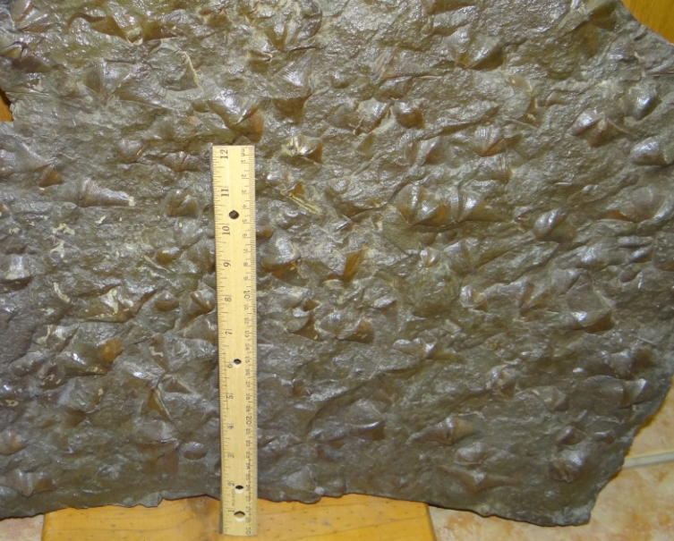
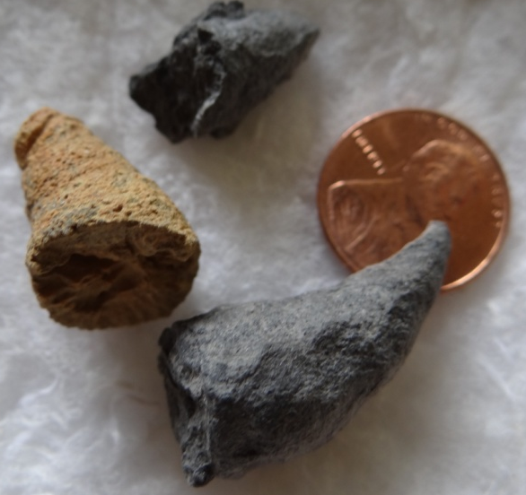

I am a RUGOSE CORAL. Actually, I’m more often called a HORN CORAL. Some say its because I look like a horn and other say I look like the popular decoration cornucopia. In any case, what you are collecting is the shell in which I lived. Horn corals are commonly thought of as solitary animal but they lived in groups and in some situations many coral lived in one shell. Look closely and you will see the internal radial walls and central support that make up my shell.
Which of these fossils am I? (There may be more than one correct answer.)
Sorry,
try again!
This is a large accumulation
of brachiopods!
Sorry!
Look at my shape and go back a few pages.
What am I?
Correct!
Previous
Next

Slide 9
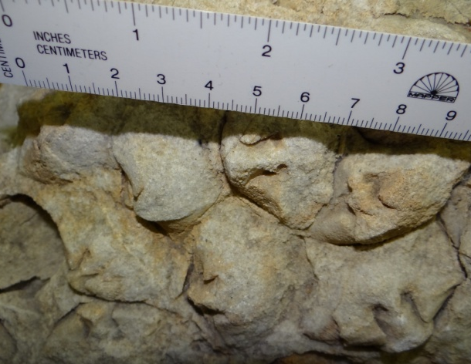
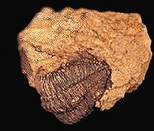
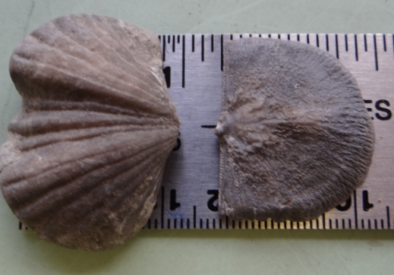

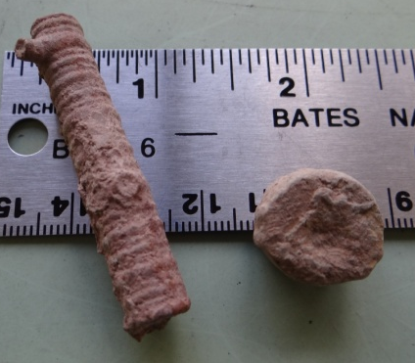
Identify the fossils!
Sorry, try again
Correct!
Gastropod
Trilobite
Brachiopod
Sorry, try again
Correct!
Brachiopod
Sorry, try again
Trilobite
Brachiopod
Correct!
Sorry, try again
Gastropod
Correct!
Horn Coral
Sorry, try again
Horn Coral
Crinoid
Correct!
Previous
Next

Slide 10
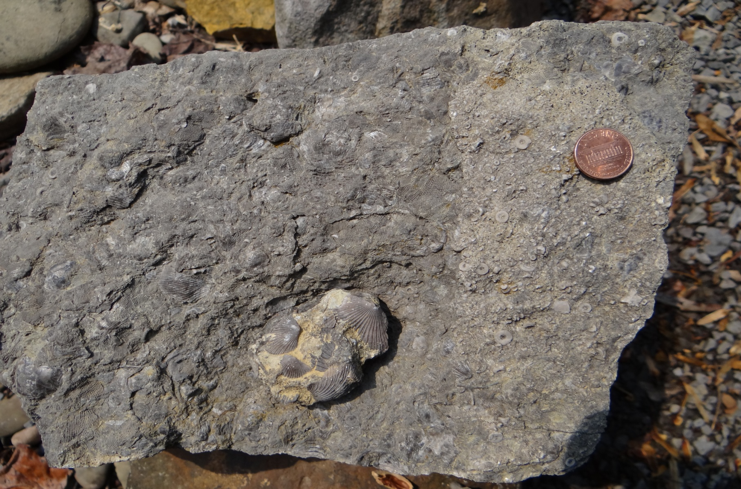
Application Time!
Click inside red boxes to check your response.
Fossil #1
Fossil #1 is a ______. How many more can you find?
Fossil #2 is actually a group of __________
This is hard! This area of Fossil #3 contains many broken pieces of ______
Even harder because you must figure it our yourself! See the lacey open nature of Fossil #4? Use this as a starting point to explore what it might be before you click on the answer.
Fossil #3
Broken brachiopod
shell fragments suggest water movement or predators at work.
This is a crinoid. See how many there are in this piece of limestone. Each piece once belonged to a long column attached to the sea floor. When the animal died the column fell apart, leaving all the pieces behind to be fossilized.
These are brachiopods
This is a bryozoa
Fossil #2
Previous
Fossil #4
Next

Slide 11
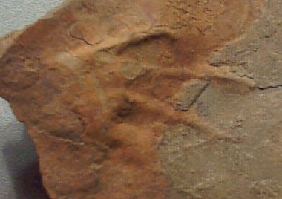
Trace Fossils
Trace fossils, also called ichnofossils, are indications of past life activity preserved in rock. Most often the term refers to animal foot impression but can include tracks, tail drag marks, burrows, and tubes. These fossil provide us with clues to animal location, size, and the surface environment at the time the impression was made. Finding trace fossils requires patience and luck.
Previous
Next

Slide 12
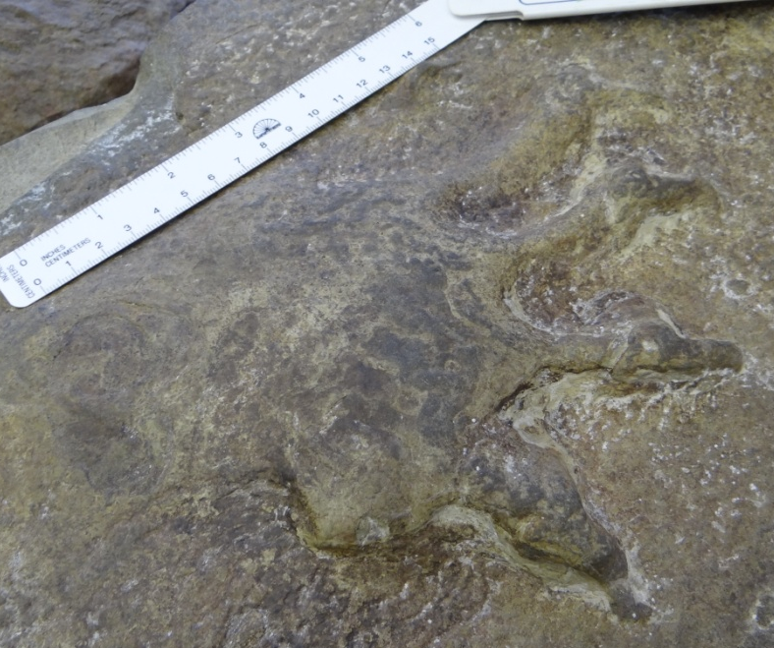
Individual footprints – amphibian or reptile?
These two trace fossil imprints came from some of West Virginia’s youngest rocks. Interpretation of the animals that made these two ichnofossils is open to debate. Why you might ask? First, the age of the rocks in which they were found has yet to be agreed upon, even though both rocks are about 290 millions years old. Secondly, back then large amphibians and small to medium size reptiles (not dinosaurs) roamed the semi-tropical plains and forests of West Virginia. Unfortunately, it is difficult to differentiate their footprints. The print on the left is supposedly that of a reptile. Notice what appears to be a claw extending from a distinctive joint at the end of each digit. (We don’t know if this is front or back foot so we can’t say toes or fingers!) Can you see a difference in the print on the right? Do its long digits look the same? See any indications of claws like the print on the left? The print on the right might be a large amphibian but we just don’t know. Open debate is the nature of science and more than not leads to consensus but, since it always lead to the need to know, it opens pathways for contributions by every new generation of geologists.
Claws?
No claws?
Previous
Next

Slide 13
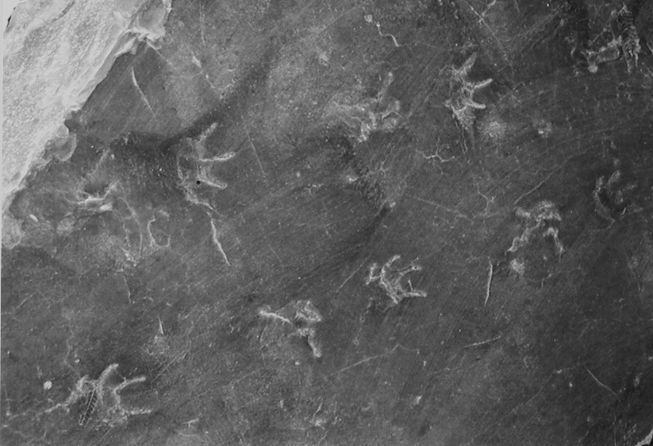
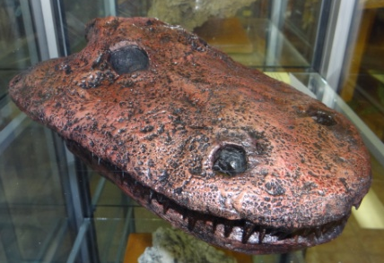
Trackway
These tracks were made by a four-footed amphibian that once roamed Tucker County. It was about 60cm (2 feet) long and looked like a large salamander with teeth! One day it was walking through the mud and left behind a series of footprints. Not too long afterward, the area was flooded by slowly rising muddy water, filling the footprint impressions with more mud. About 305 million years after it walked through the mud, a geologist split open the piece of rock, exposing the footprints.
The previous description provides clues as to what kind of sedimentary rock the trackway was found in and what kind of animal made the impressions. Can you pick the right one from those below?
Studying the track arrangement helped us determine that the animal had four feet and walked like a salamander. The prints do not seem to indicate the presence of claws. Also, there was no mark left where its tail should have dragged through the mud. The animal was probably a 60cm (2 feet) long amphibian. It made the imprints as it walked across a muddy pond or shoreline where water may have been deep enough to float its tail.
Based on what you just read, what kind of animal was I?
Amphibian
Correct!
Reptile
Sorry, try again
Based on what you just read, which sedimentary rock were my footprints found in?
Shale
Sandstone
Limestone
Previous
Next

Slide 14
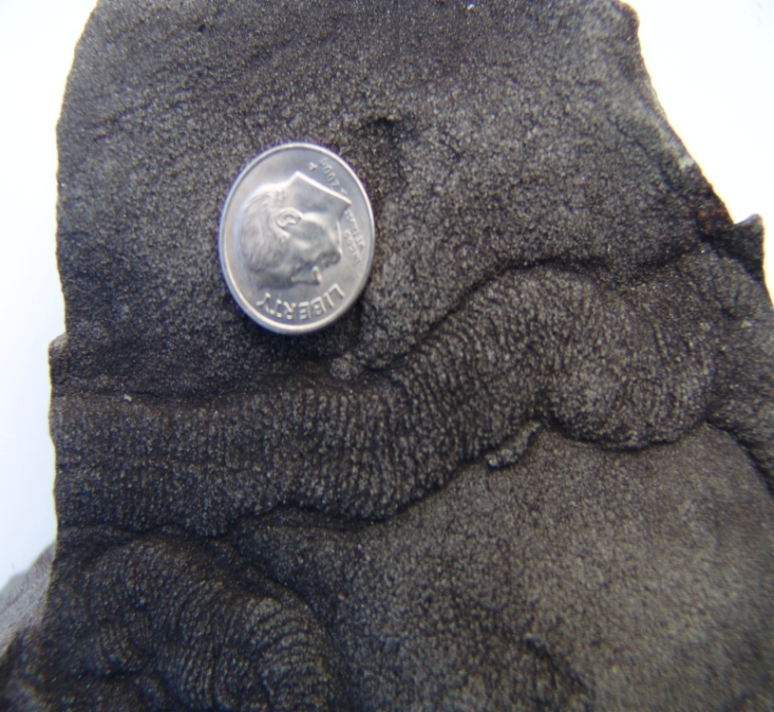
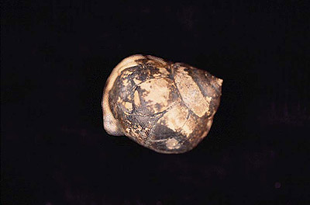
This is trace fossil of a trail left by an snail-like animal grazing for food in the mud. What animal am I?
Gastropod
Brachiopod
Previous
Next

Slide 15
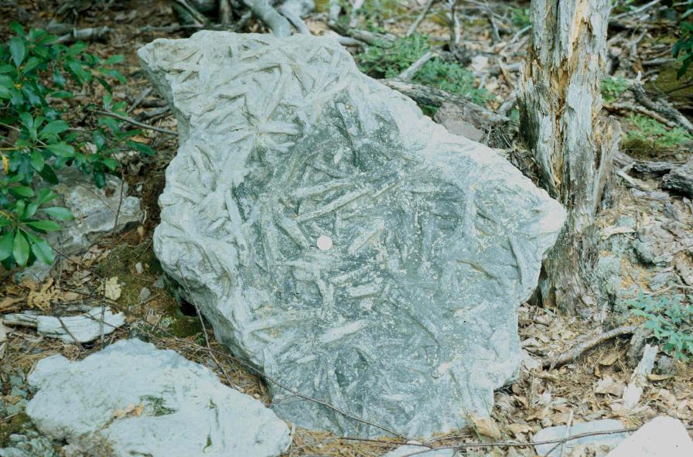
This 430 million year old trace fossil was preserved in a common Eastern West Virginia rock called the Tuscarora Sandstone. What animal was I?
Worm
Snake
Trilobite
For many years geologists thought I represented worm tubes. But, wouldn’t you expect worm burrows to be longer and more wiggly? Scientists now think these are feeding burrows created by trilobites digging around in the soft sand for food.
Previous
Next

Slide 16
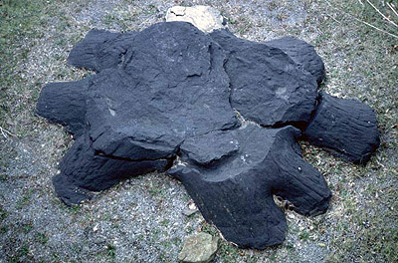
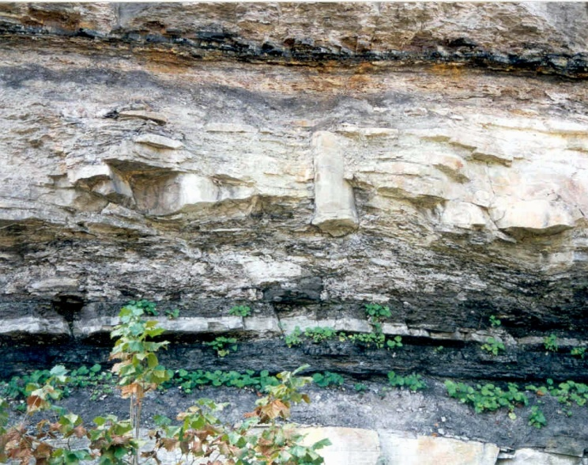
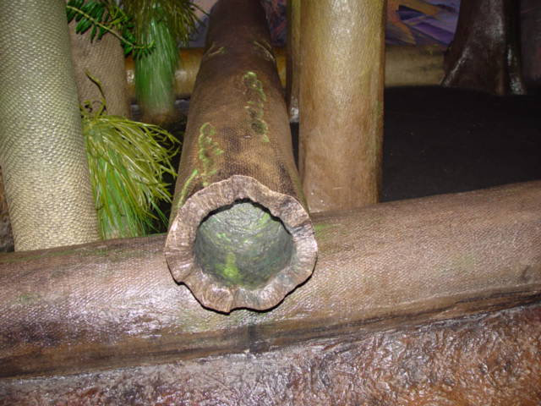
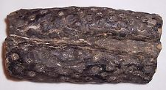
Plant Fossils
Plant fossils are very common in most of West Virginia. Most are approximately 300 million years old. On the far left is a fossilized tree stump recovered from an coal mine. It is now on display at the WVGES offices in Morgantown. The picture to its right shows a tree trunk preserved in an upright position in Southern West Virginia. Most of the trees back then had the shape of a straw—they had a tough bark but no internal wood. As a result a lot of trees, when they died, were easily crushed into a flat or oval shape. In some cases, sand and mud filled in the hollow trunk, preserving the more accurate three-dimensional shape shown by the common fossilized root in the bottom center picture.
Previous
Next

Slide 17
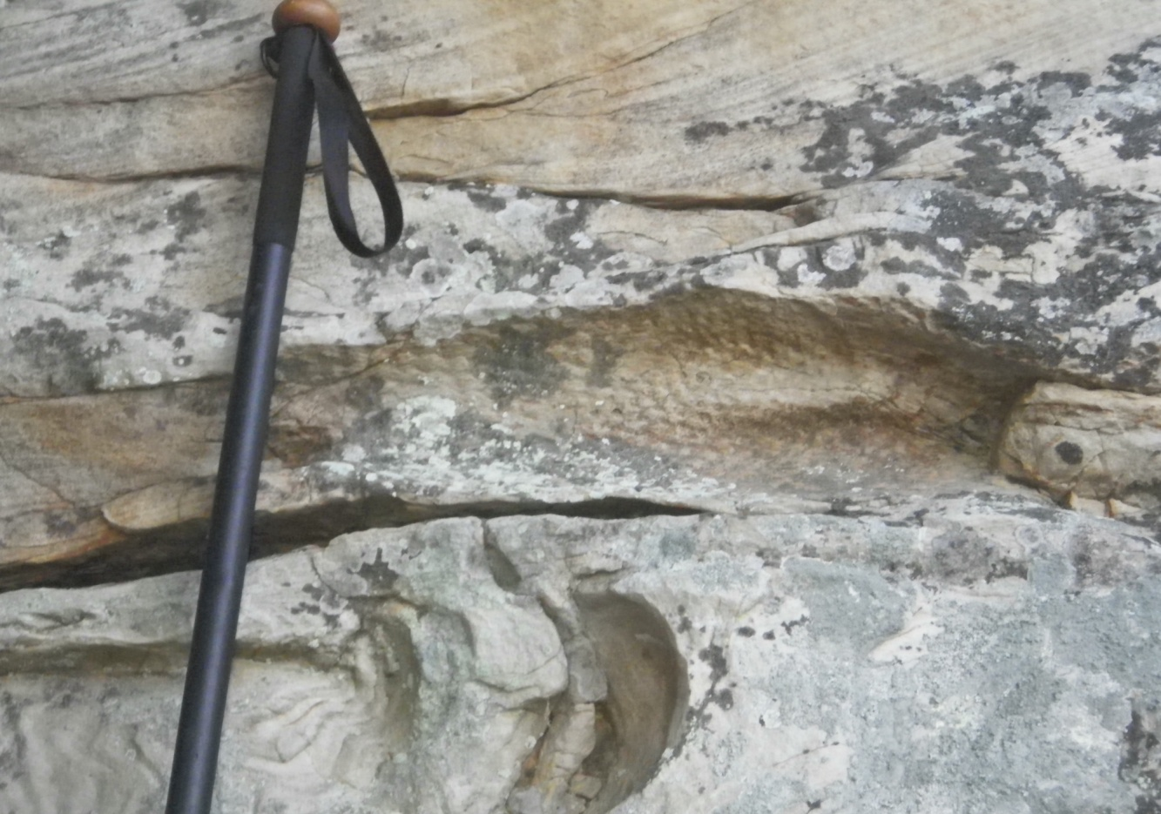
I am quite commonly found in West Virginia is those areas where there is coal. Am I a plant or an animal fossil?
Fossilized snake!
Fossilized tree root
Previous
Next

Slide 18
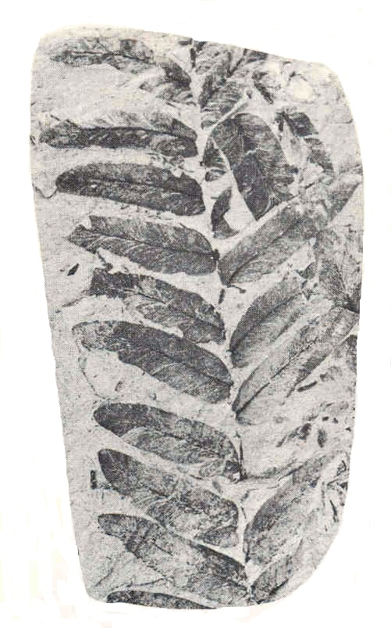
Which description best applies to this plant fossil?
(Hint: more than one may be correct)
Click the box to check yourself.
Each leaflet attached to the twig at a single point.
Each leaflet attached to twig along entire base.
Each leaflet has a prominent midvein.
Leaves are fused into a ring where they attach to the twig.
Click here to find more about this fossil.
Previous
Next

Slide 19
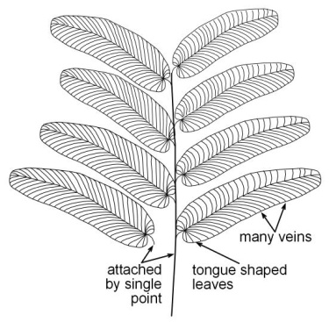
This plant fossil is called Neuropteris. Using your previous observations, which one of the three descriptions below would be most useful to identify Neuropteris
Click on text box to pick your answer.
(only one applies)
Leaflets are attached to twig at a single point. Each leaflet has a strong midvien. Each leaflet is tongue-shaped.
Leaflets are fused into a ring or whorl where they attach to the twig.
Leaflets are widely spaced. Leaflets attach by entire base. Each leaflet is tongue-shaped.
Neuropteris
Neuropteris
Previous

Slide 20
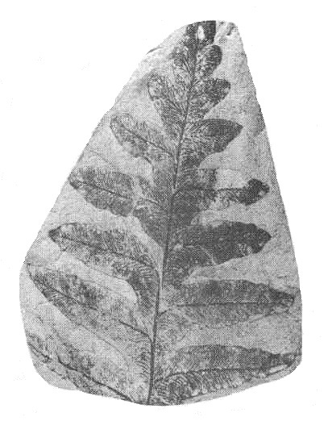
Look closely at the plant fossil below and choose which description fits best
(more than one may apply)
Click on box to check yourself.
Leaflets attached to twig across entire base.
Leaflets attach by a single point to stem.
Leaflets fused into a ring where they attach to the twig.
Tongue-shaped leaflets.
Click here to find more on this fossil
Previous
Next

Slide 21
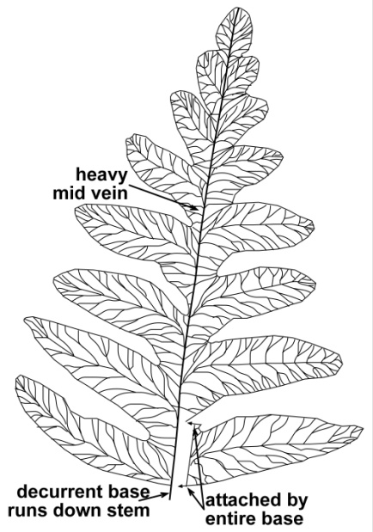
This plant fossil is called an Alethopteris. It is very common but differs from Nueropteris. Which description would allow to identify Alethopteris?
Click on a button below to pick your answer.
Leaves are fused into a ring where they attach to the twig.
Prominent midvein .
The leaflets attach to the twig across their entire base.
Alethopteris
Previous

Slide 22
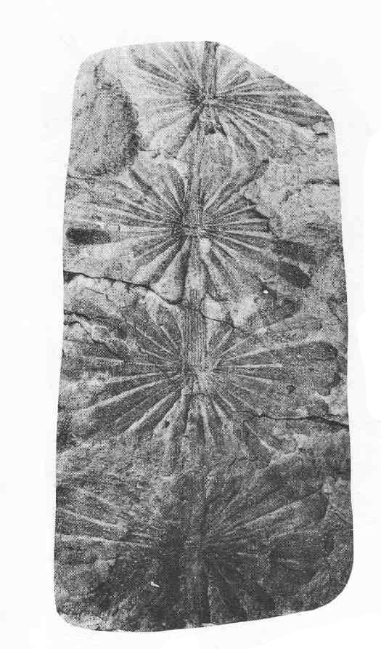
Observe the plant fossil below. Which description(s) work best?
(Hint: more than one may apply)
Click on box to check yourself.
Leaflets attach by a single point to stem.
Leaflets fused into whorl where they attach to stem.
Flowery looking compound leaf.
Prominent midvien on each leaflet.
Click here to find more on this fossil
Previous
Next

Slide 23
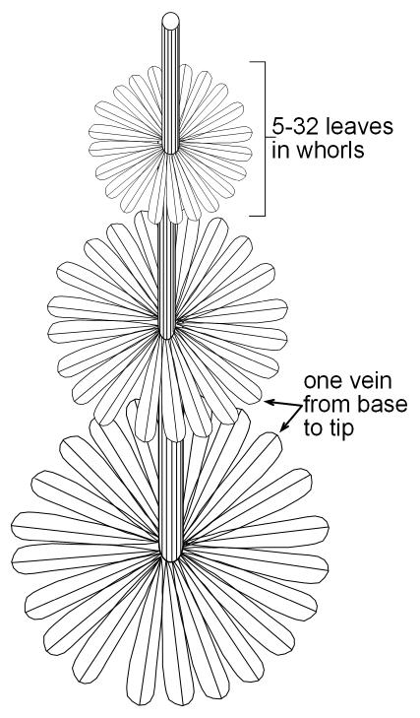
This is the plant fossil Annularia. Which description would help you identify this fossil if you found one?
Click on box to check yourself.
Leaflets are alternate and often of unequal length.
Roundish leaflets, roughly as wide as high, with a definite round tip.
Leaves are lance-shaped with one vein from base to tip and fused into a whorl where they are attached to the twig.
Annularia
Previous

Slide 24
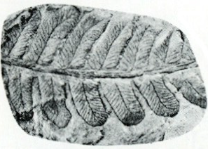
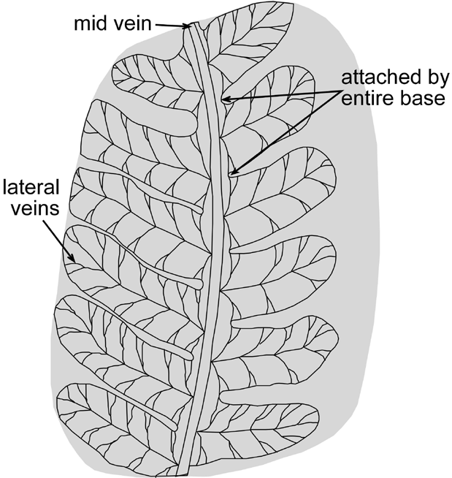
Using what you have learned so far, identify this plant fossil. Click on the PHOTO for the answer.
Very good if you said Alethopteris.
Actually, this is called Pecopteris but it shares the same attachment design as Alethopteris.
Previous

