Slide 1
Sedimentary Rocks

Slide 2
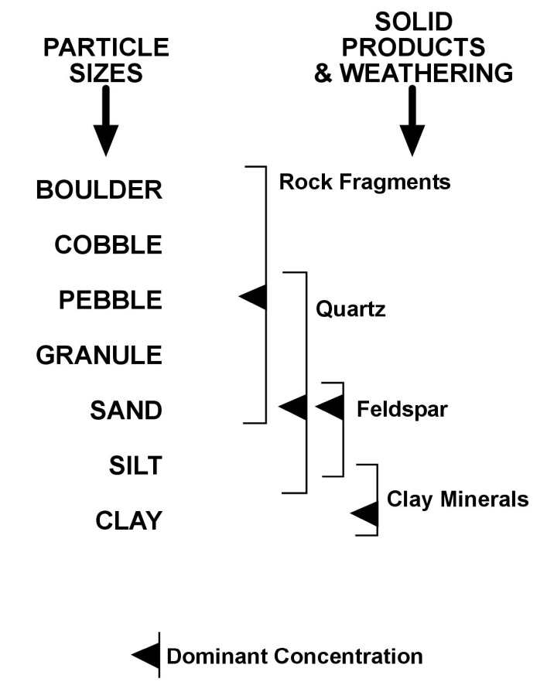
Although there is absolutely no compositional designation assigned to any of the various particle sizes, there is, nevertheless, some size segregation. The estimated range of sizes for each type of particle is indicated by the bracket with the average size indicated by the arrow head. Rock fragments, for example, usually range in size from sand to the largest of particle sizes with an average size being about pebble size. Most quartz grains, on the other hand, ranges in size from pebble to silt with an average size of sand. The only size that uses a mineral name is clay-size, most likely because clay minerals dominate the clay-sized particles.

Slide 3
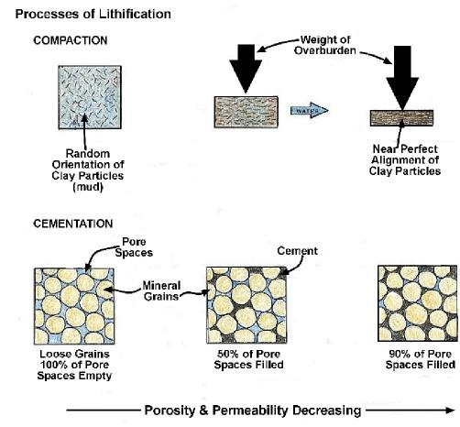
The major processes of lithification are compaction and cementation. Compaction is the primary method by which clay mineral-rich sediments such as shales are converted into rock. Initially, the clay minerals are dispersed in water in the form of mud within which the platey clay mineral particles are randomly oriented. Once buried and subjected to the weight of overlying sediments, the water begins to be squeezed out while, at the same time, the clay mineral platelets begin to orient themselves perpendicular to the vertical compressive force. Eventually, most of the water is driven out and the clay mineral platelets are aligned parallel to each other and compacted into a shale. The parallel alignment of the clay mineral platelets creates the thin layering characteristic of shales. Because the adhesion of the clay minerals to each other is not very strong, shales can be easily split parallel to bedding by physical weathering or with a chisel.
Cementation is involved in the lithification of most other sediments including loose quartz sands, precipitated calcite crystals and shell fragments. In cementation, minerals are precipitated from groundwater as it flows through the spaces between the particles of sediment, When a sufficient percentage of the spaces, or pores, are filled with cement, the loose sediments are converted into a rock. The most common cementing agents are quartz, calcite, and iron oxide.

Slide 4
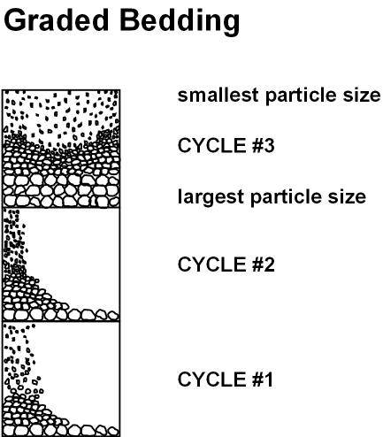
Graded bedding forms when sediments are deposited in a cyclic fashion beginning with the largest particle sizes and ending with the smallest after which the cycle is repeated. A good example are the sediments that accumulate in humid climate lakes. If we start our cycle in the Spring when the snow and ice is melting and the Spring rains have arrived, streams are flowing with their maximum discharge and load. As the streams enter the lake the largest particle sizes are deposited first. As the return to more normal discharges and loads, the maximum particle size being carried and deposited in the lake decreases. When we get to the Fall of the year when precipitation is commonly at a minimum, the stream discharge, load and maximum particle size being carried and deposited in the lake decreases even further. During the Winter when the stream may freeze over, the sediments settling to the bottom of the lake are the clay and silt sized particles held in suspension within the lake. Before the coming of Spring when all of the original suspended load has been deposited and before the repeat of the cycle, there may be no sediments accumulating within the lake. The sediments that accumulated during the one-year period is a graded bed. As time passes, the cycle is repeated, creating more graded beds. Graded beds are very important to the limnologists who study lakes and lake deposits because each graded bed represents one year in time. They call the individual graded beds varves or rhythmites .

Slide 5
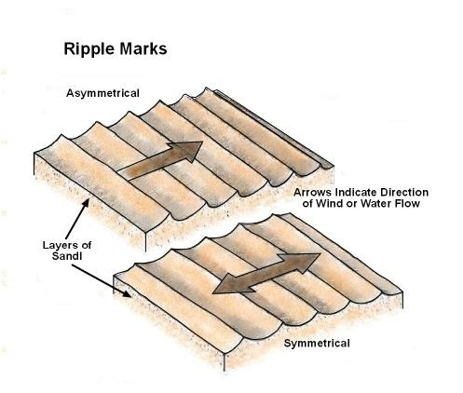
Ripple marks are sedimentary features that form on the surface of newly-deposited layers of sand-sized sediments, usually quartz sand. They are essentially small sand dunes. In the case where the current, be it water or wind, is transporting the sand in one direction, such as down stream, the ripples take on an asymmetric cross section with the steeper side sloping in the direction of current flow. Along the shallow waters at the edges of the ocean or large lakes where the sands are being subjected to the back and forth motion of the water within the shallow swash zone, the ripples are symmetrical in cross section.

Slide 6
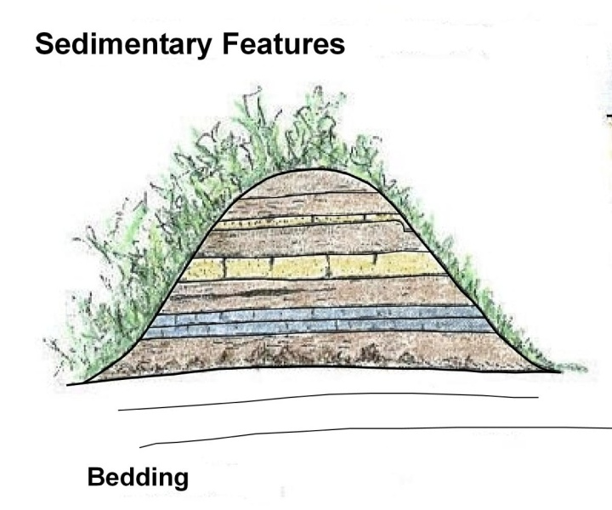
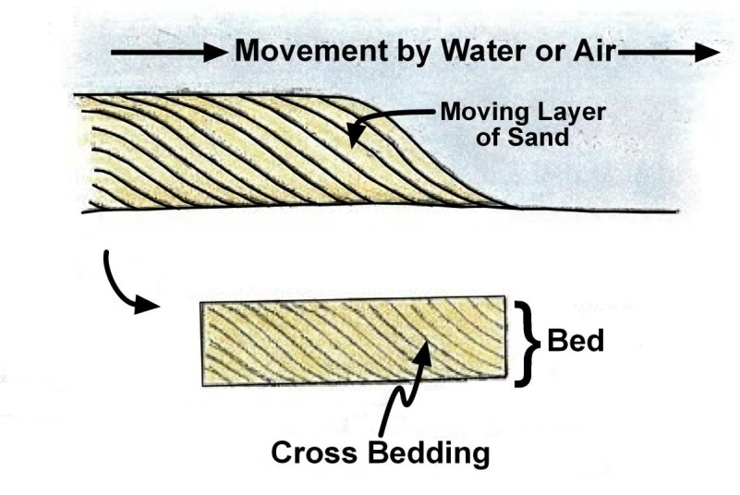
Click on illustration for more.
The most important single sedimentary feature is the bed. All sedimentary rocks are bedded.
A very common sedimentary feature is the inclined cross-bed. As particles are being transported by wind or water they begin to redistribute into a pattern where particles cascade forward forming a cross-bed. As the bed continues to be created in the direction of transport, additional cross-beds are formed. Because the cross-beds always slope, or dip, in the direction of transport, they are commonly used to determine the direction in which the transporting current, be it water or wind, was moving.

