Slide 1
Plate Tectonics

Slide 2
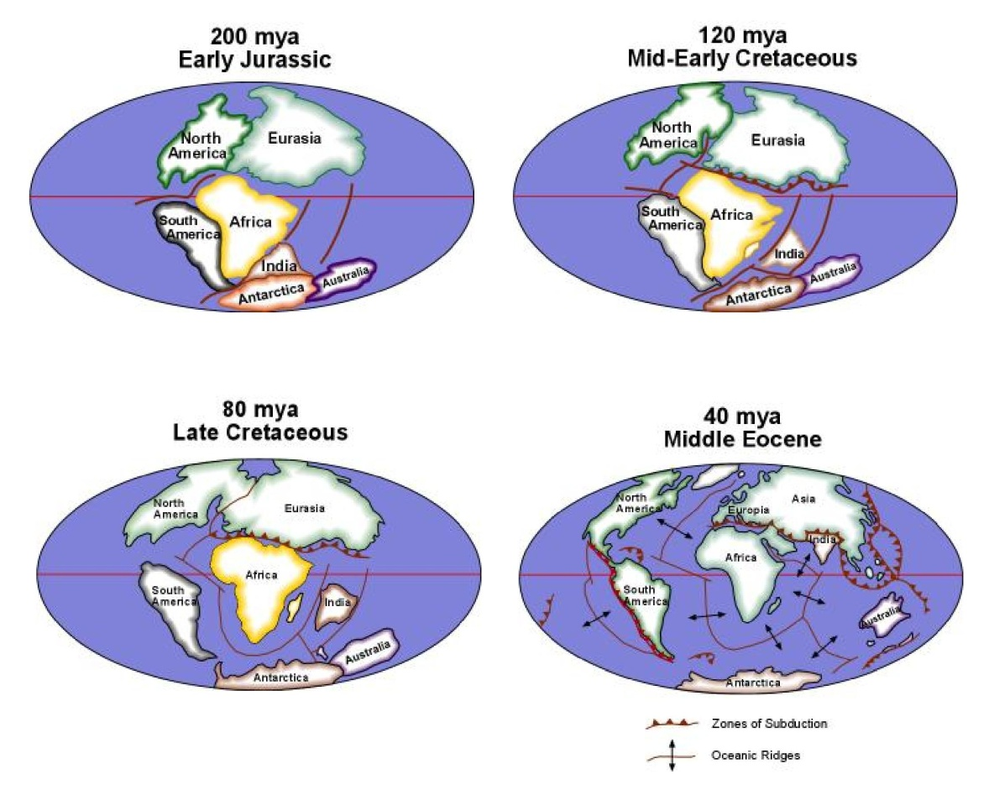
According to Alfred Wegener, the super-continent of Pangea began to break up 200 million years ago with the continents attaining the size, shape, and location where we see them today. This movement of continents has not yet come to an end. According to J. Tuzo Wilson, the breakup and drifting of the present continents is all part of a cycle referred to as the Wilson Cycle. According to Wilson, a complete cycle requires 500 million years; 250 million years after the breakup of a supercontinent during which time newly-formed continents drift apart while new oceans open. After 250 million years, the divergence of the continents reverses and the continents begin to converge as the newly-formed oceans begin to close. After another 250 million years, the continents collide to form a new super-continent At the present time, we are in an opening phase that will continue for another 50 million years. While the Atlantic Ocean is still opening at a rate equal to that at which your finger nails grow, the eastern portion of the Indian Ocean has already begun to close as indicated by the formation of a zone of subduction between Australia and Asia. The Arctic Ocean seems to have reached its maximum size.

Slide 3
With a few exceptions, most tectonic plates are bounded on one side by an oceanic ridge where new oceanic lithosphere is being created and on the other side by a zone of subduction where old oceanic lithosphere is being consumed. Driven by heat-driven convection cells within the asthenosphere, the plates move from the oceanic ridge to the zone of subduction. The upper portion of the lithosphere is Earth’s crust which consists of basaltic oceanic crust and granitic continental crust. The continents are, therefore, being carried along as a passive passenger on the moving lithosphere much like travelers are carried along by the moving sidewalks in modern airports. The continents themselves are not moving as was thought by early workers such as Wegener. As a result, there is no such thing as “continental drift.” Eventually, the oceanic lithosphere between converging continents will be consumed by the zone of subduction and the converging continents will collide, creating a new mountain range and a new, larger continent. Today, Africa is converging on Europe as the Mediterranean Sea closes and Australia has begun to converge on Asia along a zone of subduction just south of Indonesia.

Slide 4
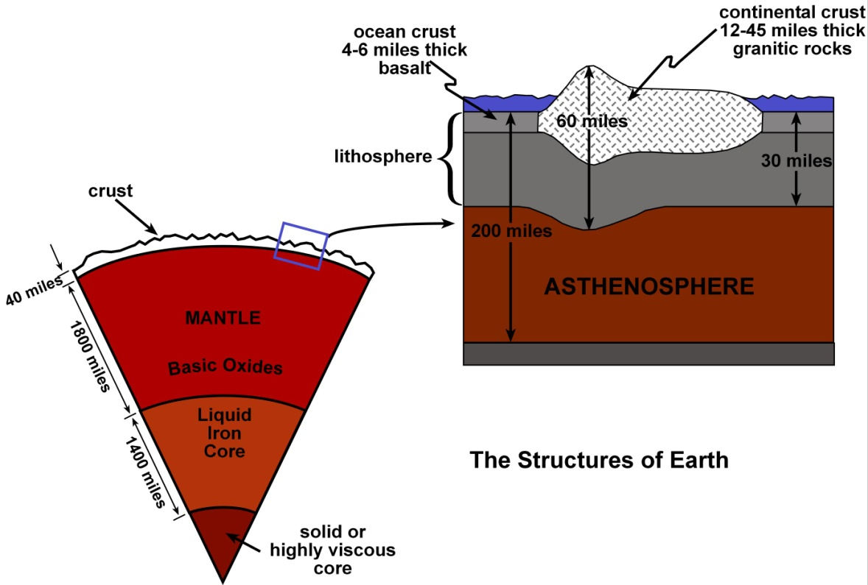
Earth consists of a molten iron core that may have either a solid center or one consisting of highly viscous molten iron. The portion of Earth that represents the largest volume is the mantle that overlies the core. The upper portion of the mantle is made of an iron-rich rock called peridotite while the bottom of the mantle is thought to consist of the oxides of the major cations making up peridotite. The outer portion of Earth is appropriately called the crust and consists of the basaltic oceanic crust and the granitic continental crust. An enlargement of the outer portion of Earth shows that the combined oceanic and continental crust and the outermost portion of the mantle for a brittle layer called the lithosphere. Below the lithosphere within the upper portion of the mantle is a plastic layer of rock called the asthenosphere. According to the theory of plate tectonics, the plates are driven by convection cells located within the plastic asthenosphere.

Slide 5
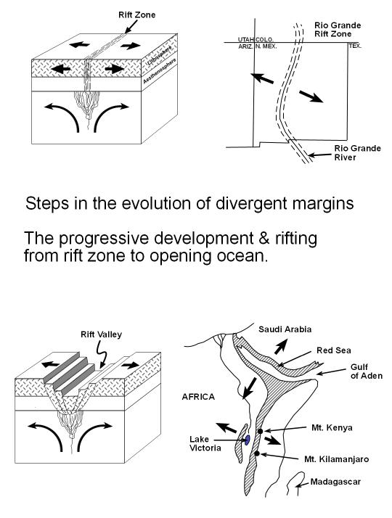
The breakup of continents begins as the rising portion of a asthenospheric convection encounters the bottom of the lithosphere and creates tensional forces within the overlying lithosphere. The tensional forces create fractures in the lithosphere that appear on the surface as a linear zone called a rift zone. Basaltic magma soon begins to form at the top of the asthenosphere as peridotite rocks begin to melt by the pressure-drop mechanism. As the low viscosity basaltic magma makes its way to the surface, it encounters groundwater which comes to the surface as a combination of hot springs and fumaroles. In time, basaltic magma erupts to form lava flows and small cinder cones. One such rift zone, called the Rio Grand Rift, extends from Mexico, northward through New Mexico and into central Colorado
As the rifting continues, rocks within the rift zone begin to collapse along normal faults, creating a rift valley, the best example being the East African Rift. In time, one end of the rift valley will reach the ocean and begin to be flooded by seawater. The northern end of the East African rift is already beginning to fill with salt lakes as waters seep up into the rift along fractures leading to the Red Sea. Eventually, the rift valley will completely flood and form a linear ocean, an example being the Red Sea. An oceanic ridge is already beginning to form along the bottom of the Red Sea. Eventually, rifting will finally break through the land-locked end of the linear ocean, creating an opening ocean with an oceanic ridge such as the Atlantic, Indian, and Arctic oceans.

Slide 6
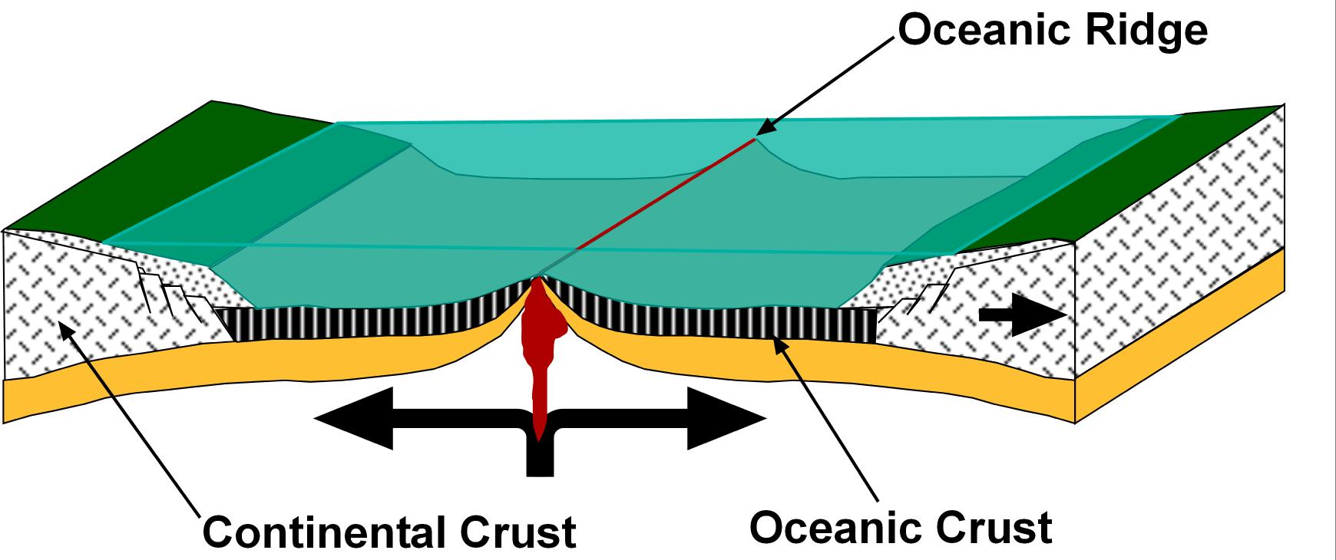
Typically, an opening ocean is bordered by two continents which are moving away from each, or diverging, as new oceanic lithosphere is being created along the oceanic ridge consisting of an upper layer of basaltic lava and a lower portion of gabbroic rock.

Slide 7
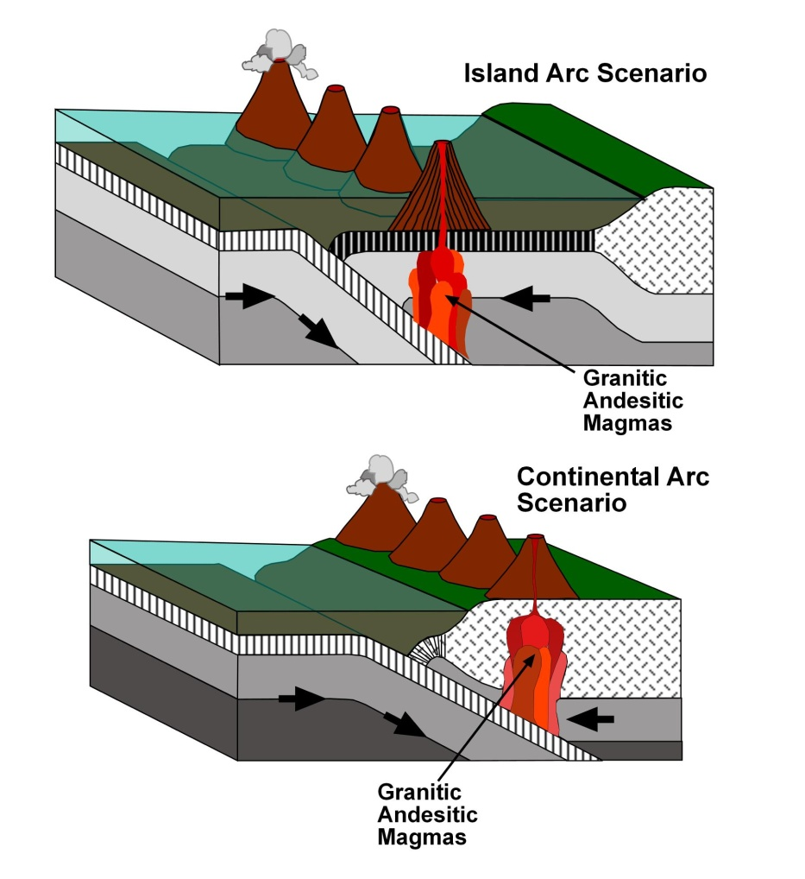
For each oceanic ridge where new oceanic crust is being created, there exists a zone of subduction where old oceanic lithosphere is being consumed in order to maintain a constant volume of oceanic lithosphere. Zones of subduction for over the down-going portion of the asthenospheric convection cells and occur in two different scenarios. In the first, the oceanic lithosphere breaks under compressive forces as the oceanic portion of the lithosphere converges on the continental portion. In some cases, the break occurs just offshore. As the oceanic lithosphere subducts, it is consumed within the mantle, creating granitic and andesitic magmas. Basaltic magmas are also created but in much smaller volumes. The highly viscous granitic magmas rise and are emplaced into the edge of the overlying continent where they eventually cool and solidify to form batholiths. The less viscous andesitic magmas rise to the surface where they erupt to form a chain of strato- or composite volcanoes along the edge of the continent referred to as continental arc volcanoes. The Andes mountains of South America or the Cascade Mountains of our Pacific northwest would be excellent examples. In the second scenario, the zone of subduction forms a hundred or more miles offshore. All else is the same except for the fact that the strato- or composite volcanoes rise from the ocean bottom and form a chain of volcanic islands that parallel the margin of the continent. An example would be the Aleutian Islands that span across the northern portion of the Pacific Ocean from Alaska to Siberia. The island arc mountain chains then continue down the western margin of the Pacific Ocean basin as the Japanese and Philippine islands.

Slide 8
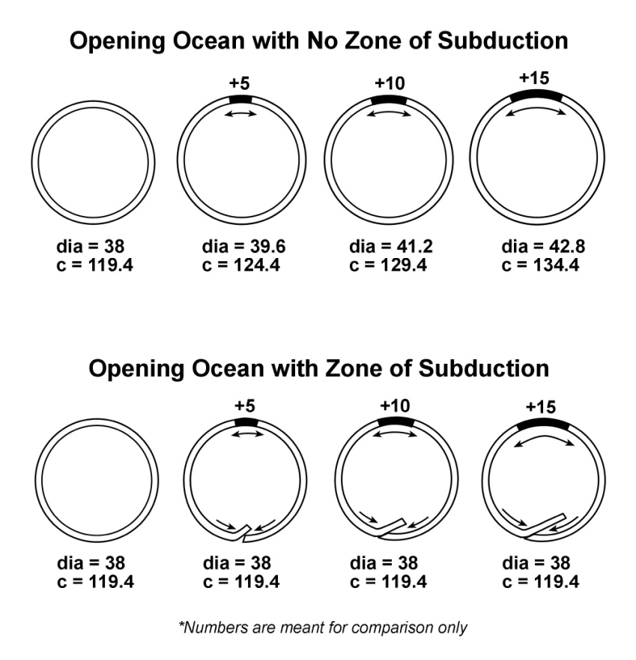
The upper set of drawings are meant to demonstrate that Earth’s diameter would constantly increase if the new oceanic lithosphere being created at the oceanic ridges was not offset by the consumption of older oceanic lithosphere at zones of subduction. The bottom series of drawings show that by balancing the amount of newly-formed oceanic lithosphere with the amount of older oceanic lithosphere at the zones of subduction, Earth’s diameter remains unaffected.

Slide 9
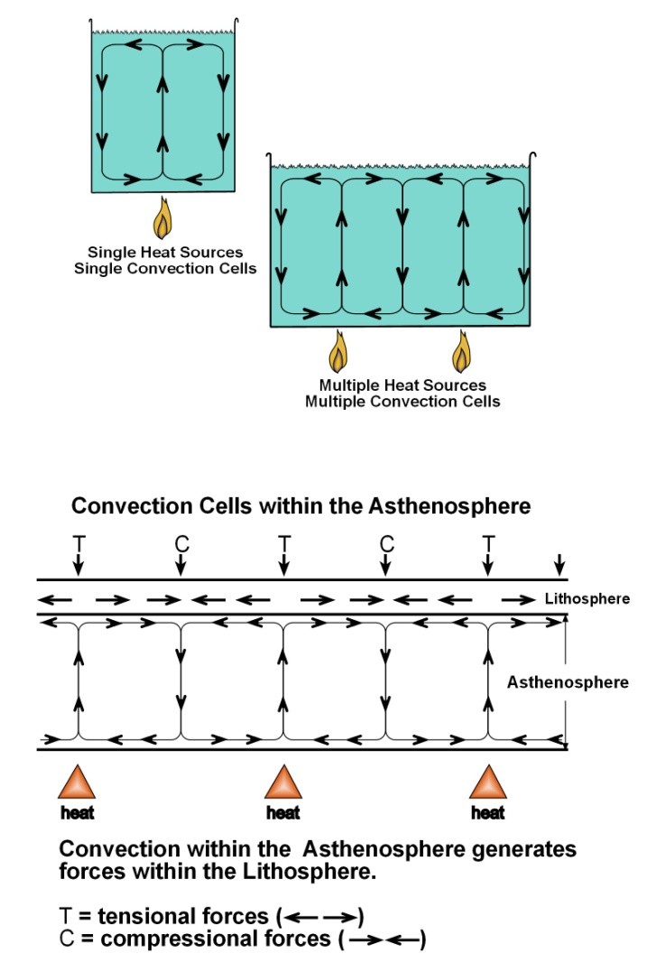
The two upper drawings are simply to demonstrate how heat-driven convection cells are created. As the water is heated and decreases in density it rises. At the top of the convection cell, the water begins to cool, increases in density and begins to sink back to the bottom of the pot, completing the convection cell, and is reheated. The upper left hand drawing shows a single convection cell formed by placing a pot of water over a single source of heat. The upper right hand drawing demonstrates the formation of two convection cells when an elongated pot such as a fish poacher is placed over two sources of heat. In both cases, the rising portion of the convection cell overlies the heat source. The point being that the number of convection cells created is simply determined by the number of heat sources.
The bottom drawing shows the lithosphere overlying the plastic asthenosphere below which are three sources of heat from within Earth. You could have as many heat sources as you like. The rising portion of a convection cell forms over each of the heat sources. As the plastic rocks of the asthenosphere reach the bottom of the lithosphere and spread out in opposite directions, frictional drag between the lithospheric and asthenospheric rocks create tensional forces in the overlying lithosphere. Where the moving asthenospheric rocks converge and cool, they form the down-going portion of the convection cell and subject the overlying lithosphere to compressive forces. It is important to note that the tensional and compressive zones alternate.

Slide 10
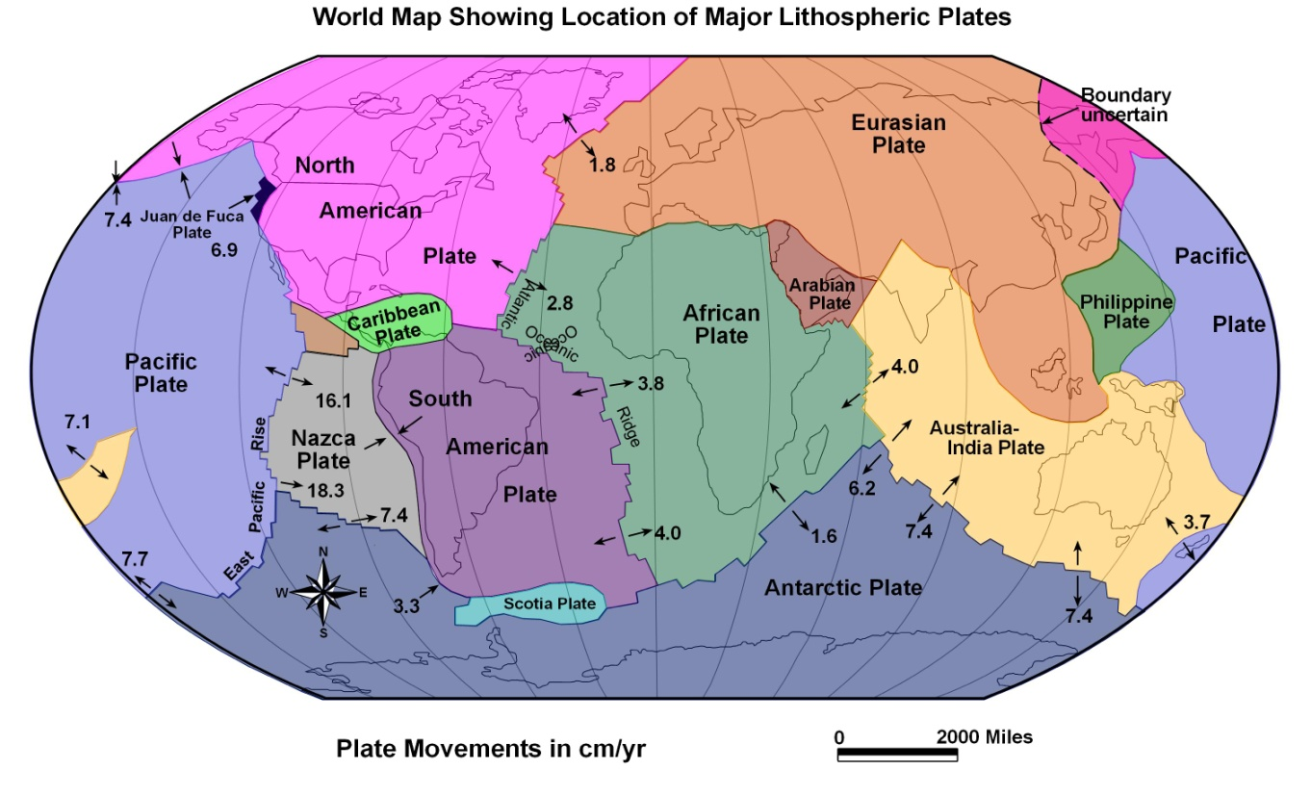
As a result of the creation of oceanic ridges and zones of subduction, the Earth’s lithosphere is broken into pieces called plates. Only about a dozen plates exist, ranging from huge plates such as the Eurasian Plate to the Juan de Fuca Plate off our northwest coast which is too small to even see on a map of this scale. Oceanic ridges are shown as frequently offset solid lines while the zones of subduction are shown with teeth. Also, we have indicated the rate at which the plates are moving away from the oceanic ridges in centimeters per year. Using the arrows will help differentiate rift zones from subduction zones.

Slide 11
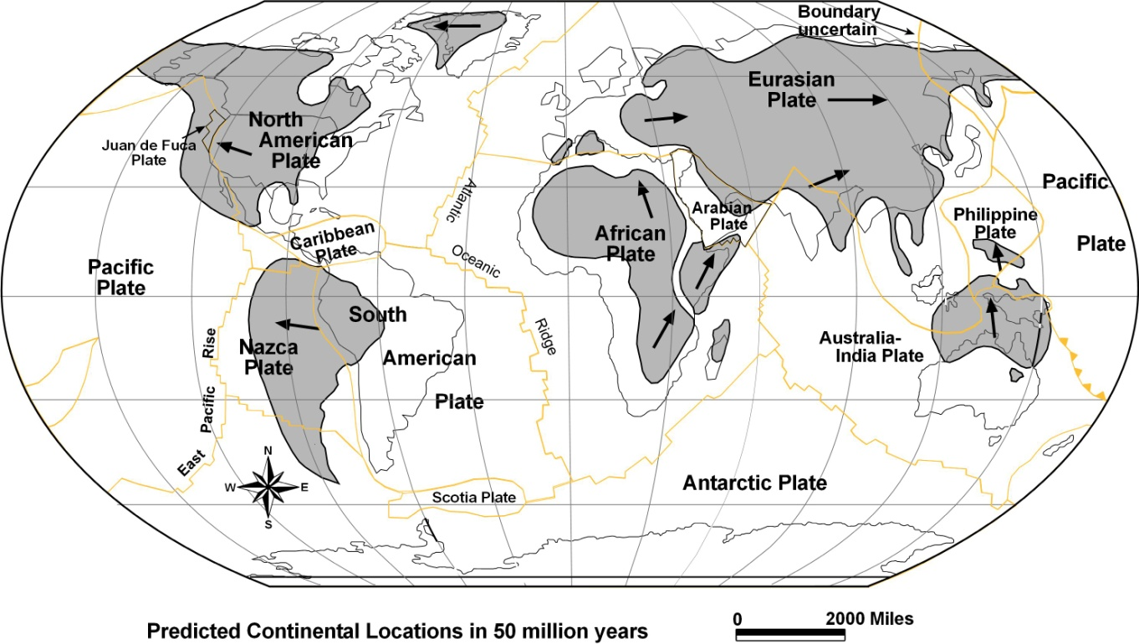
This map outlines the present location of the continents and their projected locations in 50 million years based on their present rates of movement. The purpose of the map was to answer the oft-asked question: “Will the Pacific Ocean ever close?” According to the Wilson Cycle , the present direction of the continents will reverse in 50 million years and they will begin to converge in preparation for the formation of the next super continent. By the time the reversal takes place, the Americas will not even move as far west as the Hawaiian Islands. Thus, a best we can tell, the Pacific Ocean will never close. The Pacific is the remains of the single great ocean that surrounded Pangea and in another 300 million years, it will once again become the single great ocean that will surround the new super-continent.

Slide 12
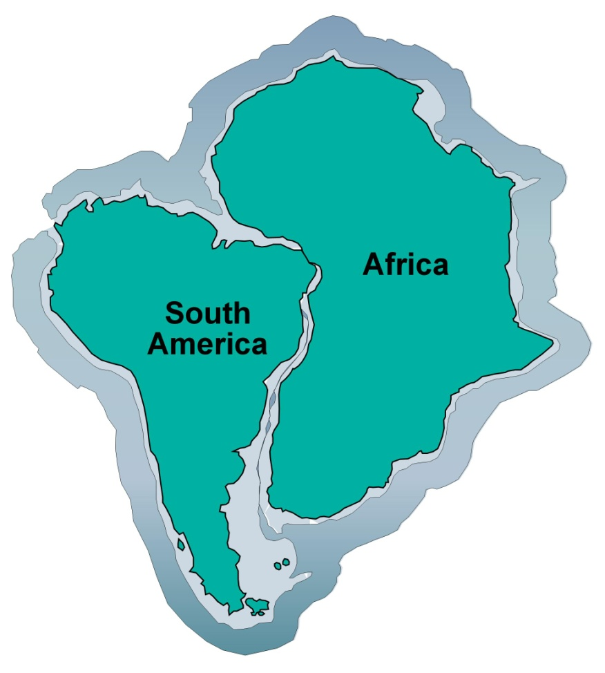
It was the similarity in the coastlines of Africa and South America that led Wegener, and others before him, to consider the two continents were once joined and that the South Atlantic Ocean was created as they broke and drifted apart.

Slide 13
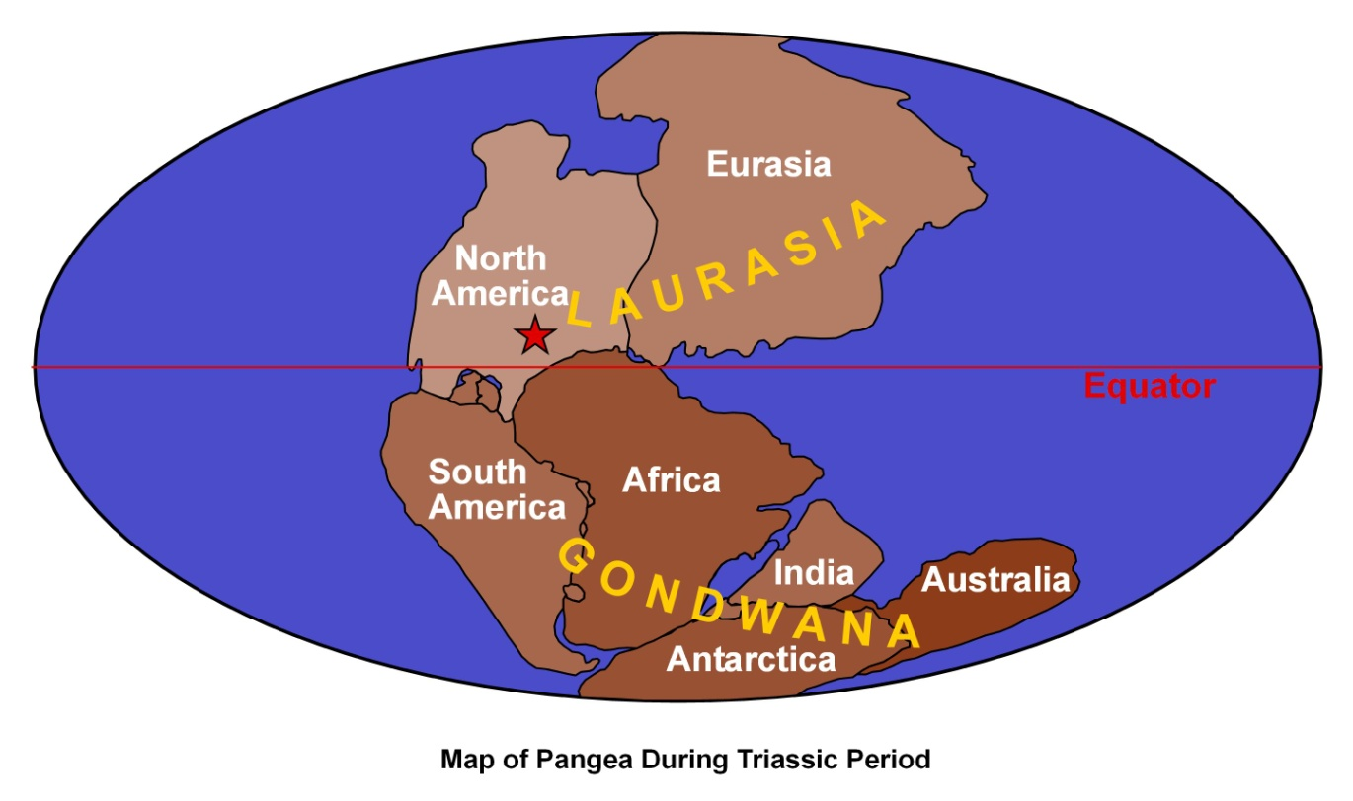
Convinced that Africa and South America were once joined, Wegener moved and placed all of the continents into one super-continent he called Pangea. In defense of his theory, he presented evidence that would have been accepted today. However, a half century would pass before he was proven to be correct. Unfortunately, Wegener never lived long enough to see his ideas accepted, ideas that changed entirely how we now view the dynamic Earth.

Slide 14
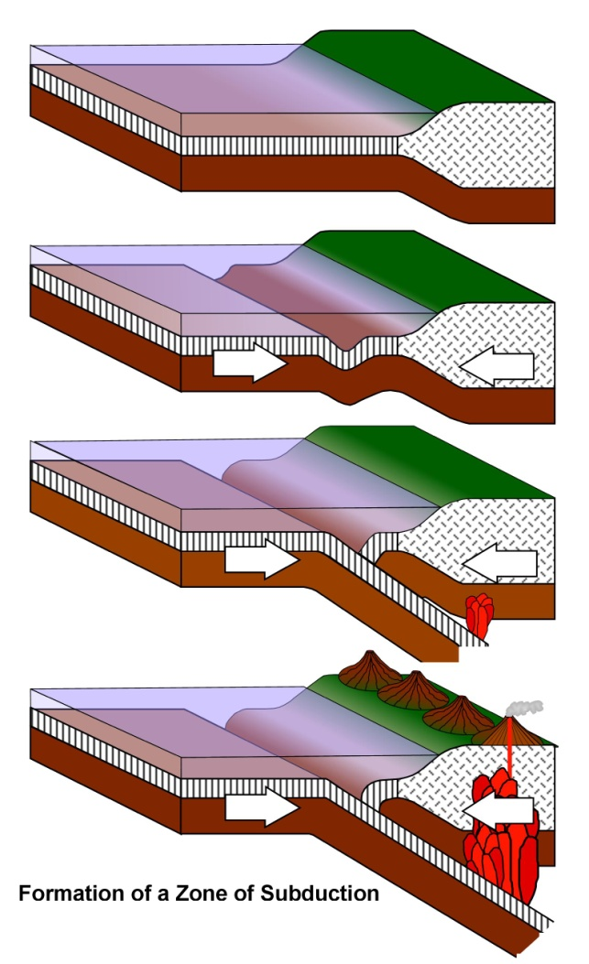
Zones of subduction are initiated when Earth’s lithosphere is subjected to compressive forces generated by an underlying down-going portion of an asthenospheric convection cell. The first response to the compressive forces is the downwarping of the oceanic lithosphere forming a long trough called a deep sea trench paralleling a continental margin. With continued compression, the brittle lithosphere breaks, driving the old oceanic lithosphere down below the continental crust. Another often asked question is whether the continental lithosphere could be subducted below the oceanic lithosphere. The answer is not likely because of the difference in densities. The higher-density oceanic lithosphere (density about 3) is just different enough that it can subduct below the lower-density continental lithosphere (density about 2.9). Low density materials will not subduct below higher density materials.

