Slide 1
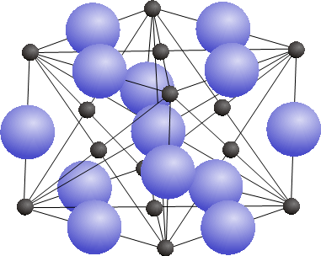
Minerals

Slide 2
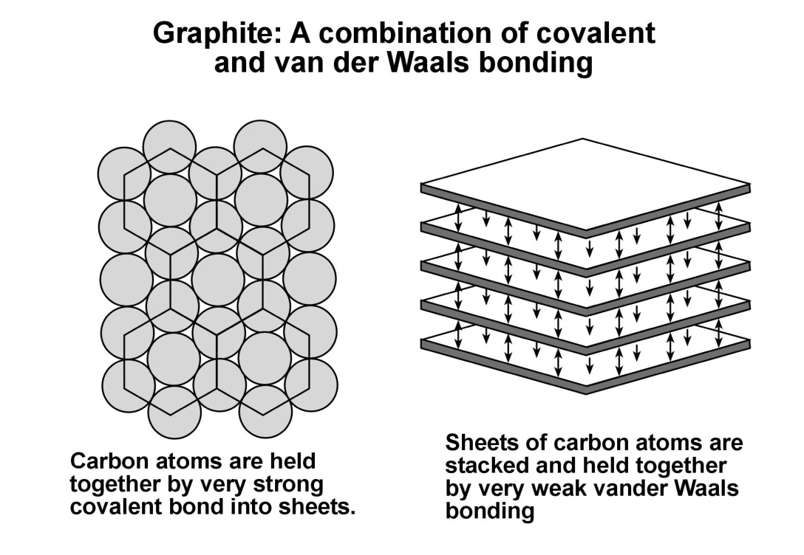
In the mineral graphite, the carbon atoms are arranged in sheets where the atoms are joined together in a hexagonal pattern and held together by the strongest of all chemical bonds, the covalent bond. The sheets are then stacked and held together by the weakest of chemical bonds, the van der Waals bond. The van der Waals bonds are so weak that they can be easily broken by the slightest pressure between two fingers, resulting in the sheets sliding over each other. This property is responsible for the softness of graphite and the greasy feeling one experiences when rubbing graphite between ones fingers.

Slide 3
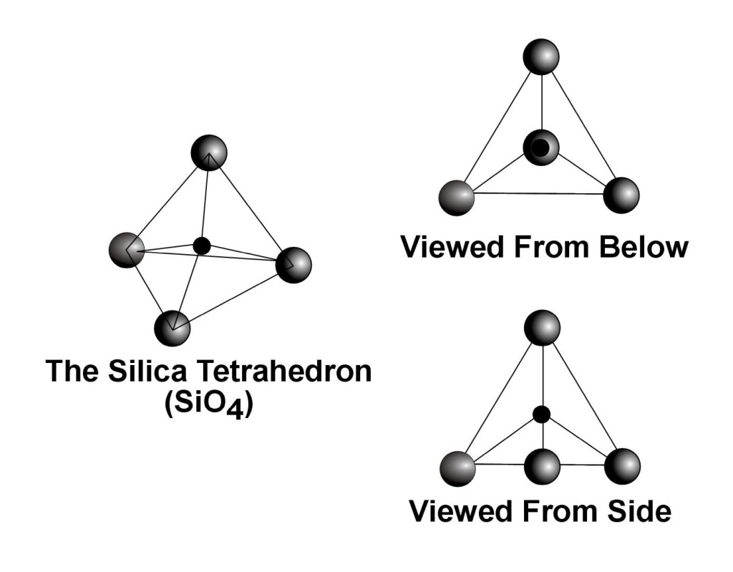
The most important rock forming minerals are the silicate minerals. The structures of all silicate minerals are build around the silicate anion, SiO₄⁴⁻. X-ray studies have shown that the silicate anion exists in the form of a tetrahedron, a four-sided figure where each side is an equilateral triangle. The silicon ion with a 4+ charge (Si⁴⁺) is located at the center of the tetrahedron and the four oxygen ions, each with a 2- charge (O²⁻) are located at the four corners. Of the two negative charges possessed by each oxygen ion, one charge is taken to counter-balance the 4+ charge of the silicon ion, leaving one negative charge at each of the four corners of the tetrahedron and resulting in the 4- charge on the ion.

Slide 4
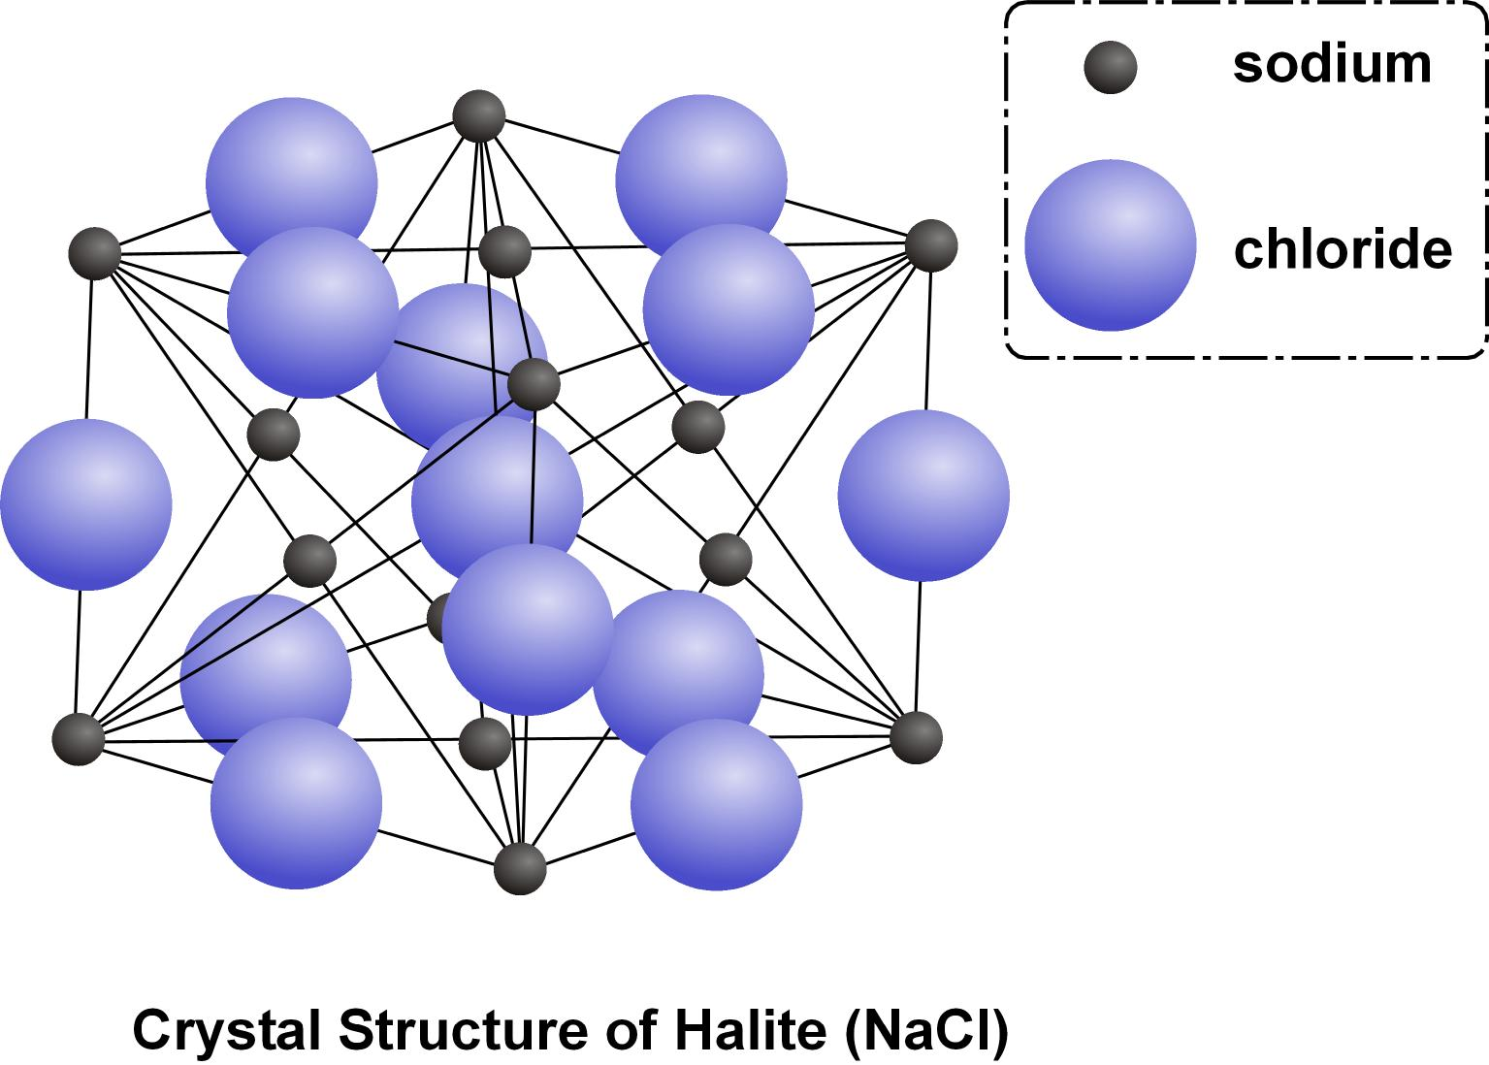
All minerals have a diagnostic crystal structure. The mineral halite, NaCl, is common table salt. In halite the ions are located within what is called a face-centered cubic lattice where the sodium ions occupy the corners and the center of each cube face while the chloride ions are located midway along each edge and in the center of the cube. The ions are held together by ionic bonds. The relatively weak nature of ionic bonds is responsible for the high degree of water solubility of halite.

