Slide 1
ENERGY

Slide 2
Hydrogen Fuel Cell
The hydrogen fuel cell was actually invented in 1836 but was not put to use until they were used during the Apollo Moon Project of the 1960’s. The cell consists of an anode infused with a catalyst that strips electrons from hydrogen atoms to create hydrogen ions and electrons and a cathode infused with a catalyst that allows oxygen to combine with hydrogen ions and electrons to form water. Between the two electrodes is a film that only allows the passage of positive ions. In operation, hydrogen gas is introduced to the anode. The electrons are stripped from the hydrogen atoms forming hydrogen ions that pass through the membrane to the cathode. Because of their negative charge, the electrons cannot pass through the membrane and must pass through a wire connecting the anode and cathode, initiating a flow of electrons, or electricity. Oxygen gas is introduced to the cathode where the catalyst drives a reaction where the oxygen atoms, hydrogen ions and the electrons combine to form water. In summary, the fuel is hydrogen gas and the end products are electricity and water. There are no pollutants. While a single cell provides a limited amount of electricity a number of linked cells provided more power. There is no limit as to how large the combined array can be.

Slide 3
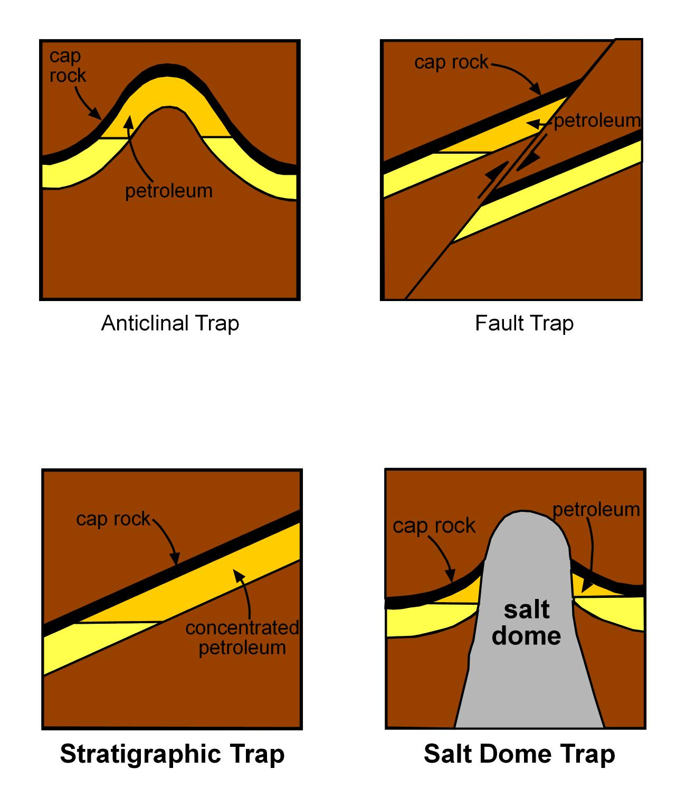
Petroleum Traps
Oil and natural gas is produced from the degradation of marine plants. Only when the free oil and gas becomes trapped within a confined geologic reservoir (yellow) does it become a valuable natural resource that can be tapped. Historically, the best reservoirs have been porous and permeable sandstones and limestones. More recently, the potential of gas reservoirs within shale units is being explored. However, within even a good reservoir, the actual amount of petroleum is quite low and most of the fluid within the reservoir is water (light yellow). Geologic structures called traps serve as natural concentration points for oil, gas, and water. The drawings show four different kinds of traps. While different, they all accomplish the same task because petroleum is lower in density than water, hence the petroleum products rise and float above the water surface within the trap. These geologic features are called traps (darker yellow) because the cap rock (usually shale) at the top of the trap possess a porosity and permeability low enough to prevent the petroleum from escaping. In essence, fluids move in to the trap but can not escape. The geologist’s job is to find the subsurface traps. The first trap that was suggested was the anticlinal trap and was the idea of Dr. I.C. White who was not only the first director of the West Virginia Geological and Economic Survey but was also the first Chair of the Department of Geology at WVU.

Slide 4
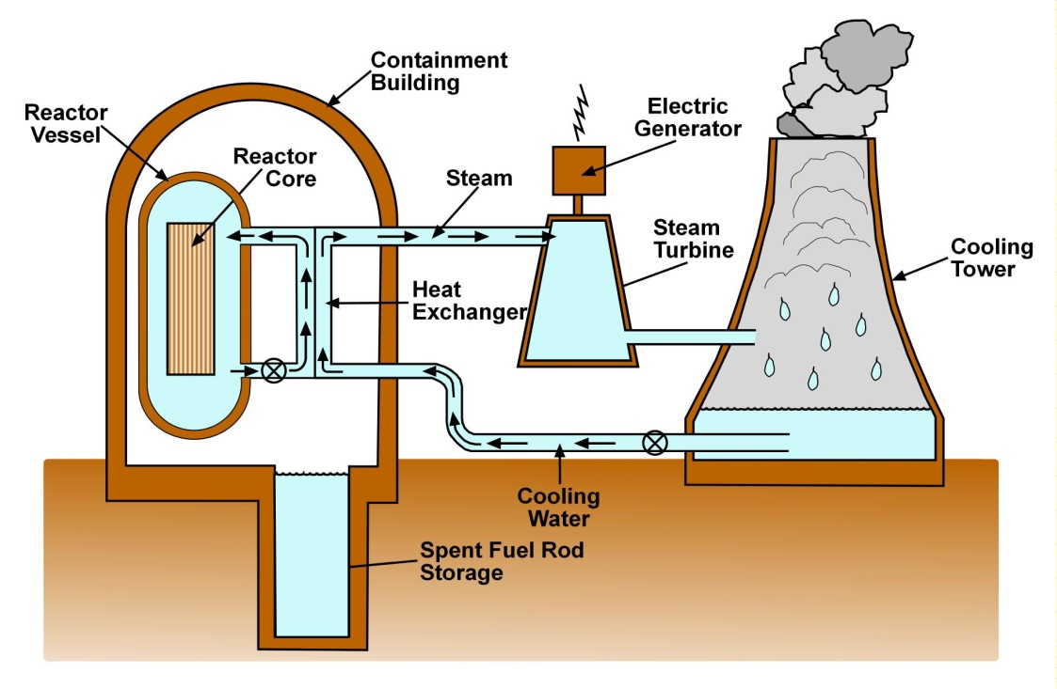
Water-Cooled Fission Reactor
This illustration depicts one of the simplest reactors. Our example is powered by uranium 235. Normally, the rate at which U²³⁵ breaks down is very slow. In other words it is not very radioactive. However, when a certain critical mass of U²³⁵ is achieved, a chain reaction is initiated whereby the rate of breakdown is greatly increased creating lead 207, cesium 137 and strontium 90, plus lots of heat. During the initial processing stage, the uranium is pressed into pellets about the size of the end of your finger and placed into metal tubes called fuel rods. Clusters of these rods form the core. Each rods is separated from its neighbor by control rods which, when inserted fully bring the chain reaction to a stop by essentially reducing the individual masses of U²³⁵ to less than the critical mass. Heat, the most valuable asset of the plant, is removed by passing water through the core under high pressure to allow the water to be heated far above its normal boiling point. The extremely hot water is brought outside the reactor to a heat exchanger where it heats water into steam to turn turbines that will generate electricity. At no time do the two streams of water physically interact. Some of the used steam escapes into the atmosphere through a large cooling tower. Some of the steam condenses back to liquid form in the cooling tower and is recycled back through the heat exchanger. Over time the ability of the U²³⁵ in the fuel rods begins to diminish. Spent rods are removed and stored temporarily in the storage pool within the reactor containment building.

Slide 5
Tidal Power Generation
Tides have been tapped as a source of energy by placing a dam across an estuary. The structure is equipped movable doors to control the tidal movement of the water. At maximum high tide, the doors are closed creating a dammed water pool. In order for the water to recede back to low tide it must flow through a turbine located in the base of the doors. This turbine generates electricity. To our knowledge, only two commercial tidal power stations exist at the present time. The oldest is a 250 MW (mega watt) station at the mouth of the Rance River in France where it flows into the Atlantic and the other a 100 MW station on the Bay of Fundy in Nova Scotia. In comparison, the average coal-burning power plant is a 1,000 MW station. Present research into tapping tidal energy involves water powered turbine blades. As opposed to wind powered turbines, these blades are driven by the water currents just outside the estuary entrance. In this scenario energy can be produced by currents going both into and out of the estuary and there is no need for a dam.

Slide 6
Dry Hot Rocks Geothermal Power Plant
This is a government-funded project that began back in the 1980s following the OPEC oil embargo on the 1970’s. The process is very simple. First, find magmas that are close enough to the surface such that the layers of dry hot rocks surrounding the magma can be reached with existing drilling technology. Next, drill two holes into the layer of dry hot rocks only. Do not hit the magma chamber! Next, fracture the rock mass between the two wells to increase its porosity and permeability. Next, pump water through the fractured hot rock. Water goes in one side and steam, produced by the heat of the nearby magma chamber comes out the second hole. A turbine on the of the second hole generates electricity. To date two experimental power stations have been built.

