Slide 1
COASTLINES

Slide 2
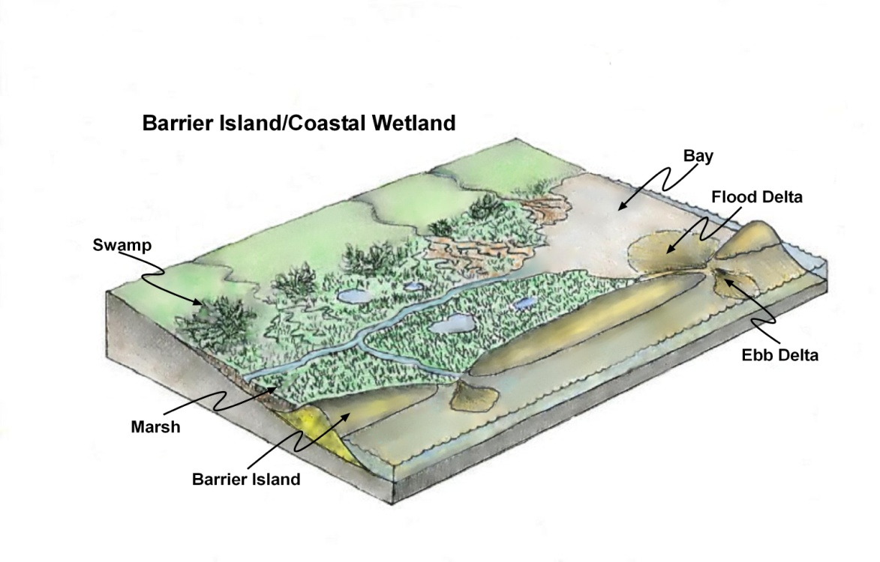
Barrier Islands
Two of the most important features along the coastlines of opening oceans are wetlands and barrier islands. The barrier islands are sand islands that were created following the last Ice Age as water was removed from the oceans to create the icecaps that covered most of the Northern Hemisphere. As sea level dropped the shoreline retreated spreading a layer of sand over the surface of the continental shelf. When the ice melted rising sea level produced an advancing shoreline that transgressed the previously deposited layer of sand. Waves, particularly during storms, heaped the sand into ridges that eventually built above sea level creating barrier islands. Initially, barrier islands were separated from the land by a lagoon. Over time, the lagoon eventually filled with sediment derived from the land and sand brought in through tidal inlets. As the lagoons in-filled, wetlands were created and eventually occupied by the bottom units of the marine food web. Barrier islands are temporary constructs constantly moving landward.

Slide 3
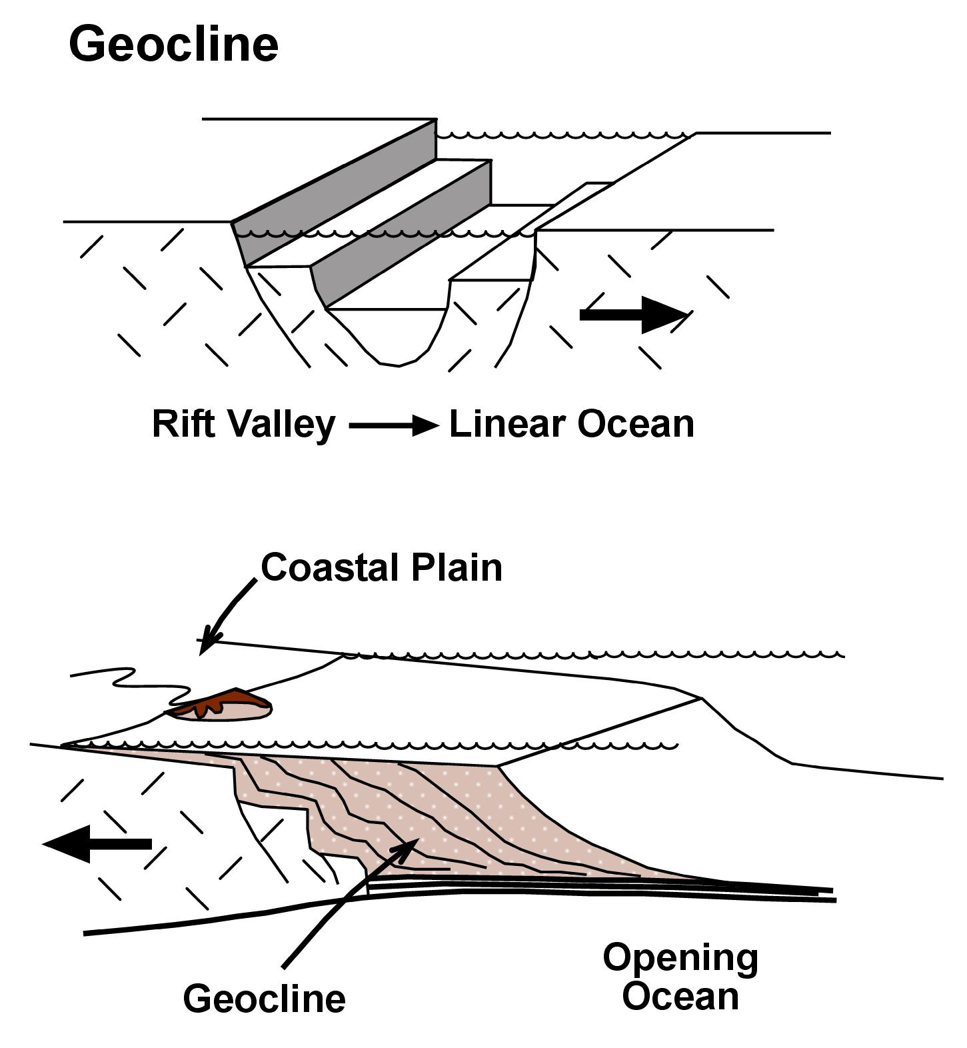
Clastic Wedge (Geocline)
The creation of a new ocean begins with the rifting of a continent by tensional forces created over the rising portion of an asthenospheric convection cell. The first feature that forms on land is the volcanically active rift zone. Continued tensional rifting converts the rift zone into a rift valley such as the East African Rift Valley. Eventually, one end of the rift valley reaches the ocean and the valley floods, forming a new linear body of water, like the Red Sea. As the divergence of the two continental masses continue, the two continents separate completely forming a new ocean.
Along both sides of the opening ocean, the continental margins
begin to accumulate the products of weathering of the exposed continental surfaces. The sediments are transported to the shoreline by streams and carried out into the ocean floor by ocean currents. As the sediment continues to accumulate, it forms a structure formerly called a geocline, now referred to as a clastic wedge, that is the major source of the materials that form most of Earth’s sedimentary rocks. A typical clastic wedge will measure several thousand miles long, average 100 miles wide with an average water depth of 600 feet at its outer edge.

Slide 4
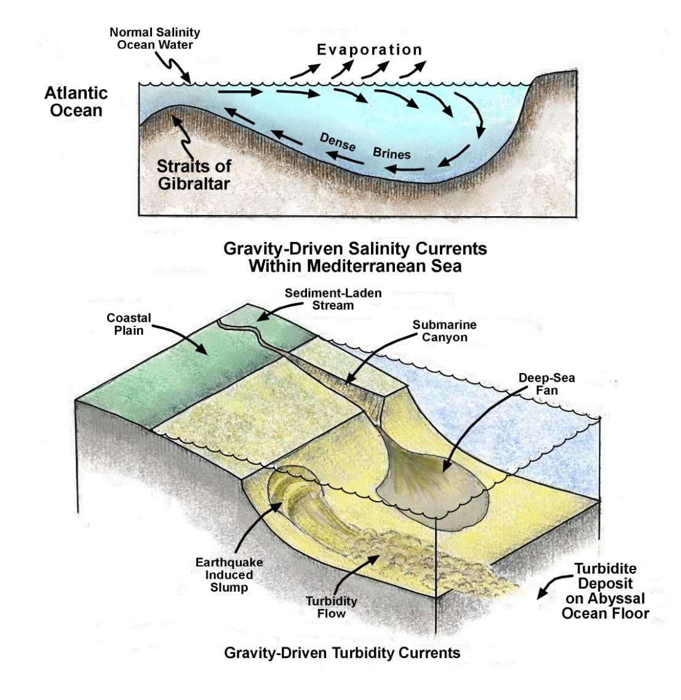
Gravity Driven Density Currents
One of several types of currents that exist within the ocean are density currents created by differences in salinity. An excellent example is the density current in the Mediterranean Sea. Normal salinity ocean waters from the Atlantic Ocean enters the Mediterranean through the Strait of Gibraltar. Once within the Mediterranean, the surface waters, subjected to the extremely dry air masses coming from the Sahara, evaporate rapidly. This process dramatically increases the water’s salinity and density, causing it to sink to the bottom of the Mediterranean basin. These highly saline waters slowly move out of the Mediterranean back into the Atlantic through deeper parts of the Straits of Gibraltar. This cyclic pattern takes about 100 years to complete.
Another type of gravity and density flow is the turbidity current. Very fine-grained sediments are carried beyond the outer edge of the continental shelf. Here they accumulate into muddy masses with little particle cohesion. Low-intensity earthquakes reduces both the cohesion and friction within the sediments to the point where they break contact with the continental slope and begin to move down slope. At this point gravity becomes the driving force. Muddy turbidity currents can attain speeds of hundreds of miles per hour and the material can flow great distances. Some reach as far as the deep ocean bottom where they finally settle to form the flattest and most horizontal surface on Earth, the abyssal plain.

Slide 5
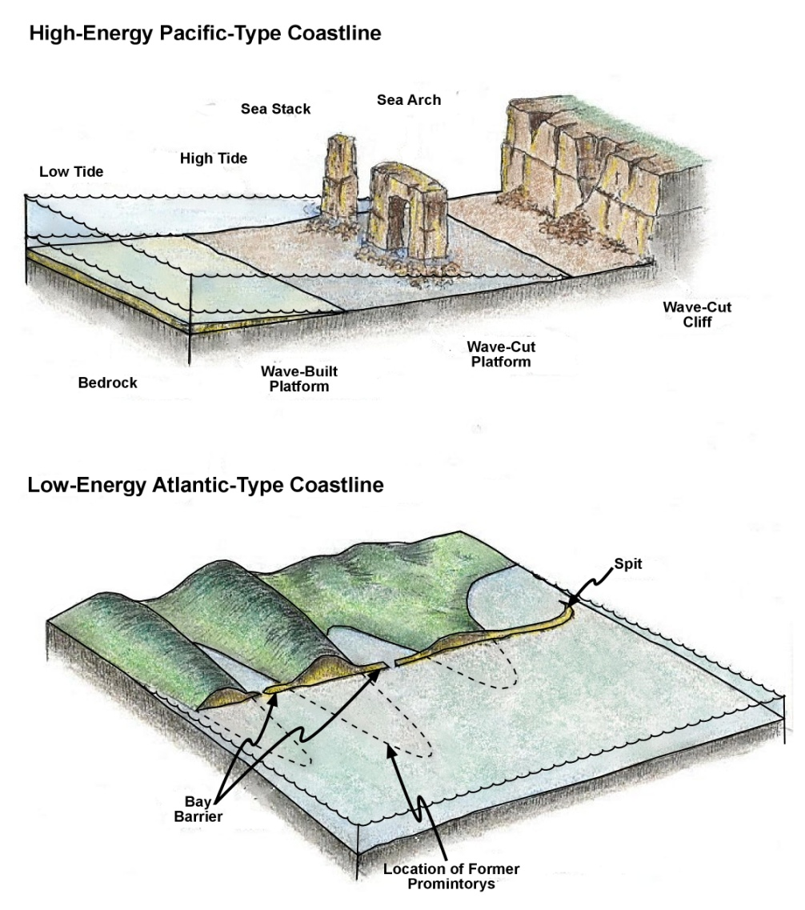
High and Low Energy Coastlines
Incoming masses of water hitting a steep coastal cliff face eventually undercut it, causing a collapse of the rocks higher on the cliff. This process continues the landward retreat of the cliff face away from the shore line. Additionally, the fallen rock debris is further broken down by wave action until it is carried out beyond low tide where it accumulates as a wave-built platform. In many places, the width of the wave-built platforms are limited as the ocean currents carry the rock debris into the offshore deep sea trenches. Wave erosion continues beyond mean high tide to the point where only storm waves can impact the cliff. Remnants of the retreating cliff called sea stacks and sea arches are temporarily by-passed. However, in time, they will succumb to the erosive action of waves.
The offshore slopes that border opening oceans are very gentle surfaces. In fact they would appear horizontal to the naked eye. These low slopes allow waves to expend their stored kenetic energy over a very long distance of approach. As a result, except for storms, such shorelines are subjected to relative low levels of wave erosion, generating relatively small-grained rock debris such as sand. Typically, promontories are cut back while the sediments that are created are carried by longshore currents to form structures such as bay barriers and spits.

Slide 6
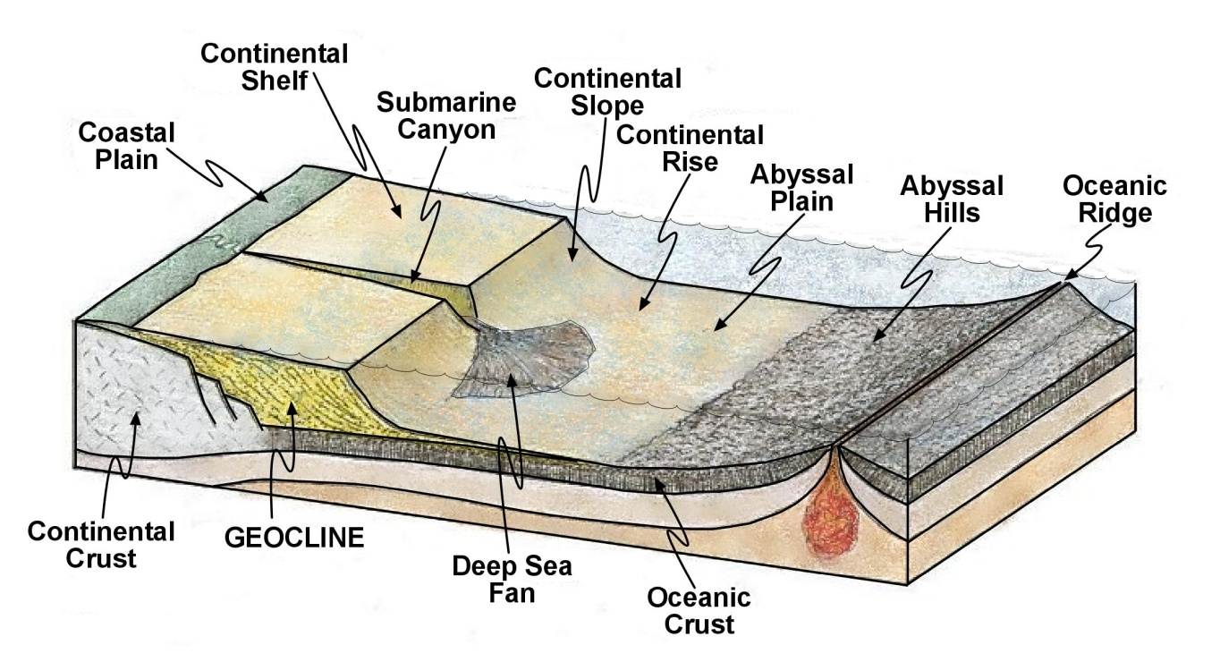
Opening Ocean Features
This diagram illustrates the various physical features associated with a tectonically opening ocean basin. The upper surface of the clastic wedge (geocline) is called continental shelf and is really an extension of the coastal plain. In opening oceans, basaltic oceanic crust underlying the abyssal plain is covered from the fine-grained sediments carried from the continental slopes out onto the deep ocean bottom by turbidity flows. Deep sea fans, similar in structure to deltas, represent land derived sediments that are carried beyond the edge of the continental shelf by flows along submarine canyons carved into the continental shelves when they were exposed as land during the Ice Ages. From the edge of the abyssal plain to the summit of the oceanic ridge, the oceanic crust is exposed. Because the molten rock cools underwater, the oceanic crust is made of pillow lavas. The irregular surface of the pillow lava gave rise to this portion of the ocean bottom being referred to as abyssal hills.

Slide 7
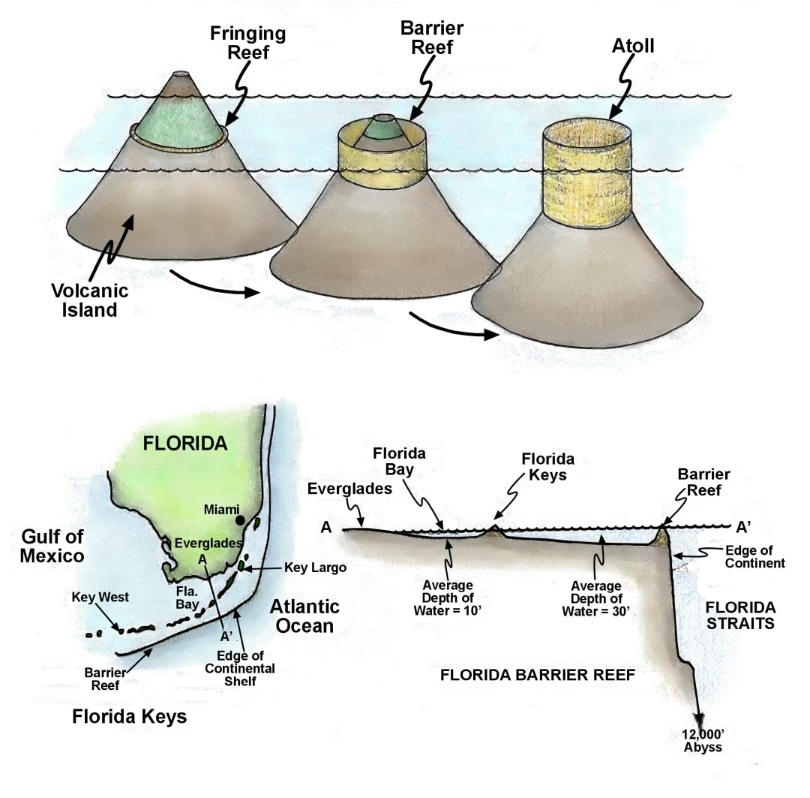
Reefs
Charles Darwin first recognized that coral grows and survives best in warm, clear, relatively shallow (less than 150 feet) marine water. Coral begins to grow in the near-shore margin of volcanic islands then, over time, as the sealevel rises—or the ocean bottom sinks—the coral grows vertically to maintain its position. It must remain within the sunlit zone of water to support the photosynthesis that allows algae to grow within the bodies of the coral polyp. The coral animal and the algal plant have a symbiotic relationship whereby the algae provides the oxygen that the coral needs while getting rid of the carbon dioxide that it emits. As the coral mass grows vertically, it eventually becomes a submerged barrier reef slowing down incoming storm waves. The water trapped between the barrier reef and the island becomes a relatively calm lagoon. If changes in water level, or island subsidence, elevate the top of the barrier reef above sea level an atoll is formed.
Coral use the mineral calcite as a shell building material. The chemical process they use to make calcite occurs best in warm sea water. Calcite is the major mineral component of the rock limestone. The Florida Keys is a perfect laboratory for the study of calcite and limestone formation. Because Florida Bay averages only about 10 feet deep the water is significantly warmer that the water of the open Gulf of Mexico. Stimulated by the prevailing high temperatures, evaporation elevates the Bay’s water salinity to the point that only a very few animals can survive in Florida Bay. This scenario is perfect for the chemical precipitation of calcite. It accumulates as a fine-grained carbonate mud covering bottom of the Bay. If converted into a rock, the mud would be a limestone. There would be no fossils in the limestone because this was a completely chemical process.
In contrast, in the nearby open Gulf of Mexico, conditions are what one would expect for a body of water located near the topics. Animals use calcite drawn from the water to build shells. Shelled animals abound within the warm and normal salinity sea water. Here, the remains and fragments of shells accumulate on the bottom. If converted into a rock, these sediments will form a highly fossiliferous limestone produced by a biological-chemical process.

Slide 8
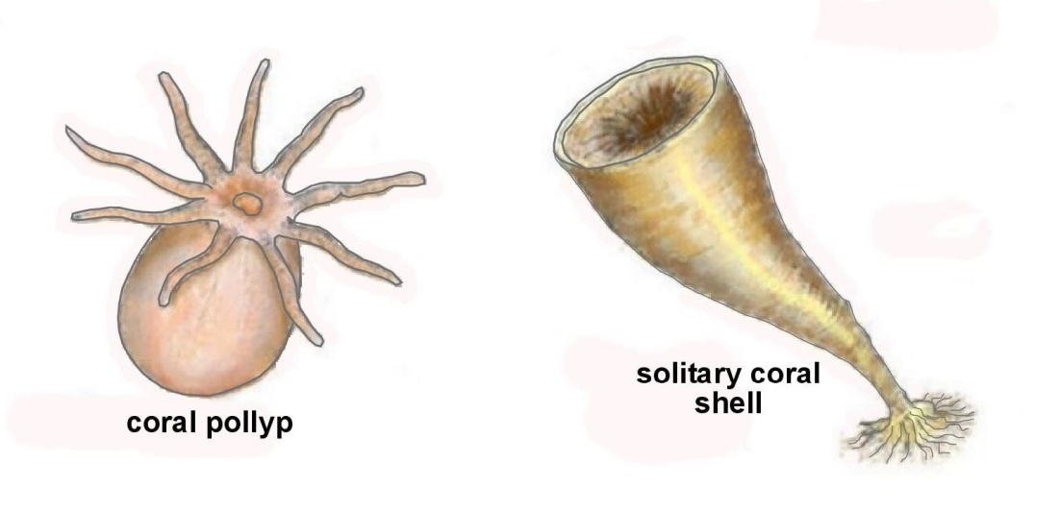
Coral
The coral animal consists of a barrel-shaped body with an entrance to the interior that is surrounded by tentacles equipped with stinging cells to paralyze prey. Early in its life cycle the coral polyp is free-swimming. However, it soon attaches itself to the bottom and secretes a shell of calcium carbonate.
Geologically, the earliest corals were solitary corals that grew a single shell. Soon, perhaps acknowledging the fact of safety in numbers, individual corals began to join to produce colonial corals. The shapes and sizes of the colonies led to common names such as brain coral, fan coral and the stag-horn coral that form the basic framework of many reefs. It is important to realize that the main constituent of a coral reef is algae. Algae and coral have a symbiotic relationship in which the algae actually lives within the body of the coral polyp. The symbiotic relationship involves the algae consuming the carbon dioxide which the coral polyp produces as a respiratory byproduct and, through photosynthesis, produces the oxygen that the coal polyp needs to survive.

Slide 9
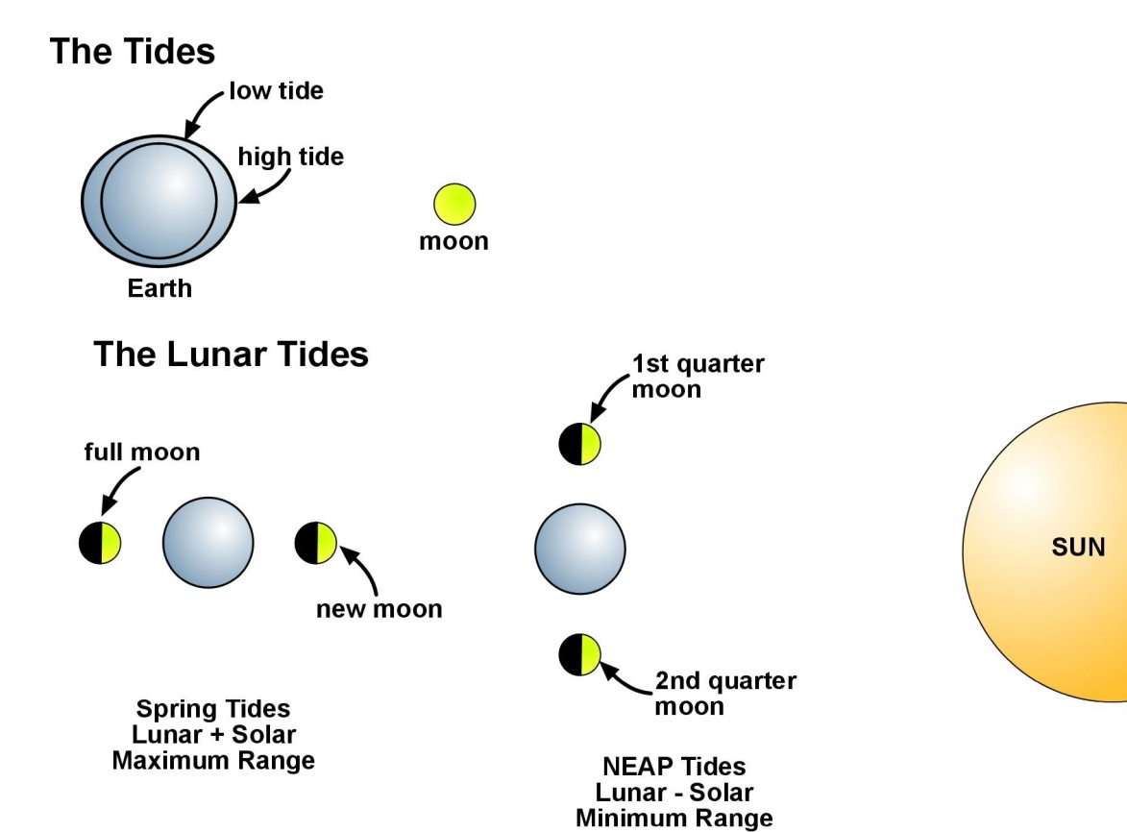
Tides
The gravitational attraction between the Moon and Earth distorts the ocean into two opposing bulges, one directed toward the Moon and the other directed away. Earth’s rotation within and through these bulges produces daily changes in water levels along shorelines. These are tides. While we always consider the effect of the Moon on the tides, the Sun also affects the tides. Even though it is much less massive, lunar tides dominate over solar tides simply because of the gravitation effect of distance. When the Sun, the Moon, and Earth are lined up at the new and full moon phases, the effects of the lunar and solar tides are additive, resulting in the highest high tides and the lowest low tides and the highest tidal range. Extreme, or spring, tides occur twice each month and have absolutely nothing to do with the season. At the first and third quarter phase of the Moon, the high tides are at their lowest and the low tides are their highest resulting in the minimal tidal range. These tides are referred to as the neap tides.

Slide 10
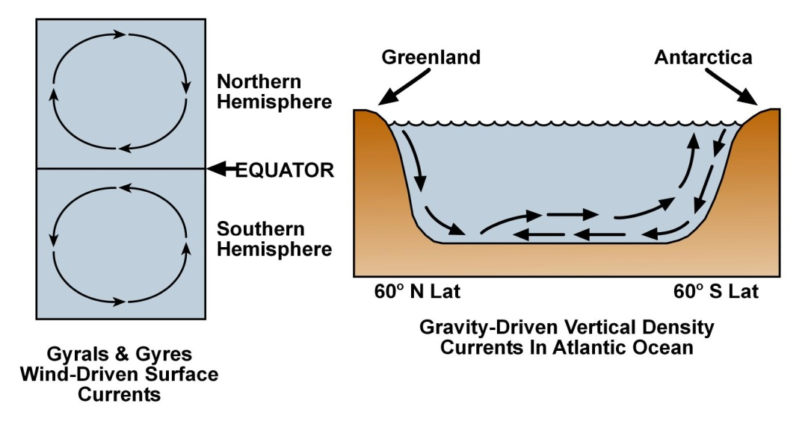
Ocean Currents
Driven by the prevailing winds, circular, surface currents called gyres are created in each hemisphere of the Atlantic and Pacific oceans. Because nearly all of the Indian Ocean is in the southern hemisphere, it has only one gyre. As the easterly winds blow along the equator, they transfer some their energy to the surface waters which begin to move westward. Eventually, these currents encounter North and South America. At this point the wind is diverted north and south along the continental margins. When they reach about 45^{O} north or south latitude they encounter westerly winds that divert them back across the ocean until they encounter the continents on the eastern margin of the oceans. At this point they are diverted toward the equator where they complete the gyre. Gyres are global heat pumps that transfer heat from the ever-hot tropical equator to the colder, higher latitudes. The North Atlantic gyre provides the climate of Europe. Without its warm, moist air masses most of Europe would much cooler.
Vertical, gravity-driven currents also exist within the Atlantic Ocean. Cold, almost freezing waters coming down between Greenland and Scandinavia enter the warmer waters of the North Atlantic. The higher density cold Arctic waters sink. Gravity begins to move the colder water southward along the ocean floor. At the same time, Antarctic waters derived, in part, by the melting of the Antarctic ice cap, descend to the ocean bottom and continue northward. Somewhere just north of the equator, the two currents meet. Because of its lower density, the Arctic waters rise above the Antarctic water and continues southward to the surface at about 65-70 degrees south latitude. Oxygen-rich and loaded with nutrients collected during its journey, these Arctic waters are said to be responsible for the band of high organic productivity of the southern oceans.

Slide 11
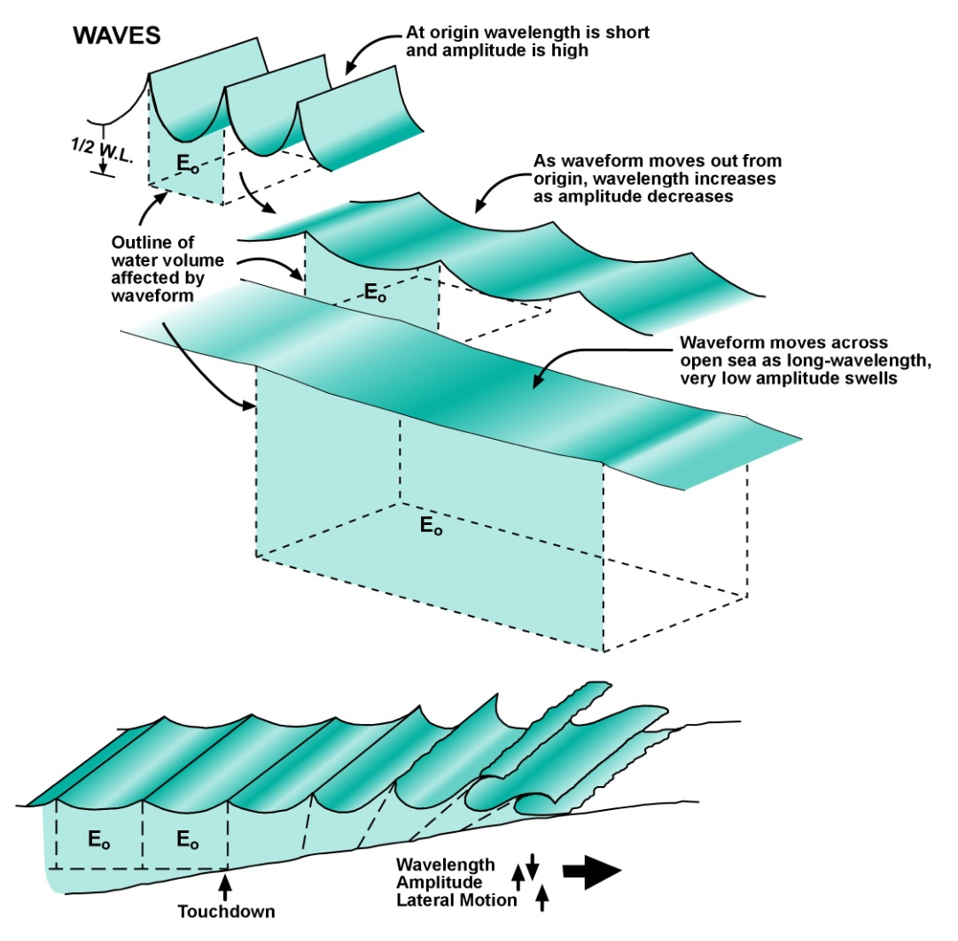
Waves
Waves are created by wind blowing across the surface of a body of water. The longer the body of water (fetch), the more energy the wind can impart to wave creation. Initially, wave amplitude is high and its wavelength short. However, as the wave moves out from its point of origin its amplitude decreases and its wavelength increases. This inverse relationship between wavelength and amplitude is very important in understanding how waves accomplish their task of erosion. Experiments have shown that the depth to which a wave moves water has nothing to do with amplitude, as is commonly believed. A passing wave affects the movement of water to a depth of approximately one-half its wavelength. As waveforms move across the surface of a body of water, whatever energy was imparted to the water by the wind remains within the mass of water. In other words, a waveform can move hundreds of miles from its point of origin without the loss of energy. Another important point is that as waves move across deep water there is no lateral movement of the water, only vertical movement.
Shorelines complicate the issue. As waves approach shore their wavelength causes them to touch bottom. From this point on, wavelength shortens, amplitude increases, water begins to move laterally, and the bottom is subjected to erosion. When the total amount of energy consumed by these activities is subtracted from the original amount of energy provided at the point of formation, the remaining amount of energy is the amount available for erosion by the surf.

Slide 12
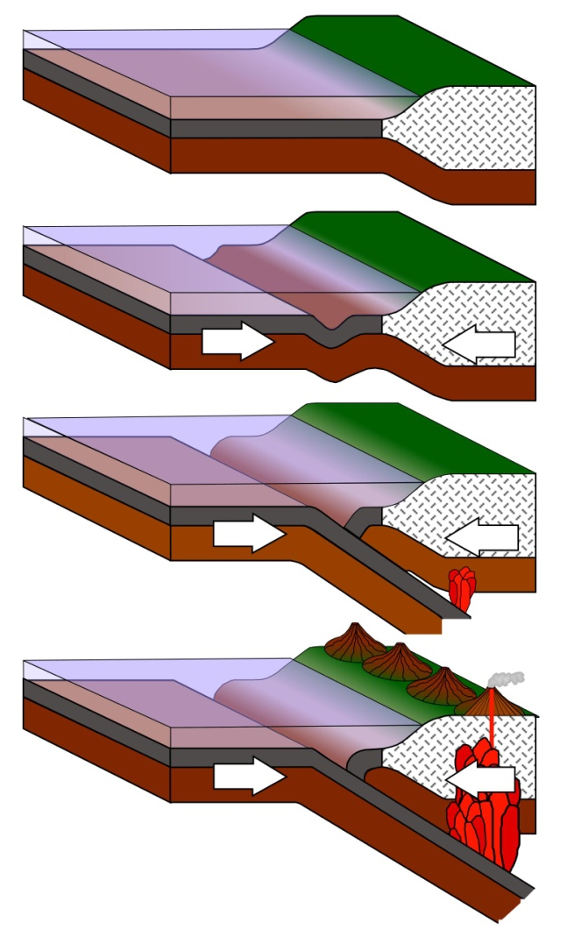
Deep Sea Trenches and Zones of Subduction
Subjected to compressive forces generated by plate tectonics, the old oceanic lithosphere begins to down-warp forming a deep sea trench that continues downward. Continued application of compression increases but remains parallel to the adjacent continental margin. Eventually, the oceanic lithosphere is driven downward under the continental lithosphere, forming a zone of subduction. As the old oceanic lithosphere descends into the mantle, it begins to be consumed. This must occur to compensate for the new oceanic lithosphere being created at the oceanic ridges. At the same time, magmas begin to form deep within the zone of subduction. Most of these granitic magmas, because of their high viscosity, rarely reach the surface. Another type of lower viscosity magma, the andesitic magmas, may rise to the surface to form a chain of andesitic strato- or composite volcanoes. Where the zone of subduction is within a few tens of miles of the coastline, the volcanic mountain chain forms on land and is referred to as continental arc volcanoes. Good examples of these are the Andes Mountains and the Cascade Mountains. On the other hand, if the zone of subduction is a hundred or so miles seaward of the coastline, volcanoes rising from the ocean bottom will form a chain of volcanic islands referred to as island arc volcanoes. Common examples of island arc volcanoes are the Aleutian Islands and the Japanese Islands. Both island arc and continental arc volcanoes comprise the “Ring of Fire” surrounding the Pacific Ocean.

