Slide 1
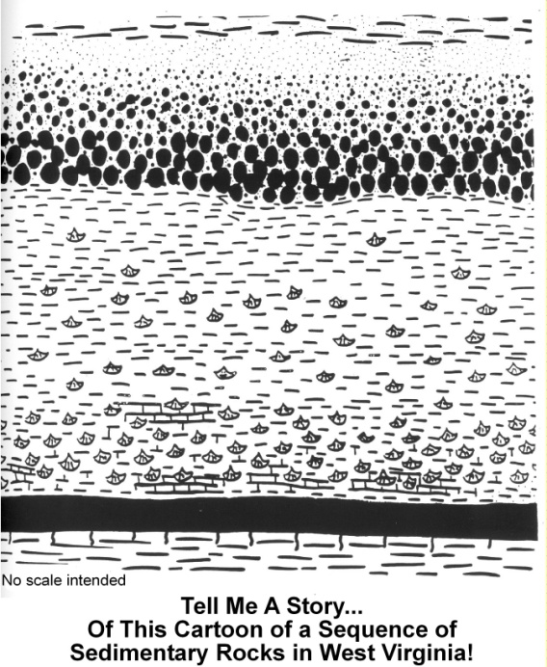

One way to begin this activity is with the following narration: “This is a cartoon of an outcrop of 300-million year old rocks found in West Virginia. The little “smiley faces” are fossils (brachiopods in this case), the dots are sand grains of various sizes, the brick pattern is limestone, a partial brick pattern indicates the rock is only partly limestone, the thick horizontal solid black line is coal, and the little vertical squiggles sticking out below the coal are plant roots. (Does this help you figure out which way is up?) Dashed lines of different sizes represent lack of artistic talent—they should all be the same length? Don’t forget to note the differences in the way the various rocks touch each other (contacts). Some are well defined, others are less well defined, while some are actually not even perfectly horizontal. The number of fossils is not the same everywhere. The size of the sand particles shows a fairly consistent change vertically. Not all of the rock layers are continuous. To a geologist, these little clues provide insight into what happened long ago.
After this brief introduction ask students to develop explanations for how the rock sequence might have developed. It is important to continually remind the students that they need to think of the rocks as sediments. This can be done by asking “How would the sediment that formed the sandstone get there?
Students will develop many different ways to explain how the sequence formed. There are no completely right or wrong answers. This exercise is a matter of interpretation and defending that interpretation based on available evidence. In the end, you will discover that some answers are more plausible than others. Just like scientists, the students will eliminate improbable or far-fetched ideas because they can not withstand the rigor of scrutiny.
After developing a suitable explanation prompt the students to see if they really understand the story. Questions such as “Which way is up?”; “Which rock layer is the oldest?”; “What was happening at this one spot 300 million years ago?”; and “Is there evidence of change over time?” can be used to probe their understanding of sedimentary rock formation.
This page is covered with common symbols used to designate rock types. The dashed lines represent shale (a sedimentary rock formed from deposits of mud and clay). The brick pattern represents limestone (a sedimentary rock formed from deposits of marine animal shells or chemical precipitation directly from the sea water). The dots represent sand grains. The various dot sizes indicate a variation between small and large sand grains. The thick black line represents a coal seam (coal normally forms from decaying plants growing in swampy, wet areas). The “smiley-face” symbols indicate the presence of sea shells. Finally, the black lines hanging down from the coal seam are tree and plant roots.
Tell Me A Story…
By Tom Repine
West Virginia Geological and Economic Survey
Click on image for a larger view for printing.
Objectives
Overview
Materials and
Equipment
Time
Procedures
Assessment
Further
Challenges
Teaching Suggestions
Safety Note
“Tell Me A Story” sheet for each student.
None listed
None listed
Recognize that a sequence of sedimentary rocks suggests different ancient environments of sediment deposition.
Develop techniques and ideas which plausibly and realistically explain a sequence of sedimentary rocks. (In essence, there is no wrong answer if its plausible.)
Variable depending on the depth of
discussion. Normally 15-20 minutes.
None suggested as this is intended to be used as an exploratory exercise.
None listed
This is a good way to introduce basic geologic concepts of superposition (the oldest layer of rock is on the bottom), stratigraphy, rock types, depositional environments, fossil assemblages, contacts between rock layers, etc. An incredible number of questions, ideas, interpretations, models, etc can be generated from this simple line drawing. The most important requirements for this activity are a vivid imagination, the fortitude to defend your ideas, and the willingness to accept a more plausible explanation than yours when the time is right.

Slide 2
This page is covered with common symbols used to designate rock types. The dashed lines represent shale (a sedimentary rock formed from deposits of mud and clay). The brick pattern represents limestone (a sedimentary rock formed from deposits of marine animal shells or chemical precipitation directly from the sea water). The dots represent sand grains. The various dot sizes indicate a variation between small and large sand grains. The thick black line represents a coal seam (coal normally forms from decaying plants growing in swampy, wet areas). The “smiley-face” symbols indicate the presence of sea shells. Finally, the black lines hanging down from the coal seam are tree and plant roots.
close

