Slide 1
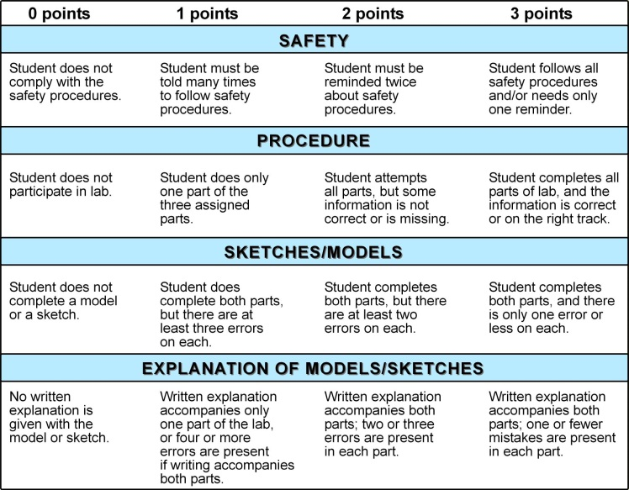

Drawing from the Past and
Building on that Knowledge
Place students in groups of three. Give each group a different sedimentary rock sample, set of markers, safety glasses, acid bottle containing 10% HCl, one dropper, nail, magnifying lens, and a large sheet of freezer paper. (Rock samples should be readily identifiable.) Tell the students that they are to use the resources at their table and in the room to identify the sample and write the name of that rock at the top of the freezer paper. Ask them the following questions:
Does your sample react with acid? (Only limestone will react with acid.)
What if you made a small amount of powder from your sample, will it then react?
Scratch off some of your rock and feel the sediments. Does it feel gritty: Does it resemble sand grains? Is it difficult to get any particles from your sample? Examine the particle size more closely with the hand lens.
Once the students have correctly determined the name of the rock sample, ask them to write one sentence about the material that they believe could have formed this rock. (Examples: sand formed this sandstone. Decayed plants formed this coal.) It is not important that their first idea about what could have formed this rock sample be correct, only that they put some thought or imagination into it.
Using one rock as an example, the teacher should identify the rock correctly, name the material that formed the rock, and then ask the students where such material could naturally occur today.
Example: “This rock is thinly bedded. It breaks easily. It does not react with the acid. When I scratch particles from the rock, the particles are very small and gritty. If I add some water to the particles, I form a kind of mud. This is a shale. Shale was formed from ancient muds. Where could we find areas of mud today?” Students often name places like mud slides, areas around swamps, the ground after a rain or flood. These are great examples.
Ask the students to now brainstorm about their own samples. They should be able to come up with a few places for each sample. The students are to then label and sketch these environments on their large sheets of freezer paper. A brief explanation should accompany each sketch to insure that the students and the teacher both understand the meaning of the sketch.
The students should now be ready to tackle more difficult concepts. Join the small groups of three into groups of six. Pose the following problem to the groups: “Place your two rock samples at opposite ends of the freezer paper. You know the possible depositional environments of your own sample. The group that joined you knows the possibilities of their sample. Your groups must now sketch a plausible landscape that would explain how your two samples were found near one another. A one paragraph explanation must accompany each sketch to explain how the group decided on the landscape and why it is reasonable.”
Examples: A sandstone is placed near a limestone. The sandstone represents the beach environment, while the limestone represents a shallow ocean environment. The groups would simply sketch the beach beside the ocean.
A coal is placed near a shale. The coal represents a plant dominated swamp or bog. The shale represents a place where water has receded. The sketch would consist of a swamp surrounded by a muddy area where both coal and shales could have formed.
At this point a little more practice may be needed, but most students will be nearing the point where they can connect the depositional environments on their own. One helpful tip is to keep the depositional environment sketches posted at the front of the room until it is time for a more formal evaluation.
Scoring Rubric
By Chris Cumashot, Pocahontas County
Angela McKeen, Wetzel County
Click on image for a larger view for printing.
Objective
Overview
Materials and
Equipment
Time
Procedure
3D
Application
Evaluation
Teaching Suggestions
Safety Note
By using sketches and constructing models of depositional environments, the students will bridge the gap between concrete knowledge and the more abstract concepts of historical geology.
None listed
Many times, students and teachers alike do not take the evaluation of drawings and models as seriously as they do a pencil-paper test. In this unit it is imperative that the grading of the sketches and models be given as much weight as a written test. The beginning sketches are like quizzes, but the final constructions and sketches are the means by which the teacher can examine the student’s understanding of depositional environments in historical geology.
The most objective way to grade sketches and models is with a rubric. A sample rubric has been provided.
None listed
None listed
None listed
Allow students to work with partners. Give the team a rock sample that neither had in their groups. The students are to identify the sample correctly and construct the depositional environment for the sample in the clear plastic containers. The students must try to use sediments of the appropriate grain size. For example, if the student has a fine-grained sandstone, the team should not use large-grained sands in their construction. The object is to construct an environment that could closely represent one of the samples. If the students have limestones, they may use sands or silts as the base of their construction, layer crushed shells above this, whole shells on top of that layer, then cover the area with salt water. If the limestone contains whole fossils, then the students should “make” animals that represent the type of sea life that is found in the sample.
Classroom set of safety goggles
1 rock hammer
10% HCl
10 droppers
10 nails
10 magnifying lenses
Labeled jars of various sediments including sands, silts, clays, and assortment of seashells
Grain ID booklet
Samples of sandstone, limestone, shale, and coal, or any other rock indicative of your area
Large pieces of freezer paper
Classroom set of colored pencils, markers, and/or crayons
Classroom set of clear disposable storage containers
Various reference books or approved web sites to assist students in identifying rock samples and their origin
Exploration
Concept Development
Application

Slide 2
Scoring Rubric
close

