Slide 1
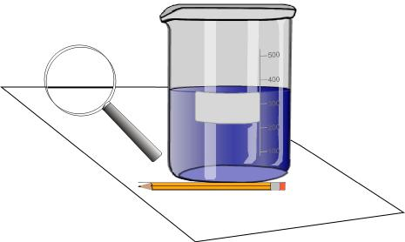
The students will calculate the volume (cubic cm) of the dry sponge by measuring the length, width and height with a ruler and multiplying the numbers together (L x W X H = V) and record the answer.
The students put 300-400 ml of water in the beaker. Record the exact water amount.
The students will immerse the sponge in the water being careful not to spill the water out of the beaker. Try to squeeze the air out of the sponge with it still immersed under water.
Very quickly and carefully remove the wet sponge from the water and put it in a second container.
Record the water level in the first beaker.
Calculate the change in the volume of water in the first beaker. Record the answer.
Calculate the porosity of the sponge by dividing the change in the water volume by the volume of the sponge and multiplying the answer by 100 to get the percent porosity.
The students will record the porosity of their sponges on the board.
Open discussion about what they did in the procedure and what their calculation means. They should be able to come up with the concept of the spaces (pores) holding the water. This is called porosity.
Hand out a sample of sandstone to each student. Have them examine the sandstone with a hand lens and discuss the rock’s properties.
Put a drop of crude or motor oil on the rock and have the students record their observations.
Students will write an explanation of what is happening to the oil on the rock.
Calculating Porosity of
A Sponge
By Regina Smith
Morgantown Day School
Objective
Overview
Materials and
Equipment
Time
Procedures
Assessment
Further
Challenges
Teaching Suggestions
Safety Note
Students will calculate the percent porosity (spaces) of the sponge.
Students will verbally define porosity.
Students apply the concept of porosity in a written explanation of oil in rocks.
45-60 minutes
1 rectangular sponge (approximately 12 cm x 7 cm x 2 cm)
1 graduated beaker or cylinder in ml (a measuring cup may be substituted but is less accurate)
1 metric ruler
Pencil, paper, calculator
Sandstone, crude or used motor oil
Water
Hand lens
Second container to hold sponge.
Teacher observation on participation and cooperation. Hand in the completed lab for a grade or comments.
None listed
The teacher may want to demonstrate the procedures for a younger group of students so that they fully understand what they need to do.
Porosity is the portion of the volume of a material that consists of open spaces. Open spaces can fill with a liquid such as oil or water. Oil reservoirs form when oil becomes concentrated in sandstone, limestone, or dolomite. Sandstone has a porosity of 5-20% depending on the degree and type of lithification. Only about 25-50% of the oil can be extracted from the rock. The rest of the oil remains in the pores. Horizontal drilling and fracking are new methods developed to extract more oil and gas
Using a beaker of dry sand, a beaker of water and a graduated beaker. Have the students figure out the porosity of the sand in the beaker.
Using coins of various sizes or the same size, have the students arrange the coins in different configurations to model the spaces in the rocks. Then, mathematically calculate pore space on a 2-dimensional level. Which model has the most pore space? What has the least?
Give the students the following problem using the sponge soaked in oil or a rock that has been soaked in oil. How much oil can you get out of the sponge or rock? You may not handle, move, or squeeze the sponge/rock with your hands. You must use some sort of device and/or chemical additives to extract the oil from the sponge or rock. The students should submit a written plan for approval, then collect all needed materials and try out their plan. A written explanation of their success/failure, and how their plan relates to what the oil companies do may be useful for evaluation and class discussion.

