Slide 1
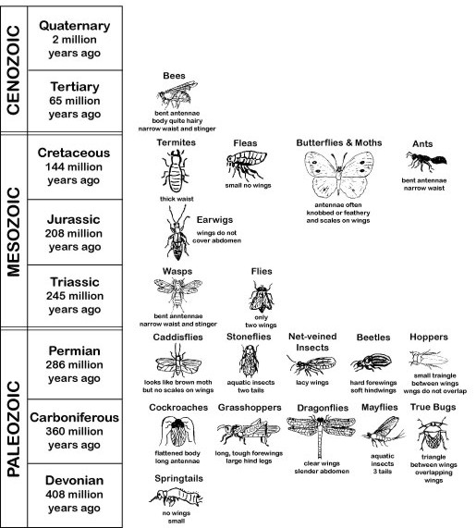
Behind Jurassic Park
Geologic History of Insects
(insects are listed beside the period during which they first developed.)
With students working in pairs, pass the cardboard or styrofoam strips with insects pinned to them but in the wrong time periods. As an alternative, students can use their own insect collections and receive empty strips.
Line each strip up with the marked sections matching the geologic time periods on the Geologic History of Insects sheet. Use the sketches on the sheet to help determine where to put each insect. Insect field guides can be used to check questionable specimens.
By Paula Waggy
Franklin High School
Click on image for a larger view for printing.
Inse
Objective
Overview
Materials and
Equipment
Time
Procedures
Assessment
Further
Challenges
Teaching Suggestions
Safety Note
Match modern insects to the time period in which they evolved as an attention-getting introduction to geologic time.
50 minutes
None listed
Pick a geologic time period and research it to find out what type of plants lived then, what large and small land creatures inhabited the earth, and if any other flying creatures besides insects had appeared. Draw the environment on a poster or mural including as much detail and as many species as possible. This activity can take as long as five 50-minute class periods. Working in pairs on a poster board is an effective way of accomplishing this. By the end of the activity after students have shared their research and art work, they have a good working knowledge of the geologic time periods.
8-10 pinned insect specimens
Cardboard or styrofoam strips divided into sections which match the time periods on the Geologic History of Insects sheet
Geologic History of Insects sheet.
Ask students to keep the strips lined up beside the Geologic History of Insects charts. Check for accuracy after they have rearranged the insects into the correct time periods during which they evolved. For most insects, a typical member of an insect order has been represented on the chart. Consider that all the other insects in that order evolved during the same time period. For instance, a yellow jacket would be placed beside the Triassic period where bees, wasps, and ants are listed. The exception is order Orthoptera. Most evolved during the Triassic period (i.e. crickets, mantids, katydids, etc.). However, the cockroach was 115 million years ahead of the rest of the order and evolved during the Carboniferous period.
None listed
The possibility of recreating dinosaurs from DNA in insect saliva stirs the imagination. This improbable scenario can be used to start students considering what other organisms shared the Jurassic scene with ancient behemoths. They may be startled to realize that most of the insects alive during the T-rex’s reign would be familiar to them, as all but six common modern orders of insects had already evolved.
None listed

Slide 2
Geologic History of Insects
(Insects are listed beside the period during which they first developed.)
close

